Slide 2
Vision
We all see the world differently.
Fund Race presentation
Notes:
Today I’d like us to think about our eyesight and try to understand what it might mean to be blind or partially sighted.
[Reassure the children that although this can be a difficult subject to talk about, it is important as it can affect anyone. Remember to be sensitive if there are any staff members or students who have sight loss.]
We all see the world differently.

Slide 3
You might not be able to see colours.
You might need glasses to adjust your vision.
You might not be able to see anything at all.
You might have an eye condition that caused you to lose some of your sight.
Fund Race presentation
Notes:
You might not be able to see colours, or you might need glasses to adjust your vision.
You could have an eye condition that causes you to lose some of your sight, or you might not be able to see anything at all.
It’s important that we all have regular eye tests, to make sure our eyes are healthy.

Slide 4
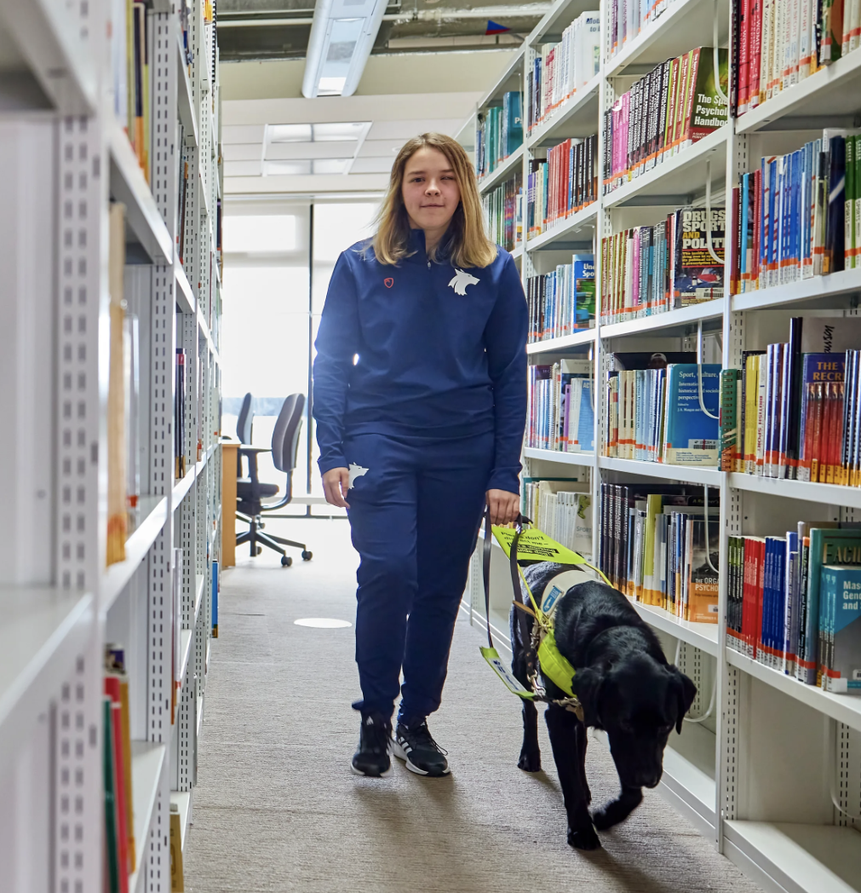
Partially sighted
Blind
Fund Race presentation
Notes:
Does anyone know what we mean by the terms partially sighted and blind?
A person who is partially sighted has reduced vision but are able to see.
A person who is blind is unable to see.

Slide 5
What challenges do you think living with an eye condition such as blindness could bring?
Fund Race presentation

Slide 6
Activity
Close your eyes and listen to the sounds coming from different places around the room.
Turn your head towards the direction of the sounds.
Fund Race presentation
Notes:
We’re going to do a short activity to show how we can use our other senses.
Please listen to these instructions carefully: You’re going to close your eyes, then you’ll hear a series of sounds from different places around the room. When you do, I want you to turn your head to face each noise but keep your eyes closed until I say to open them.
Firstly, I need you all to completely cover or shut your eyes. Ready, eyes closed? [Wait for the group to settle.]
Signal to the other teacher to make the first noise, then hide the instrument, wait for them all to turn.
Ask everyone to open their eyes and ask students
Can anyone guess what the sound was? Did you get it right?
Repeat, with a few different sounds from different places in the room.

Slide 7
How difficult was
it when you couldn’t see?
Fund Race presentation
Notes:
Was there anything you noticed about how easy or hard the activity was? How quickly did you adapt to using your hearing?
Someone with sight loss may use their other senses to complete tasks and everyday activities. For example, a smart phone user can set their phone to read aloud their messages. Many devices are designed like this to be accessible for everyone, they have settings that can be adapted for each person.

Slide 8
Inclusion
Fund Race presentation
Notes:
Does anyone know what inclusion means?
Inclusion means making sure that everyone can be themselves and that we’re all given the opportunity to take part.
How could you make an activity accessible, to make sure a friend who has a vision impairment is included? Think about how your friend might use their other senses. Perhaps prompt with a few examples…
Playing sports? Can you change a sport in some way to make it inclusive by making other senses involved more?
In the classroom? – What could people do when entering a classroom or starting a conversation so that everyone knew they were there without having to use their sight? Example – announcing their name.
Activities outside of school? What activities do you enjoy and how could we adapt them so everyone can take part, even if they have sight loss?

Slide 9
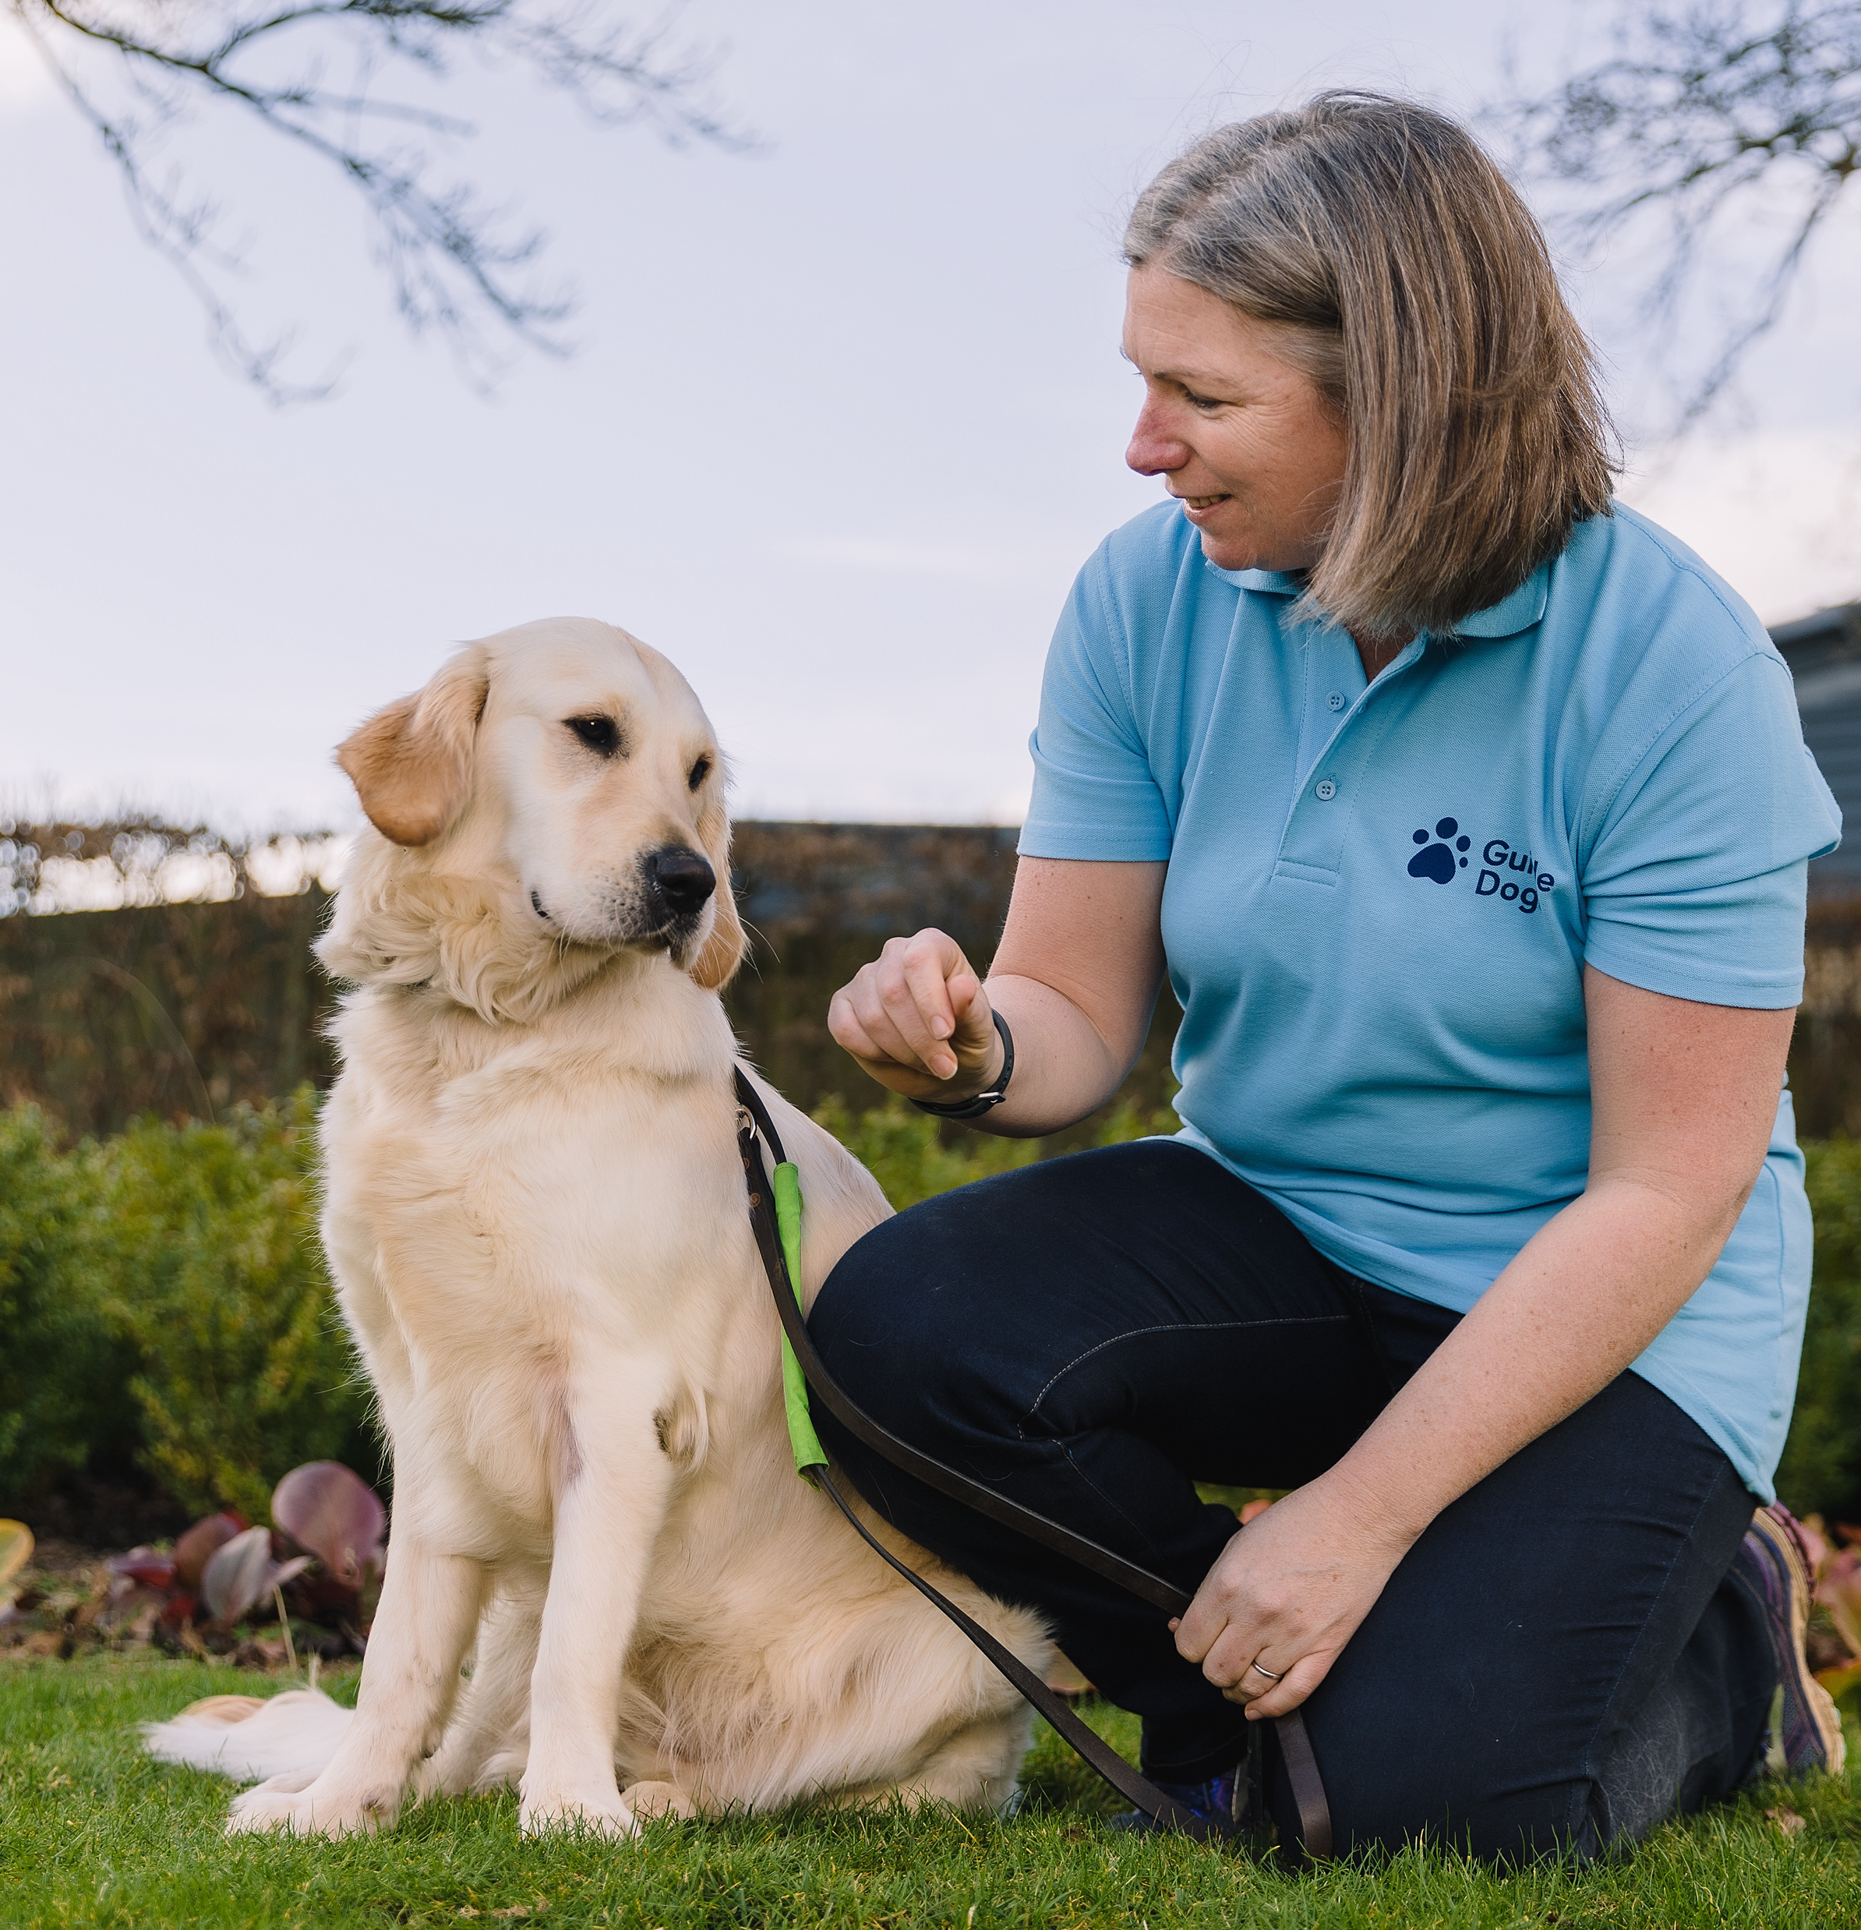
Guide Dogs
There are over 2 million people in the UK with sight loss and 28,000 of these are children.
Guide Dogs is best known for their very special dogs.
Guide Dogs also work with children to teach them a range of skills so they can do all the same things as their friends.
Fund Race presentation
Notes:
There are over 2 million people in the UK with sight loss and 28,000 of these are children.
Guide Dogs is best known for their very special dogs, who are trained to guide people safely when they go out, but they also provide lots of other services.
Guide Dogs work with children to teach them a range of skills so they can do all the same things as their friends. They teach children how to use a long cane to get around, how to cross roads/climb stairs/prepare food, how to label things around the home, and how to use money to buy things. They work with schools and give children free technology, such as iPads, which have lots of extra features that make activities much easier. Guide Dogs’ well-trained buddy dogs can help children with sight loss feel more confident.

Slide 10
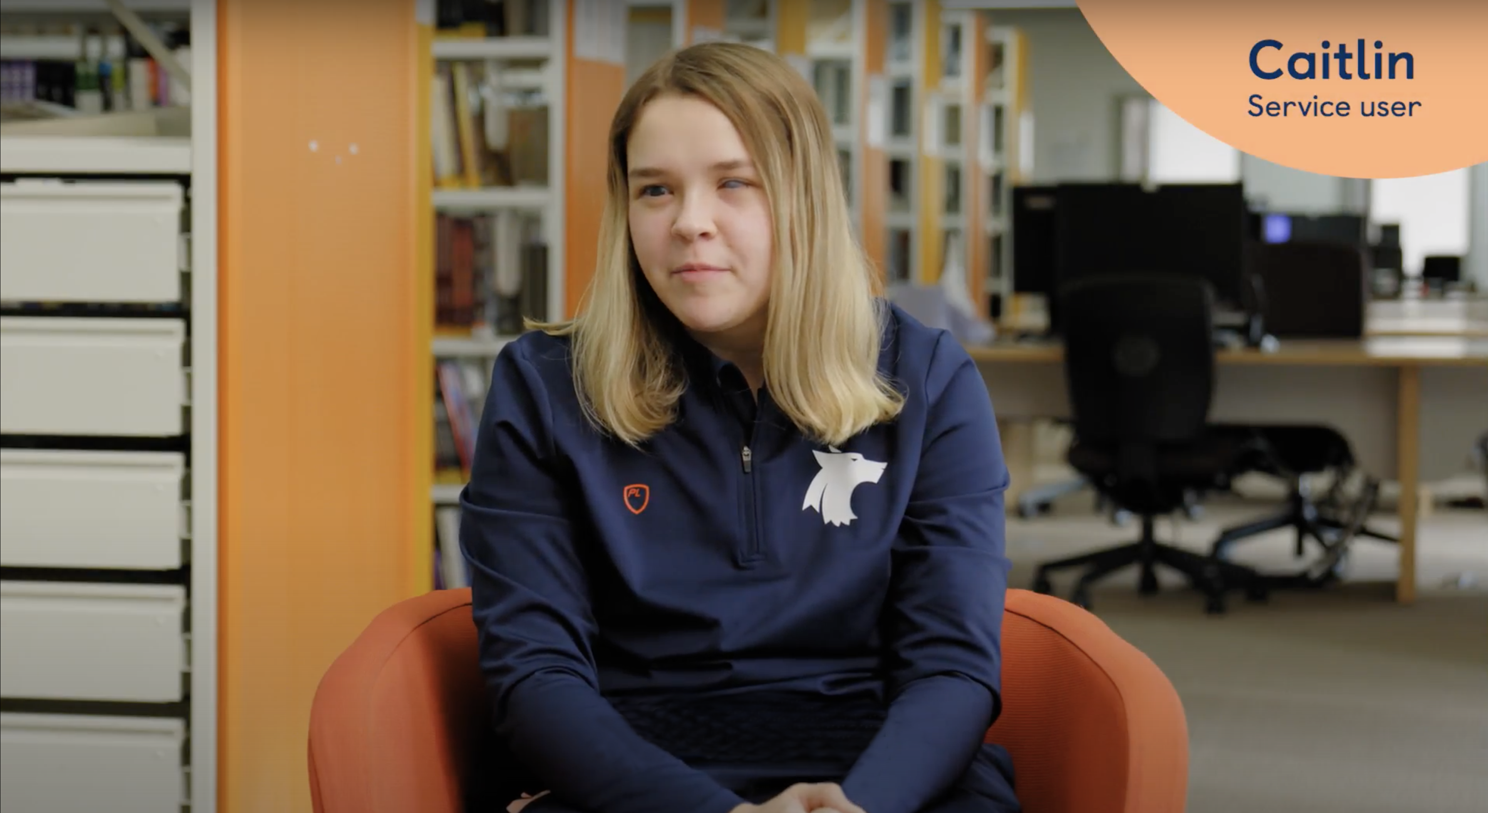
Caitlin’s video
www.guidedogs.org.uk/FundRacePack
Fund Race presentation
Notes:
We’re now going to watch a short video made by Guide Dogs about Caitlin who has a vision impairment.
The English and the Welsh version is found at www.guidedogs.org.uk/FundRacePack

Slide 11
What has been the most important or surprising thing you have learned today?
Would you like to help Guide Dogs and young people like Caitlin?
Fund Race presentation
Notes:
What has been the most important or surprising thing you have learned about vision impairment or Guide Dogs in this assembly?
Would you like to help Guide Dogs and young people like Caitlin?

Slide 12
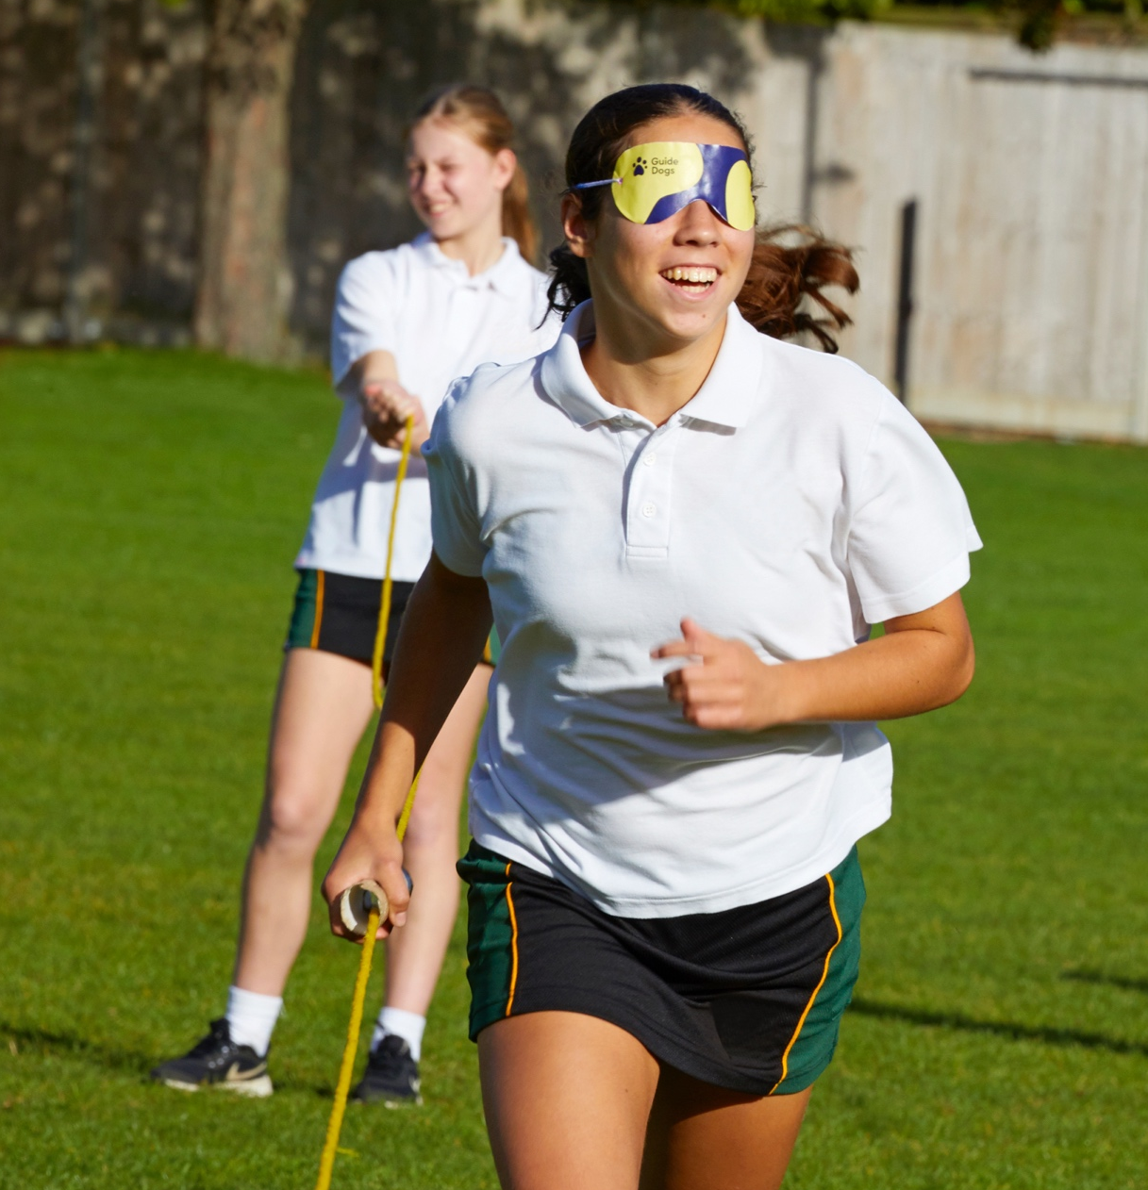
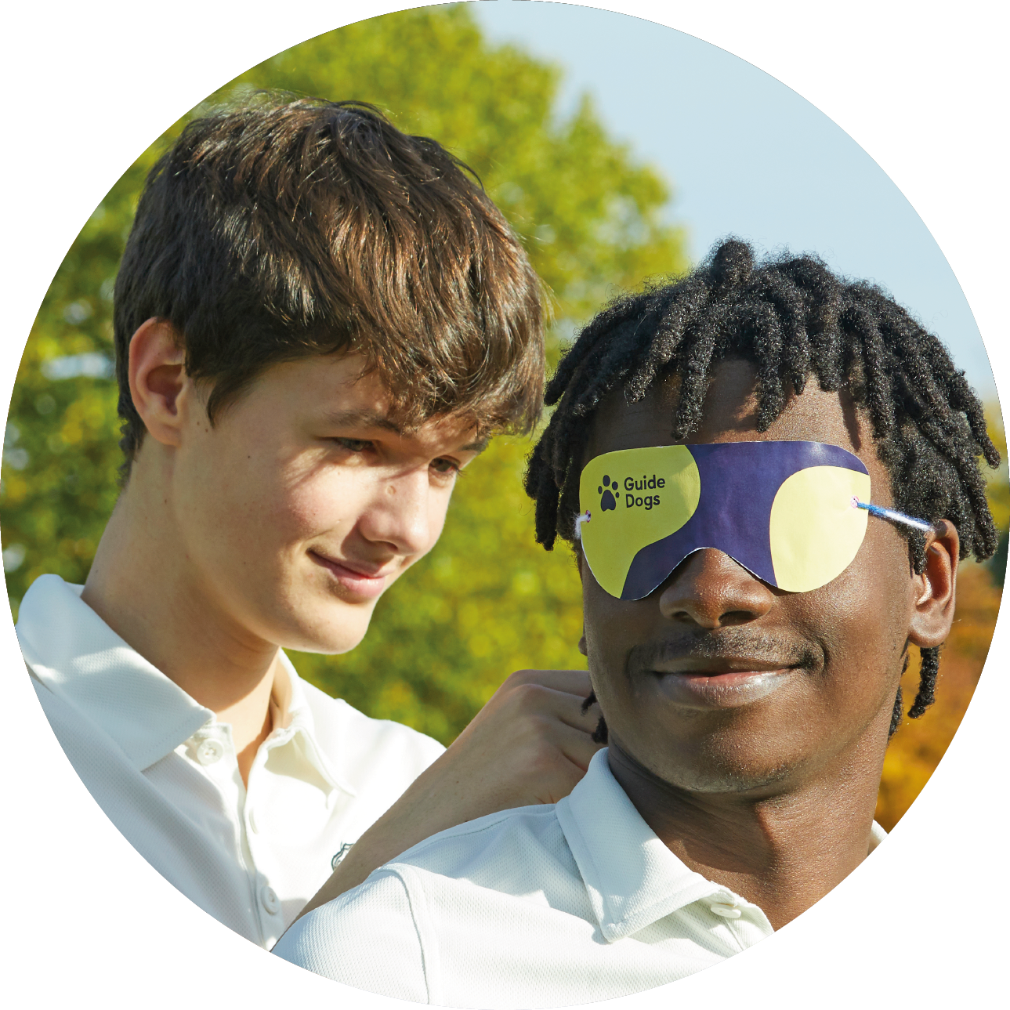
Fund Race
We’re making our sports day more inclusive and raising money for Guide Dogs.
Fund Race presentation
Notes:
Outline how your school intends to help Guide Dogs through taking part in Fund Race and explain that as part of your sports day activities, you are going to run this race as a way of making sports day accessible and inclusive. You may want to show the Fund Race introductory video that is available at guidedogs.org.uk/FundRacePack.
Take this opportunity to listen to students’ views and experiences of fundraising and how they would like to raise life-changing donations for Guide Dogs. Some pupils may want to volunteer and take a leading role or join a committee to help with the event.

Slide 13
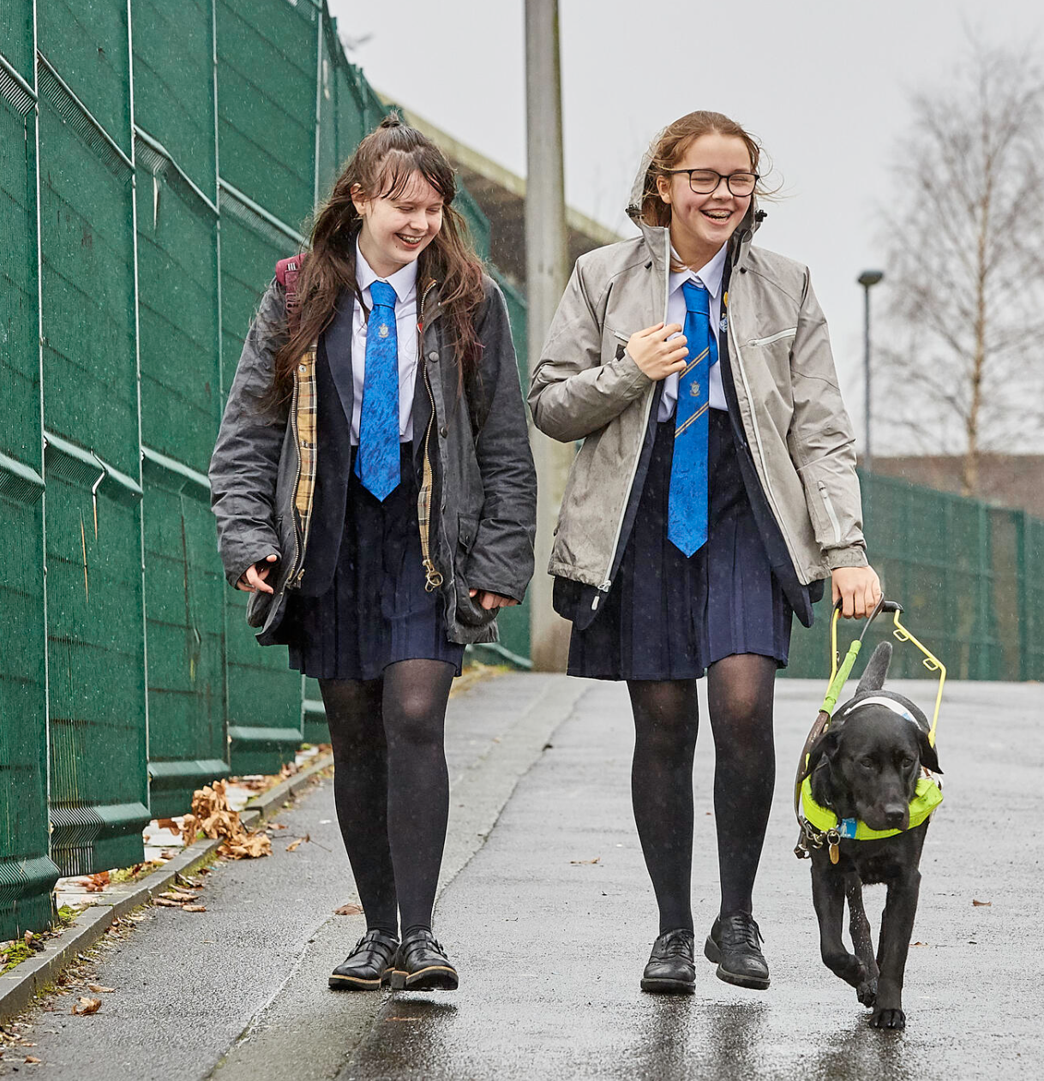
We can all be more inclusive
We can all help to make the world a more inclusive place for each other by thinking about other people’s needs, giving everyone the freedom to be themselves and taking the time to make sure everyone is able to take part.
Fund Race presentation
Notes:
We can all help to make the world a more inclusive place for each other by thinking about other people’s needs, giving everyone the freedom to be themselves and taking the time to make sure everyone is able to take part.

