Slide 1
Make Every Cuppa Count

Slide 2

What is Make Every Cuppa Count?
Make Every Cuppa Count is our annual tea-rrific fundraising campaign where we encourage people to host a tea party, coffee morning or bake sale for Guide Dogs.
Our DIY supporters are directed to sign up for their free fundraising pack, which includes a fundraising guide, cookie cutter, cake toppers, puppy sweepstake and more.
Our volunteers and groups can get their downloadable resources from VIP, or if they need any additional resources such a cookie cutter or cake toppers, then they are directed to contact their Regional Supporter Care Team.

Slide 3

When is Make Every Cuppa Count?
Date: Friday 25 April 2025.
As always, this is the date we encourage people to Make Every Cuppa Count on, but if they can’t fundraise on this date, they can choose any date they like!

Slide 4
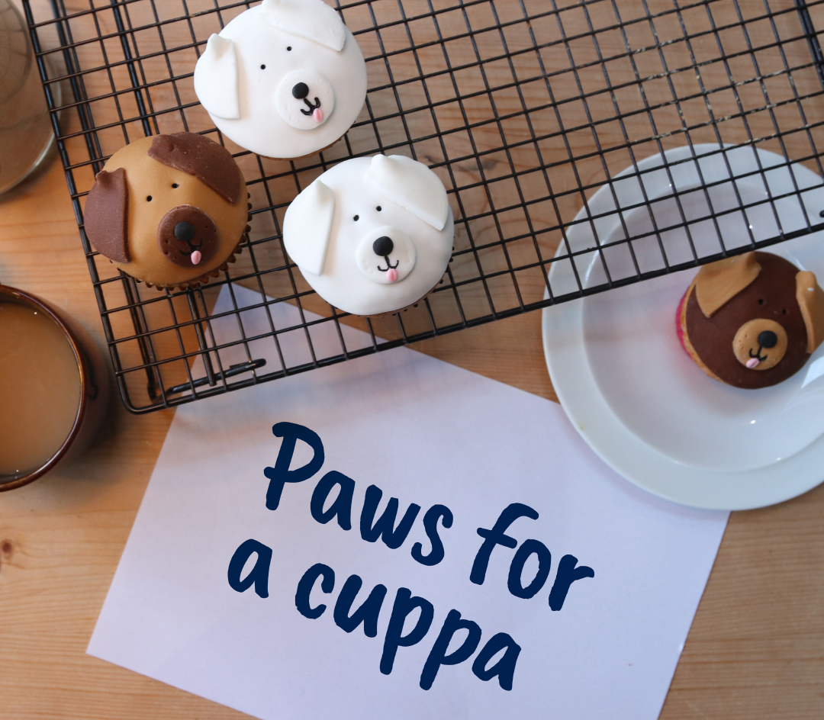
Paw-fect fundraiser!
Whether people love to bake or just eat cake, Make Every Cuppa Count is the perfect fundraising event for them.
At home.
At work.
At school.
In the community.
Local businesses.
NAP & COY supporters.

Slide 5

How can your fundraising group get involved?

Slide 6
Host
​Many of you will receive an email to Make Every Cuppa Count and take the opportunity to get together and celebrate our life-changing work over a cuppa and lots of delicious cake. Making every cuppa count is not only a great way to fundraise, but it’s a fantastic opportunity to recruit new volunteers to your group too​.
Use our editable posters to promote your fundraiser.
Decorate your venue and cakes with our bunting and cake flags​.
Add a sweepstake or raffle to boost your totals.
If you are a trading group, set up a stand to sell your goodies.
Set up a separate area or table for guests to chat with you about volunteering opportunities in your group.​
Print a list of volunteer roles you are looking for with your contact details for people to take away (your Community Fundraising Relationship Manager can help with this).
Advertise any upcoming events people can help or attend – why not include a data capture sheet!

Slide 7
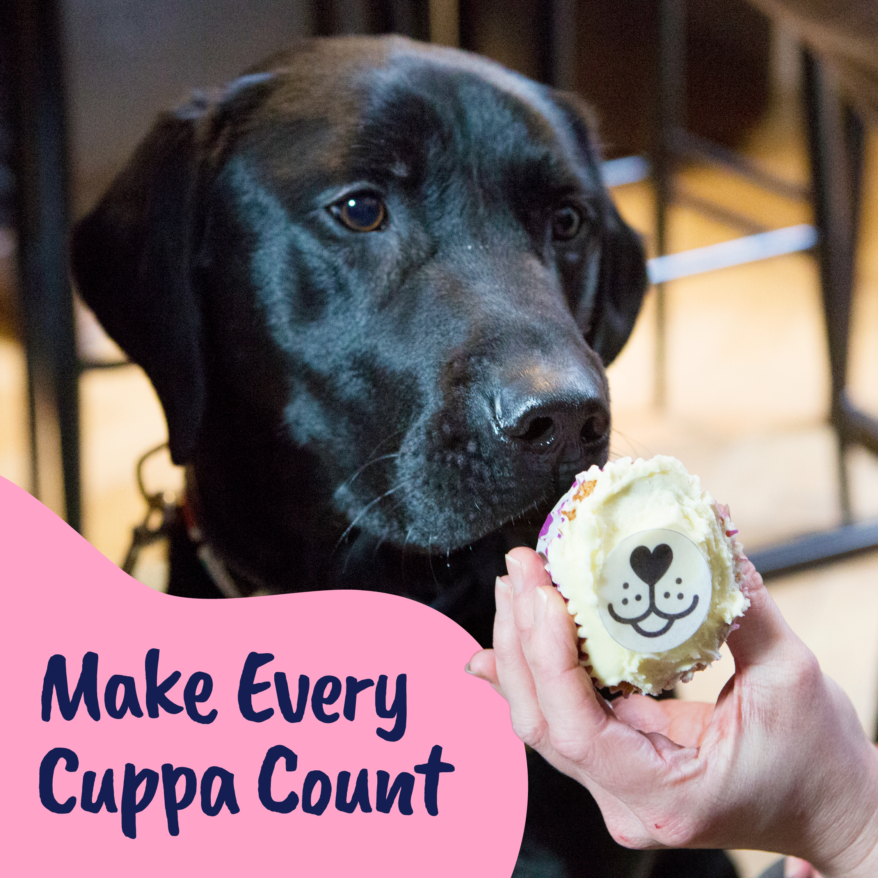
Encourage
If you know anyone who loves to bake or just eat cake, then reach out to your contacts and get them involved!​
Local schools and youth groups​.
Friends and family​.
In the workplace of family and friends​.
At your local collection/places you have relationships with like a Specsavers stores for example​.

Slide 8
Share
Share our posts from brand and regional social media accounts on your groups’ Facebook page​.
Brand Facebook - facebook.com/guidedogsuk ​
We'll also be sharing posts on Guide Dogs other social channels:​
Brand Twitter/X twitter.com/guidedogs​
Brand Instagram Instagram.com/guidedogsuk​
Brand Linked In linkedin.com/company/guidedogsuk​

Slide 9

Where to get your resources
​Download everything you need for your fundraiser from VIP (Volunteer Information Point).
Fundraising resources | VIP (guidedogs.org.uk)
Please don't register for a pack via the website for your group's resources, as​ these use the in aid of logo. If you need any additional resources or help, please ask contact your Regional Supporter Care Team.

Slide 10
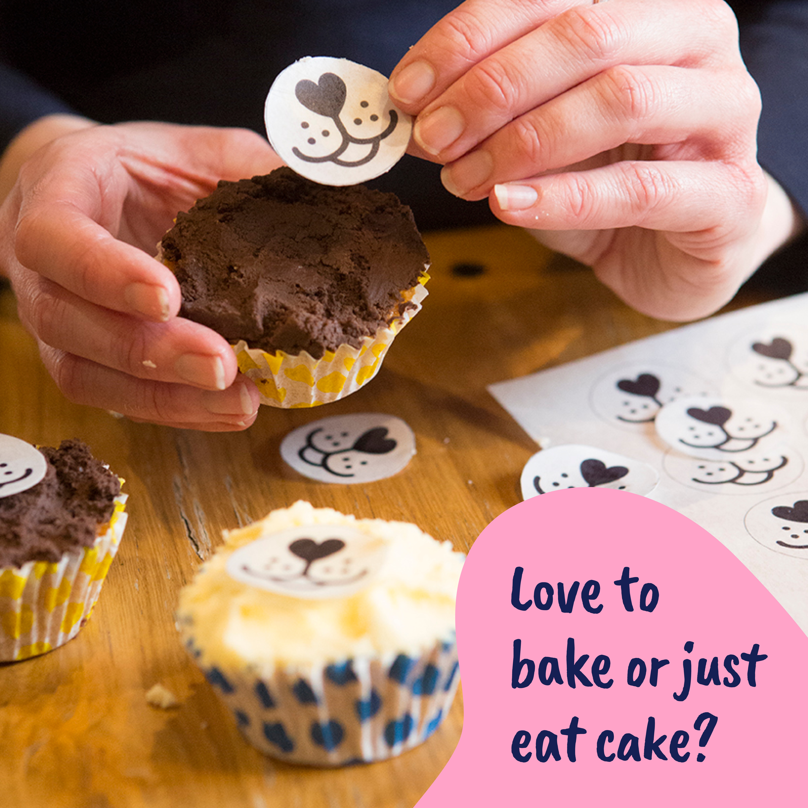
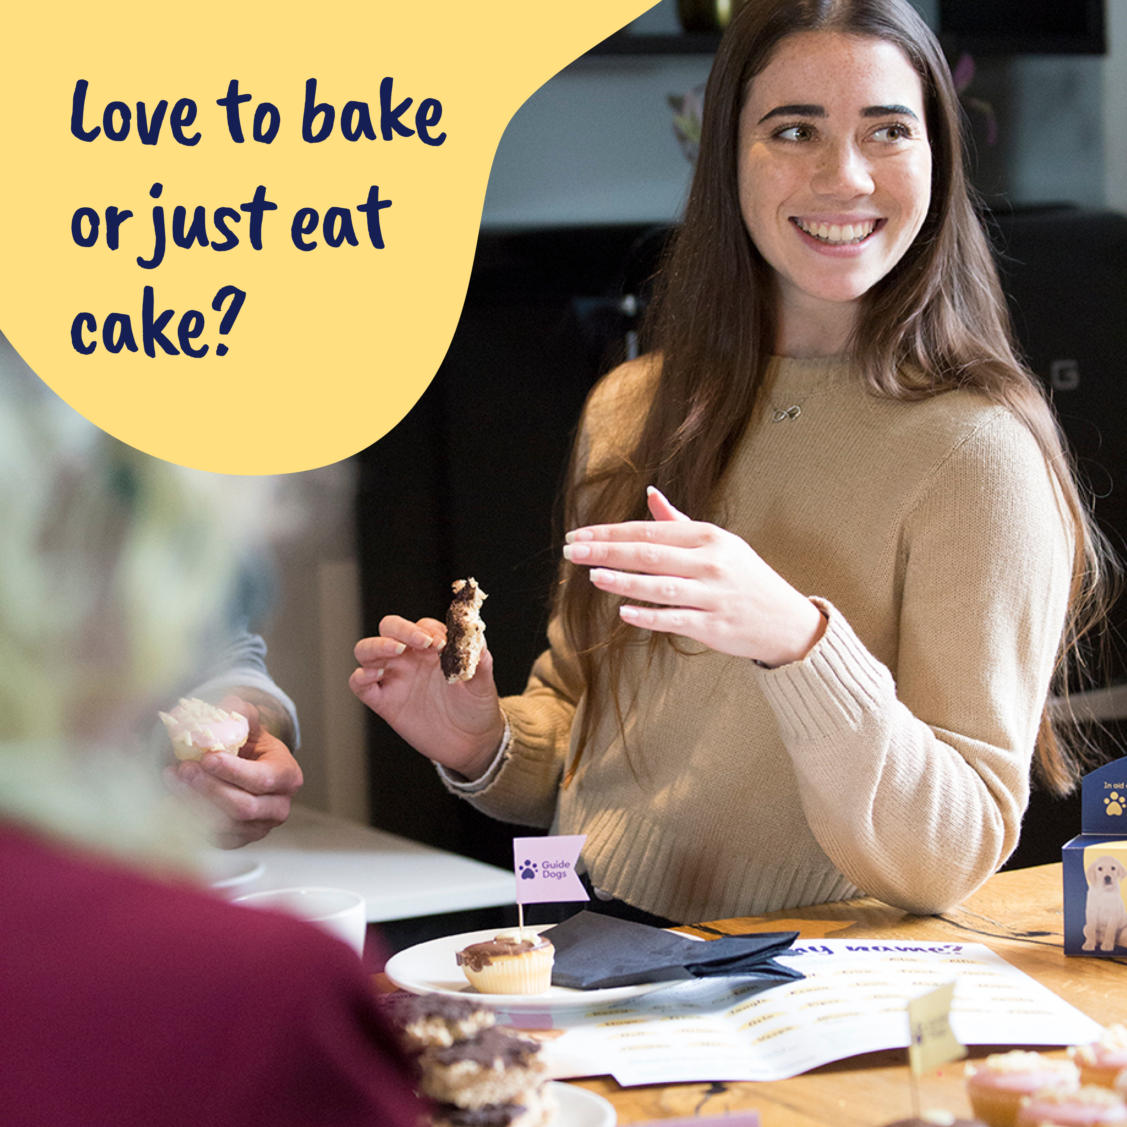


MidlandsGroups@guidedogs.org.uk
BelfastGroups@guidedogs.org.uk​
​SouthEastGroups@guidedogs.org.uk
NorthEastGroups@guidedogs.org.uk​
​SouthWestGroups@guidedogs.org.uk
NorthWestGroups@guidedogs.org.uk​
​WalesGroups@guidedogs.org.uk
ScotlandGroups@guidedogs.org.uk

Slide 11
Paying in
​Group Make Every Cuppa Count
Pay in the funds from your group fundraisers using the code TEA PARTY on your banking slip​.
Note: If you selling merchandise or a Guide Dogs tombola, pay in separate funds from them in the usual way​.
Individuals
If individuals in your group want to pay via the group, use the code TEA PARTY on your banking slip​.

Slide 12
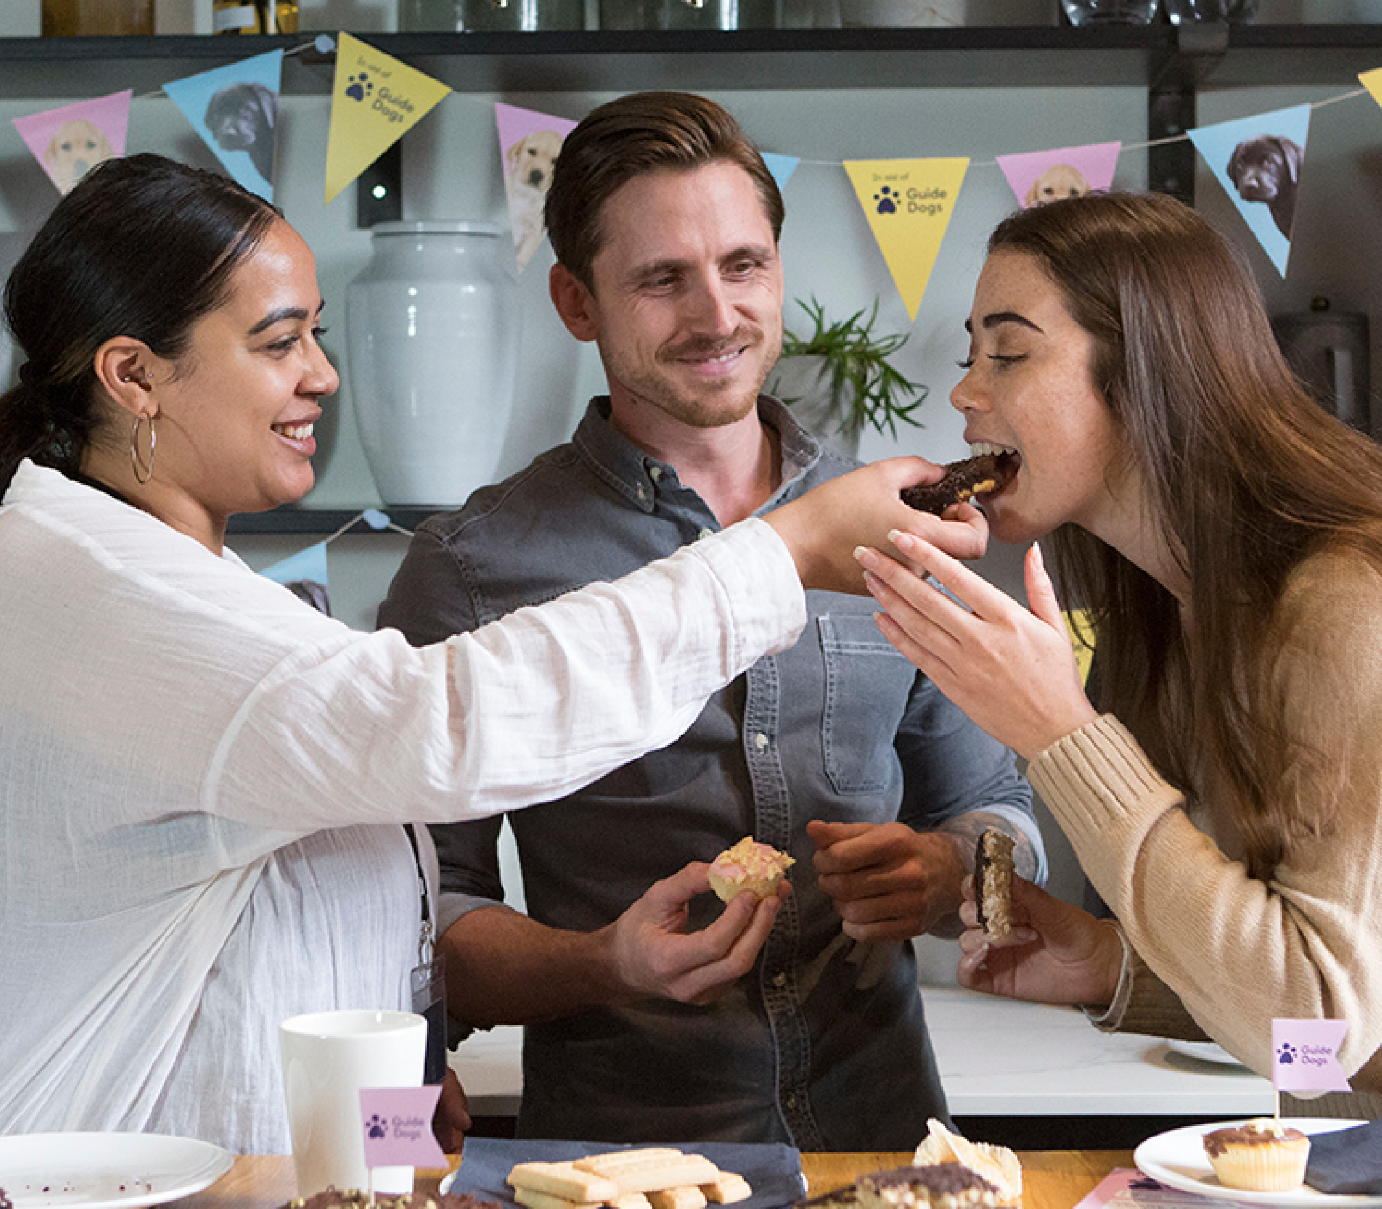
Send us your photos!
Please send all your photos to your Regional Supporter Care Team - we would love to see how you made every cuppa count.

Slide 13
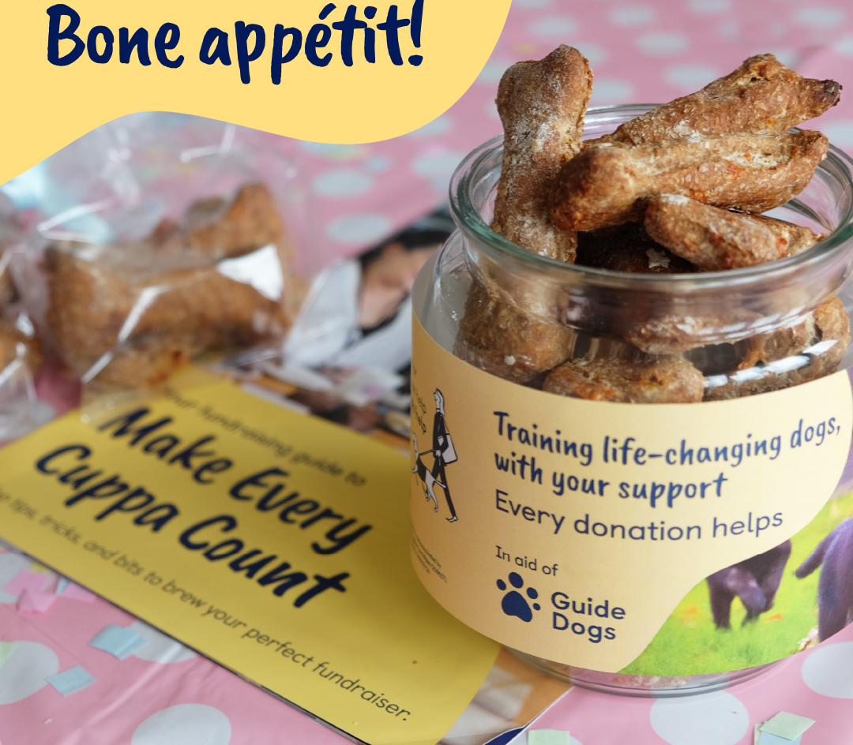
Thank you!

