Slide 1
Title Slide
Quiz Night
Celebrity Sound Round
Can you name our Guide Dogs
celebrity supporters ?

Slide 2

Hint
What would this cheeky chappy find to cook in your kitchen cupboards?
Number 1

Slide 3
Number 2
Hint
Does this lady breathe fire when she’s cross?

Slide 4
Number 3
Hint
Will this lady be able to tell you if your oil painting is a fake or worth a fortune?

Slide 5
Number 4
Hint
Will this gentleman be able to help you love your garden?

Slide 6
Number 5
Hint
How would you like to be on this lady’s sofa in the morning?

Slide 7
Number 6
Hint
Would you like this jolly gent to judge your kitchen masterpieces?

Slide 8
Number 7
Hint
Do you wish you’d looked after your teeth like this lady poet?

Slide 9
The Answers…

Slide 10
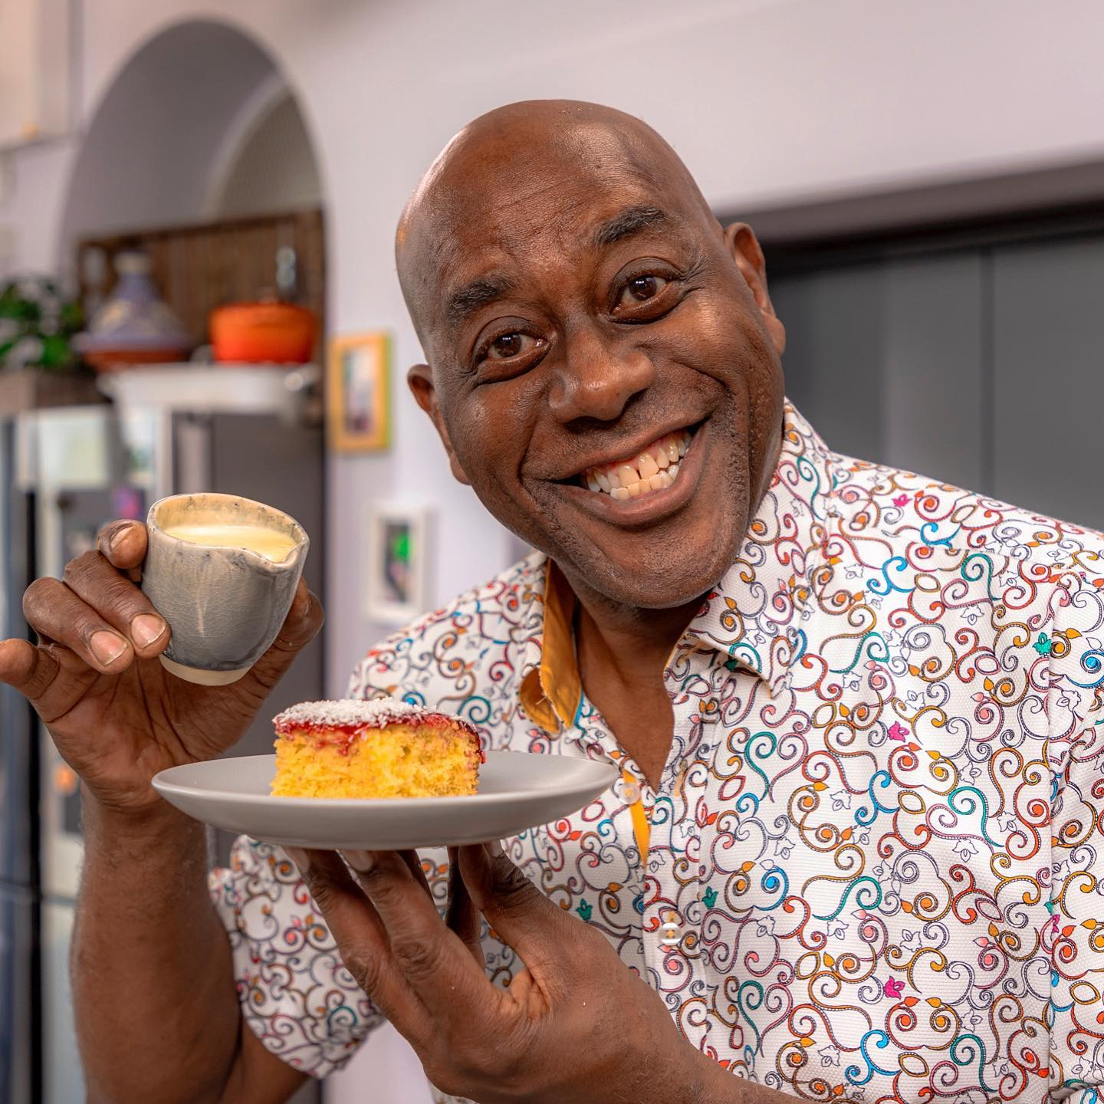
Chef and TV Presenter
Ainsley Harriott
Number 1

Slide 11
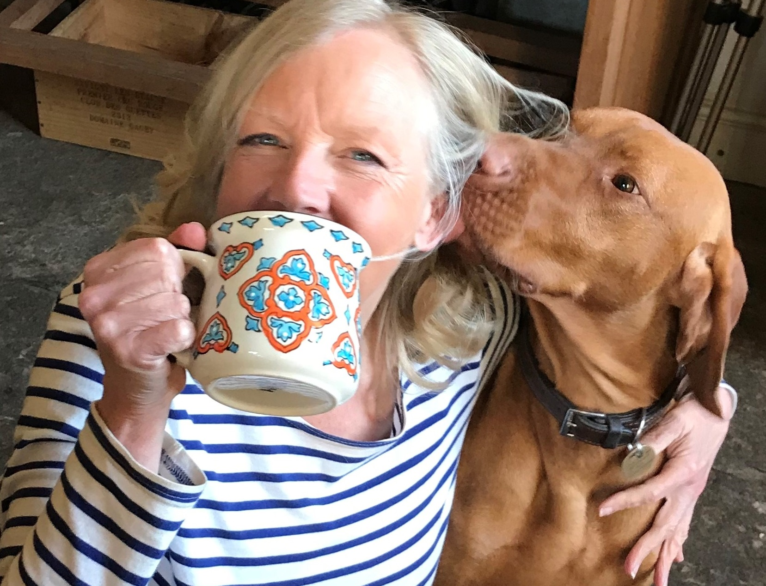
Entrepreneur and
Dragon’s Den investor
Deborah Meaden
Number 2

Slide 12
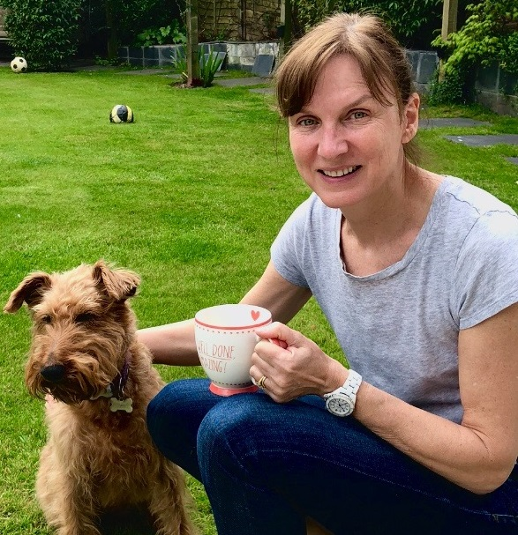
BBC Newsreader and TV Presenter Fiona Bruce
Number 5

Slide 13
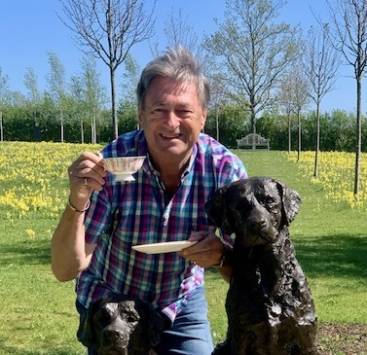
Gardener, Radio &
TV Presenter,
Poet & Novelist
Alan Titchmarsh, MBE
Number 4

Slide 14
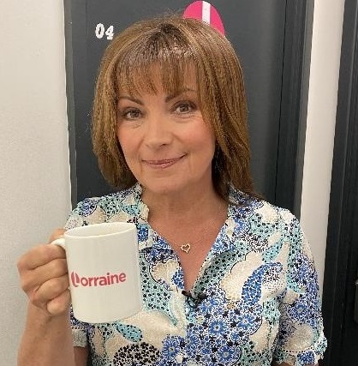
Television Presenter and Journalist
Lorraine Kelly OBE
Number 5

Slide 15
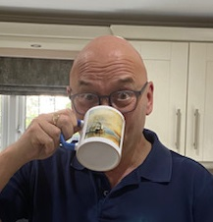
Masterchef Judge, TV Presenter and Food Lover
Gregg Wallace
Number 6

Slide 16
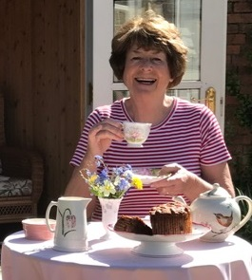
Poet, Comedian, Songwriter, TV & Radio Presenter
Pam Ayres, MBE
Number 7

Slide 17
Thanks for Playing!

