Slide 1

Title Slide
Tea Party
2022

Slide 2
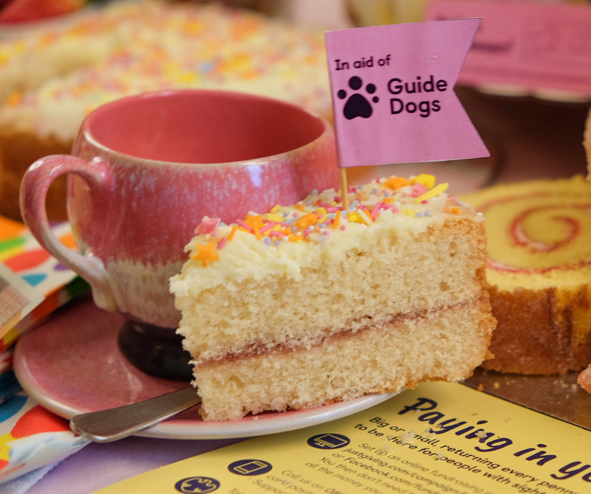
Title Slide
What’s new?
From now on, we won’t be tying in our Tea Party promotion around National Tea Day.
Instead, we will be encouraging people to host a Tea Party or do a Bake Sale on the THIRD Friday in April
This year that is Friday 22 April
As always, people can do their Tea Party ANYTIME – as long as they raise life-changing funds we don’t mind when they do their Tea Party!

Slide 3
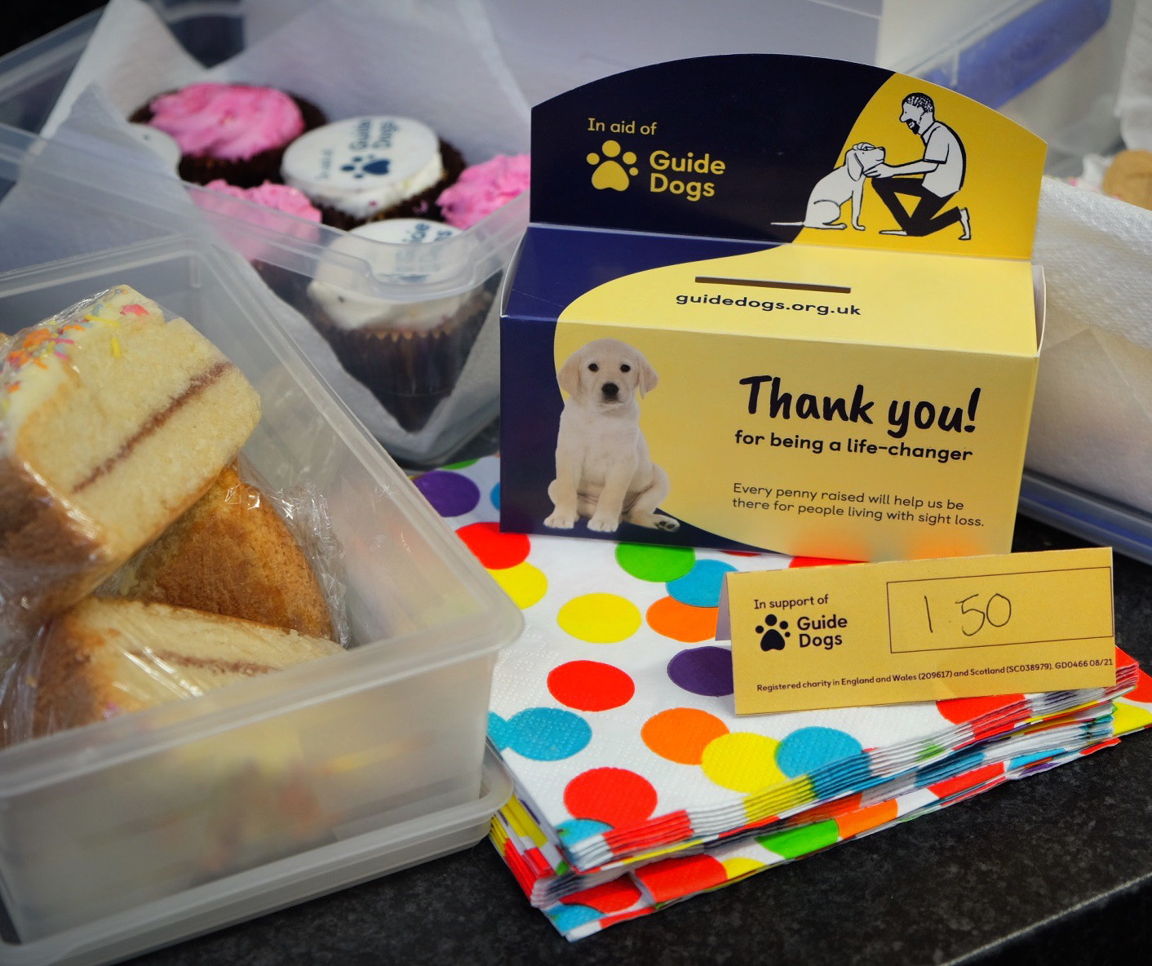
Title Slide
Come together
over a cuppa
We hope that by April, things will be back to normal, and we’ll be asking people to host a Tea Party – just like we did pre-Covid
Of course, we still have the resources to support people wanting to do virtual Tea Parties
Tea Party promotion will start at the end of February and run throughout March and April

Slide 4
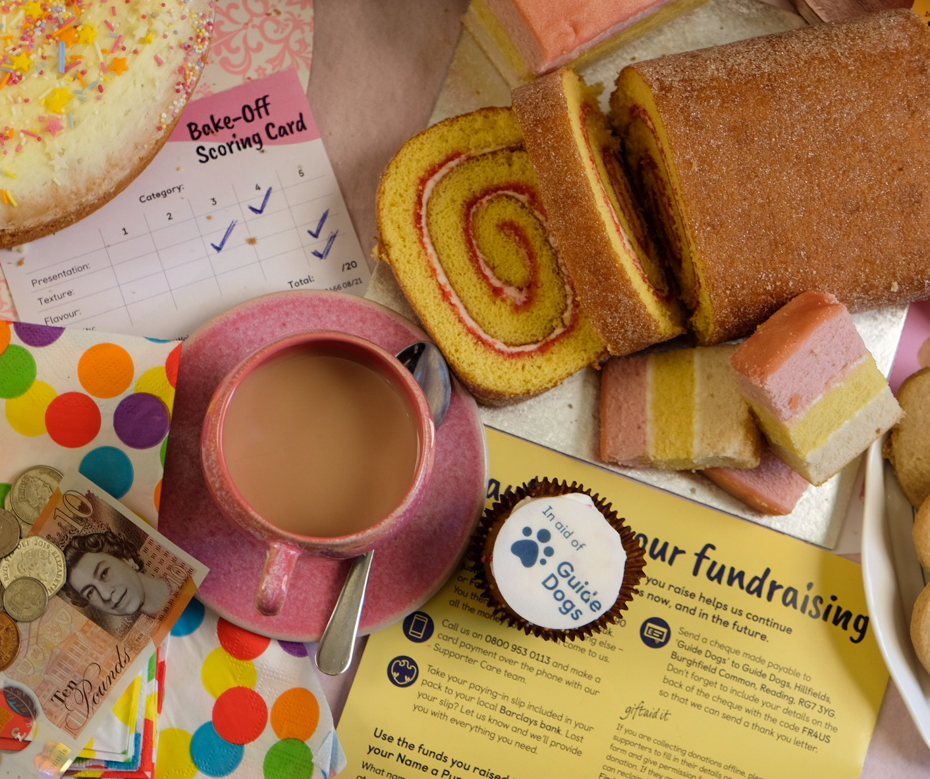
Title Slide
How can your fundraising group support Tea Party?

Slide 5
  1st Way to support Tea Party – SHARE!
    Share posts about Tea Party from brand and regional social media accounts on your groups’ Facebook page
    Brand Facebook - facebook.com/guidedogsuk
    We'll also be sharing posts on Guide Dogs other social channels:
    Brand Twitter twitter.com/guidedogs
    Brand Instagram Instagram.com/guidedogsuk
    Brand Linked In linkedin.com/company/guidedogsuk

Slide 6
  1st Way to support Tea Party – SHARE!
    You can also share from your Regional Facebook pages
    Cymru facebook.com/guidedogscymru
    Midlands & East facebook.com/guidedogsmidlandsandeast
    Northern Ireland facebook.com/guidedogsNI
    North East facebook.com/guidedogsnortheast
    North West facebook.com/guidedogsNW
    South West facebook.com/guidedogssouthwest
    South East facebook.com/guidedogssoutheast
    Scotland facebook.com/guidedogsscotland

Slide 7
  2nd Way to support Tea Party – ENCOURAGE!
    If you know anyone who loves to bake (or just eat cake), you help by encouraging them to host their own Tea Party
    Local schools and youth groups
    Friends and family
    In the workplace of family and friends
    At your local collection venues or businesses you have relationships with like Specsavers stores for example
    Please direct them to guidedogs.org.uk/teaparty to register for their own tea party pack which use the in aid of logos and comes with paying in instructions

Slide 8
  3rd Way to support Tea Party – HOST!
    Hosting a Tea Party in your local community is not only a great way to fundraise, it's a fantastic opportunity to recruit new volunteers to your group too
    Email your regional supporter care team with your Tea Party details to add to the events and collections calendar
    Use our new Tea Party posters to promote your event
    Decorate your venue and cakes with our bunting and cake flags
    Add a sweepstake or raffle to boost your tea totals
    If you are a trading group, set up a stand to sell your goodies or a Guide Dogs tombola
    Set up a separate area or table for guests to chat with you about volunteering opportunities in your group
    Print a list of volunteer roles you are looking for with your contact details for people to take away (Your Community Fundraising Relationship Manager can help with this)

Slide 9
  Where to get your Tea Party resources
    Download everything you need for your Tea Party with the 'In Support' logo from VIP (Volunteer Information Point)
    guidedogs.org.uk/vip/resources/community-fundraising
    Please don't register for a pack via the website for your groups tea party resources, as
    these use the in aid of logo. If you need cake toppers, donation labels etc or help with
    posters etc, please ask for these via your regional supporter care team:
    MidlandsGroups@guidedogs.org.uk BelfastGroups@guidedogs.org.uk
    SouthEastGroups@guidedogs.org.uk NorthEastGroups@guidedogs.org.uk
    SouthWestGroups@guidedogs.org.uk NorthWestGroups@guidedogs.org.uk
    WalesGroups@guidedogs.org.uk ScotlandGroups@guidedogs.org.uk

Slide 10

  Paying in your Tea Party funds
    Pay in the fundraising from your group Tea Party using the code 'TEA PARTY' on your banking slip
    If you selling merchandise or a Guide Dogs tombola, pay in separate funds from them in the usual way
    As a special thank you, any group paying funds from their own Tea Party in 2022 using pay in code Tea Party will receive one of the new Guide Dogs tote bags.
    It will be one tote bag per group – why not use it as a thank you to your own star baker or raffle it off at your next group meeting?
    Please contact your regional supporter care team after you have paid in your Tea Party funds to let them know who to send the tote bag to.

Slide 11
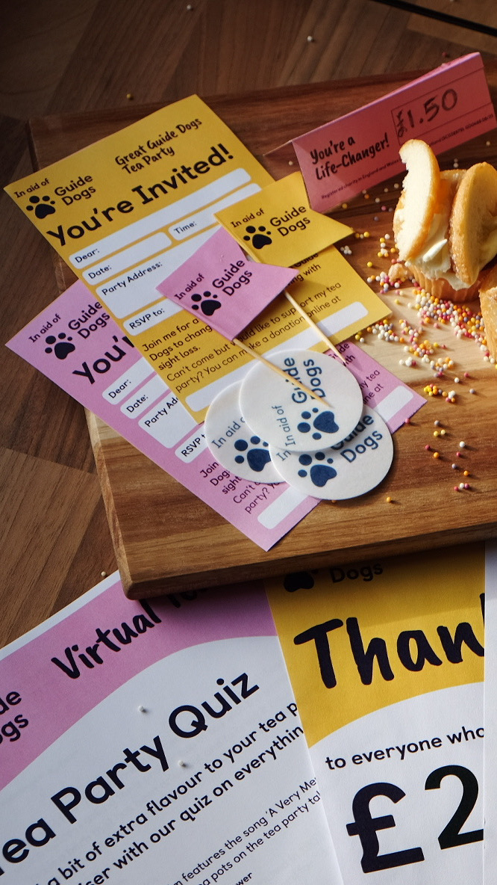
Title Slide
Send us your Tea Party photos!
We’d really love to see photos from the Tea Parties you host
Please send them to your regional supporter care team

Slide 12
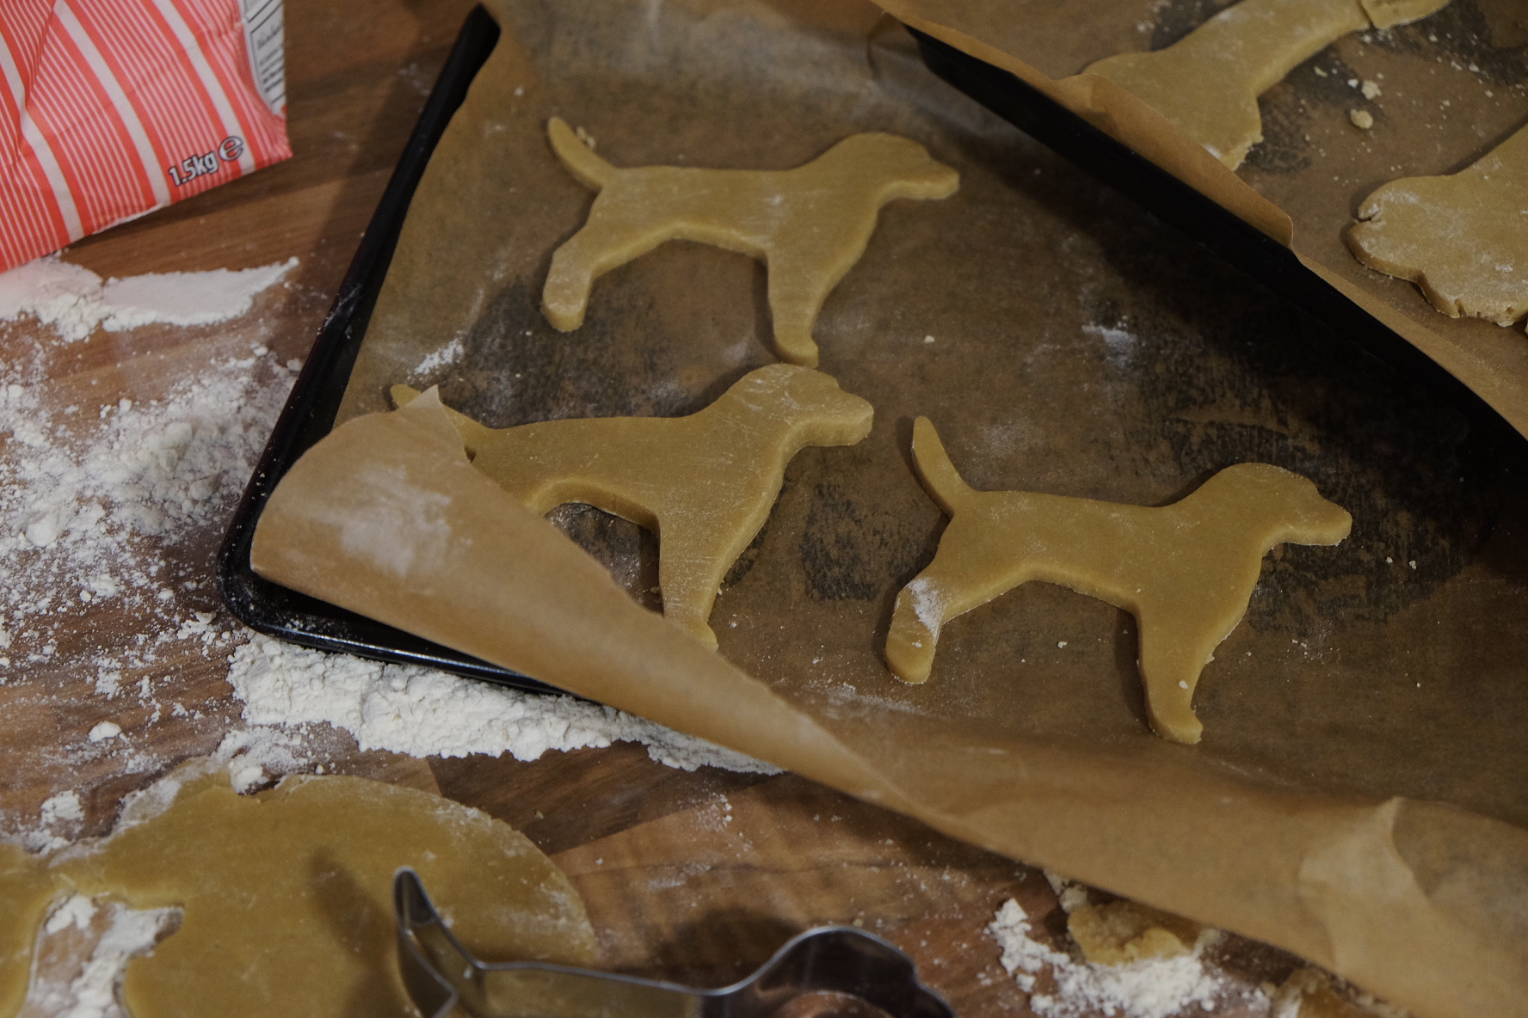
Title Slide
Thank you!
Any questions?

