Slide 1

Title Slide
Tea Party
2023

Slide 2
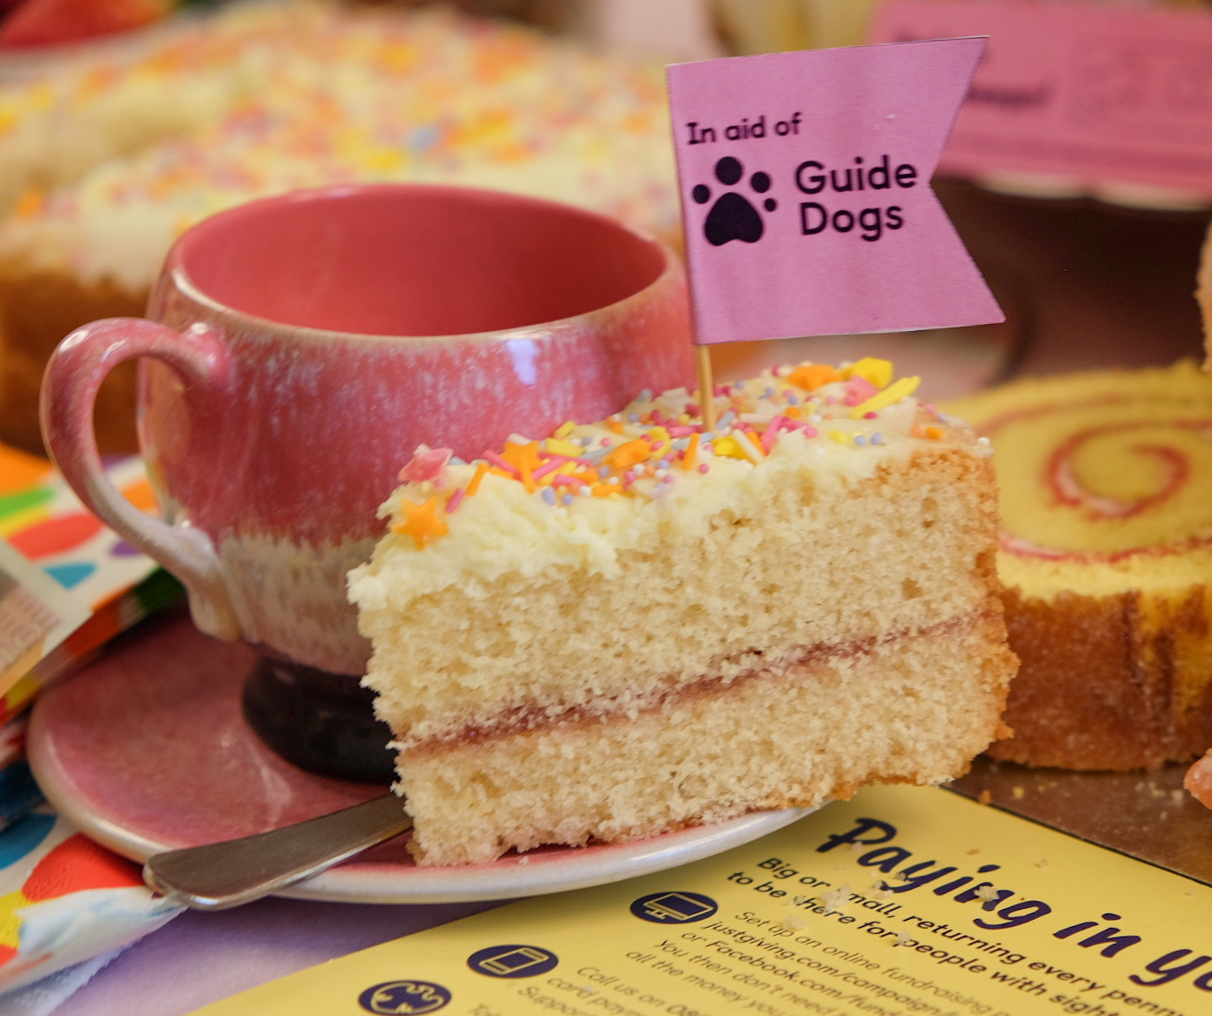
Title Slide
When is Tea Party?
It is usually on the 3rd Friday in April
This year that is Friday 21 April
As always, people can do their Tea Party ANYTIME – as long as they raise life-changing funds we don’t mind when they do their Tea Party!
Tea Party promotion will start at the end of February and run throughout March and April

Slide 3
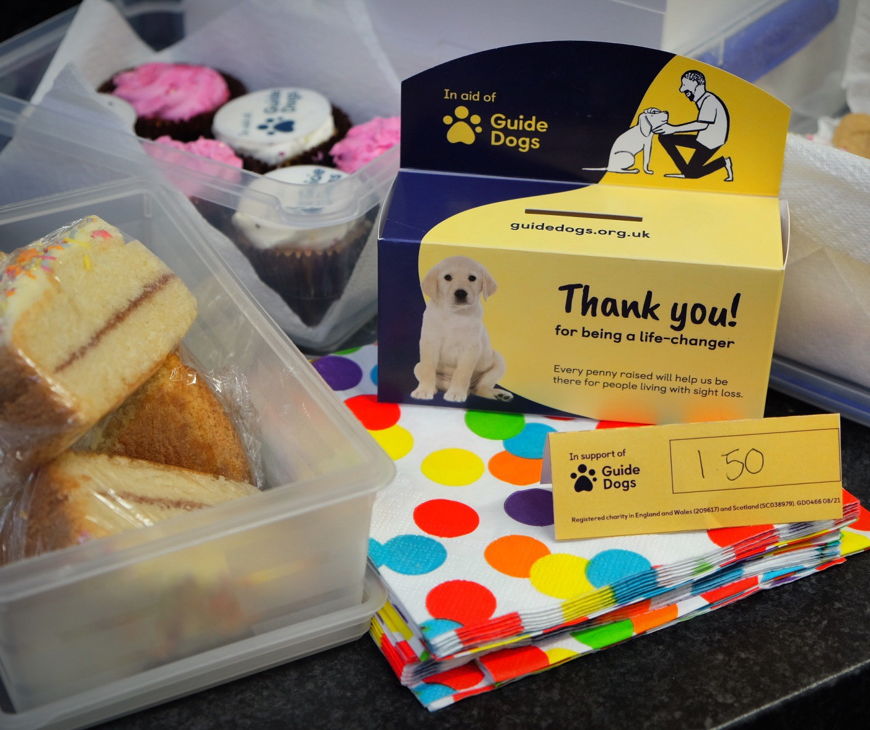
Title Slide
Come together
over a cuppa
We’ll be encouraging people to make moments that matter this April
At work
At home
In the community
Local businesses
NAP & COY supporters

Slide 4
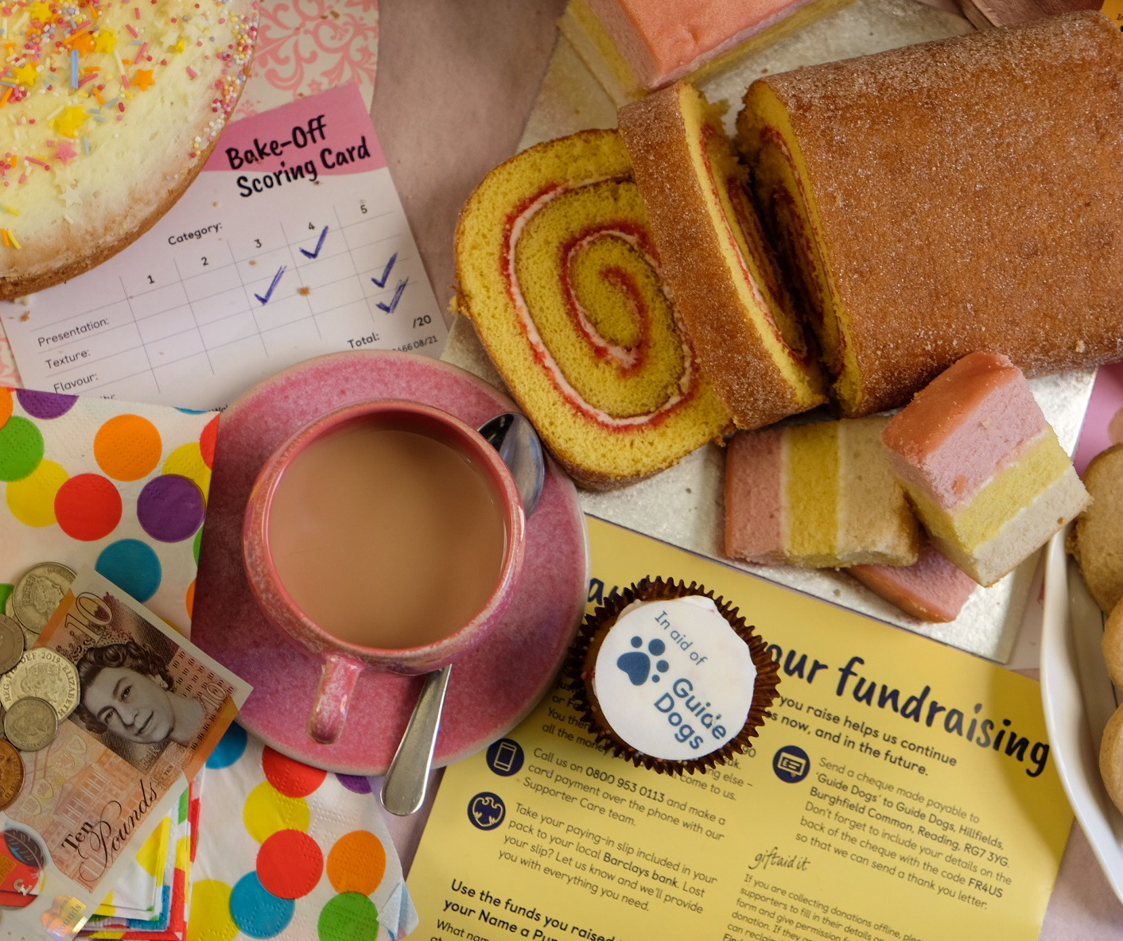
Title Slide
How can your fundraising group get involved?

Slide 5
Text Only Slide
1st Way to support Tea Party – SHARE!
Share posts about Tea Party from brand and regional social media accounts on your groups’ Facebook page
Brand Facebook - facebook.com/guidedogsuk
We'll also be sharing posts on Guide Dogs other social channels:
Brand Twitter twitter.com/guidedogs
Brand Instagram Instagram.com/guidedogsuk
Brand Linked In linkedin.com/company/guidedogsuk

Slide 6
Text Only Slide
2Nd Way to support Tea Party – ENCOURAGE!
If you know anyone who loves to bake (or just eat cake), use the handy templates in the Tea Party 2023 – Fundraising Group Toolkit to reach out to your contacts
Local schools and youth groups
Friends and family
In the workplace of family and friends
At your local collection venues or businesses you have relationships with like Specsavers stores for example
Please direct them to guidedogs.org.uk/teaparty to register for their own tea party pack which use the in aid of logos and comes with paying in instructions

Slide 7
Text Only Slide
3rd Way to support Tea Party – HOST!
Hosting a Tea Party in your local community is not only a great way to fundraise, it's a fantastic opportunity to recruit new volunteers to your group too
Email your regional supporter care team with your Tea Party details to add to the events and collections calendar
Use our editable Tea Party posters to promote your event
Decorate your venue and cakes with our bunting and cake flags
Add a sweepstake or raffle to boost your tea totals
If you are a trading group, set up a stand to sell your goodies or a Guide Dogs tombola
Set up a separate area or table for guests to chat with you about volunteering opportunities in your group
Print a list of volunteer roles you are looking for with your contact details for people to take away (Your Community Fundraising Relationship Manager can help with this)

Slide 8
Text Only Slide
Where to get your Tea Party resources
Download everything you need for your Tea Party from VIP (Volunteer Information Point)
guidedogs.org.uk/vip/resources/fundraising-resources
Please don't register for a pack via the website for your groups tea party resources, as
these use the in aid of logo. If you need cake toppers, donation labels etc or help with
posters etc, please ask for these via your regional supporter care team:
MidlandsGroups@guidedogs.org.uk BelfastGroups@guidedogs.org.uk
SouthEastGroups@guidedogs.org.uk NorthEastGroups@guidedogs.org.uk
SouthWestGroups@guidedogs.org.uk NorthWestGroups@guidedogs.org.uk
WalesGroups@guidedogs.org.uk ScotlandGroups@guidedogs.org.uk

Slide 9
Text Only Slide
Paying in your Tea Party funds
Group Tea Parties
Pay in the fundraising from your group Tea Party events using the code SOCIAL EVENT on your banking slip
Note: If you selling merchandise or a Guide Dogs tombola, pay in separate funds from them in the usual way
Individuals
If individuals in your group want to pay via the group, use the code TEA PARTY on your banking slip

Slide 10
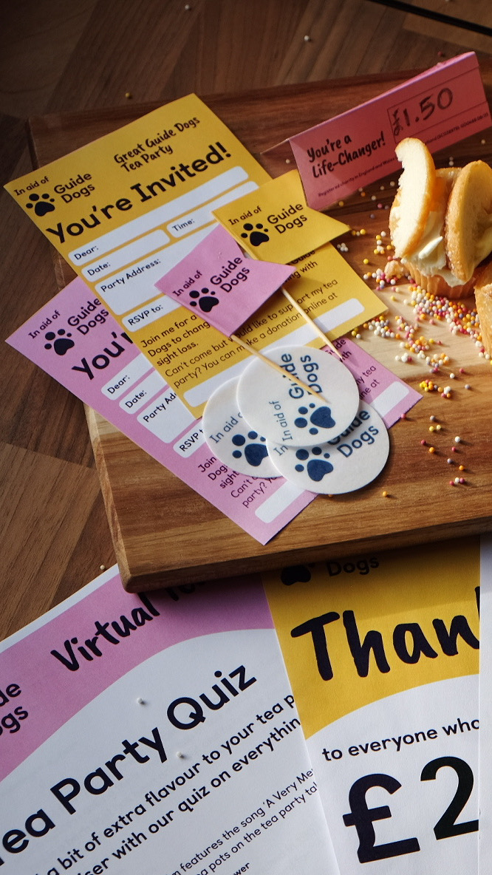
Title Slide
Send us your Tea Party photos!
We’d really love to see photos from the Tea Parties you host
Please send them to your regional supporter care team

Slide 11
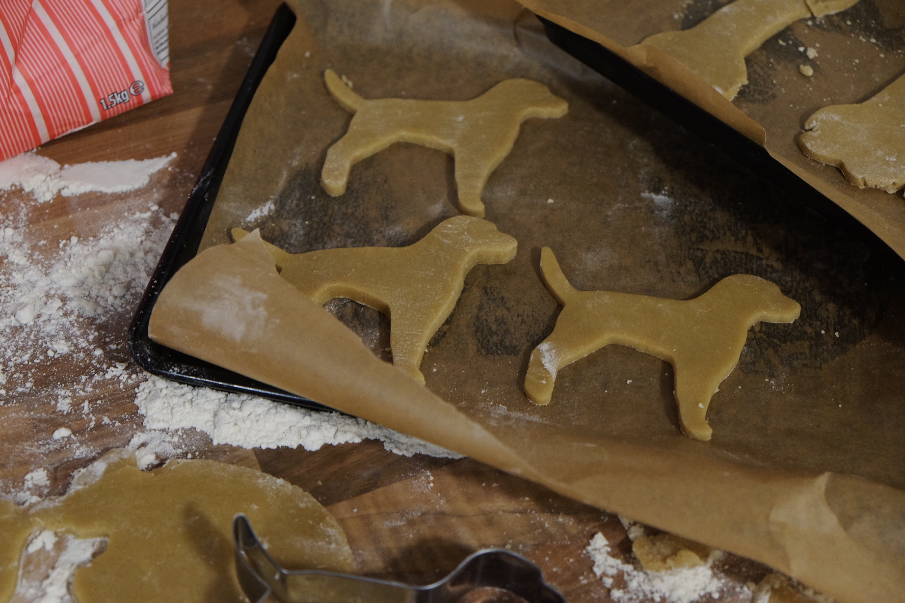
Title Slide
Thank you!
Any questions?

