Slide 1
Leading the way
Guide Dogs Futures webinar series
28th June 2021
Hosted by: Damion Afflick
Panellists: Emma Foulds, Kirstie Bowers, Marie Orpen, Leah Hampton-O’Neil, Molly Wyatt, Simon Goodwin

Slide 2
Welcome to ‘Guide Dogs Futures: leading the way’
We’ll cover:
An overview of sight loss and support services
The different ways in which Guide Dogs helps people with sight loss
Introducing ‘The Academy’
How we’re helping more people with digital content
Making it easier to ‘ask’ for help online
Coming soon: Tech for All - accessible technology for every child in the UK
Kallidus: an online learning platform for Puppy Raisers
Exploring how we can better nurture our volunteering community
Comments and questions
Close and thank you

Slide 3
An overview of sight loss and support services

Slide 4
Sight loss can affect anyone, at anytime
Every six minutes in the UK, one more person loses their sight
Every day, 250 more people join the 2 million already living with sight loss
And this number is set to double by 2050

Slide 5
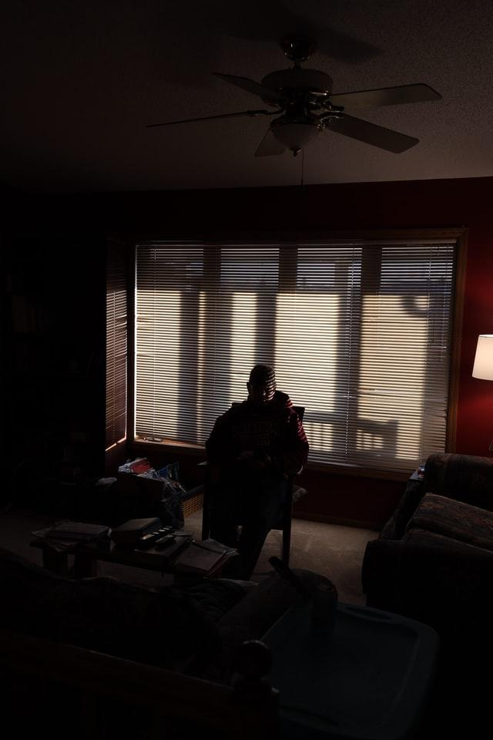
Everyone’s sight loss journey is different, including their support needs

Slide 6
In the last 50 years, sight loss support services have grown in response to the wide-ranging needs of people with a visual impairment
Isolation
Independence
Reading materials
Information & advice
Mobility skills
Digital inclusion
Support groups
Entertainment
Reasonable adjustments
Emotional support
Mental health & wellbeing
Assistive technology

Slide 7
In recognition of people’s various support needs, sight loss organisations have diversified their services and improved the ‘customer’ experience
Person-centred approach
Options for different services
Accessible information & guidance
Connections or companionship
Ongoing support

Slide 8
The different ways in which Guide Dogs helps people with sight loss

Slide 9
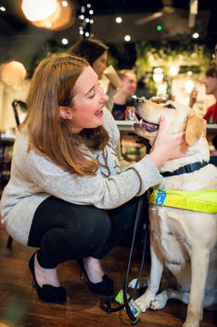
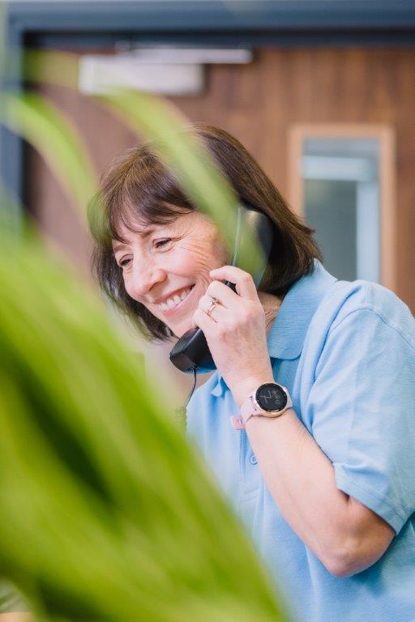
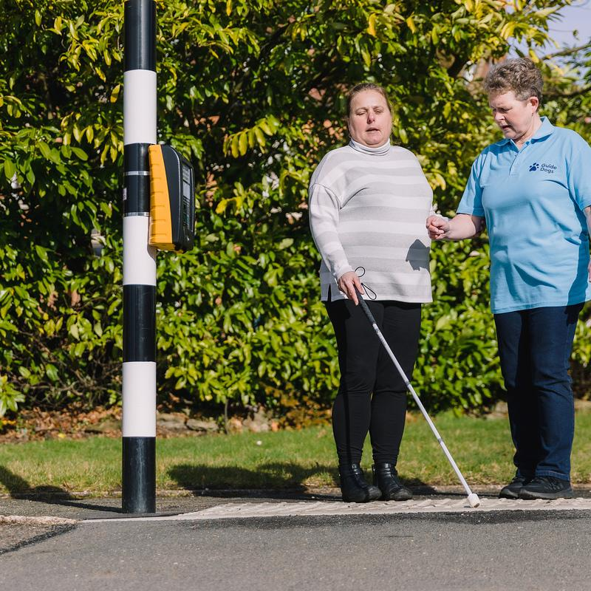
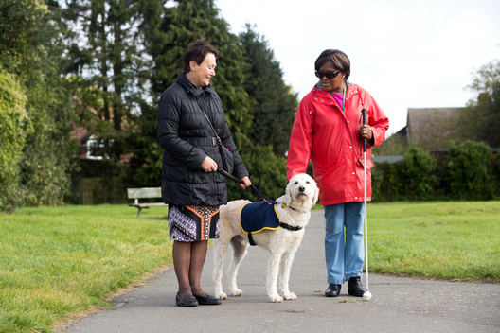
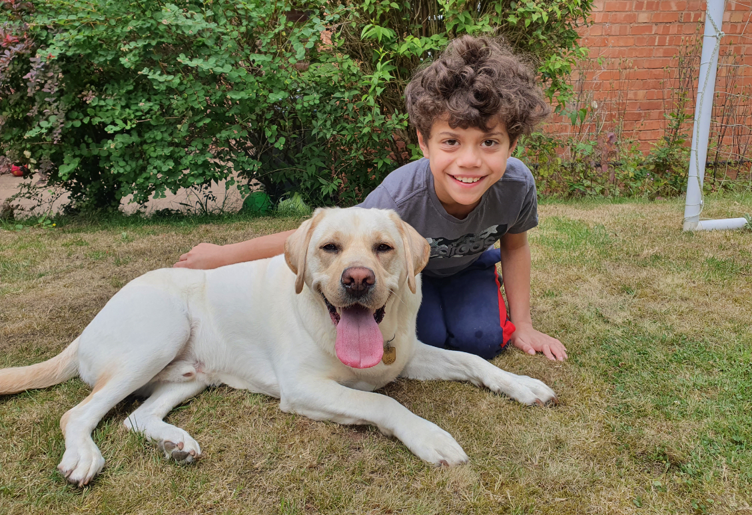
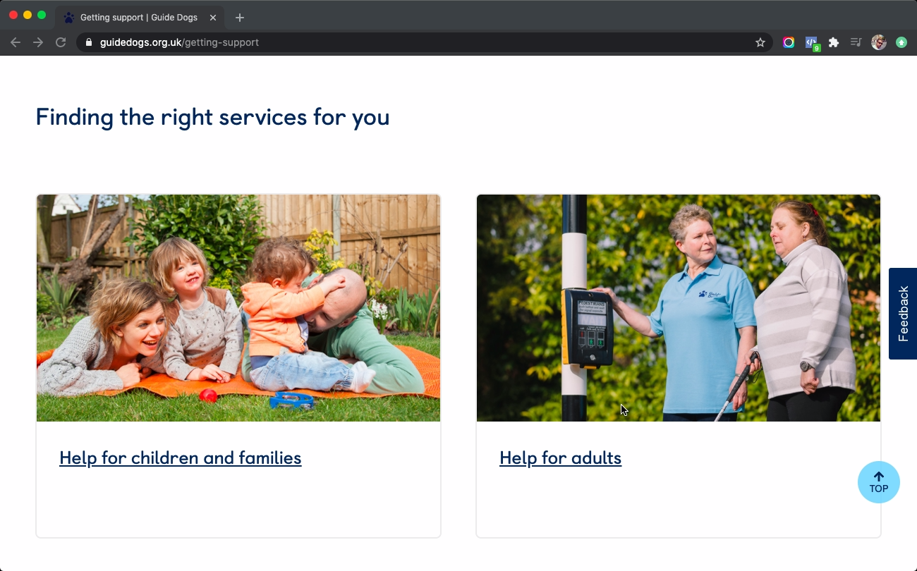
We’ve been helping people with sight loss for 90 years - introducing new services and ways of providing support

Slide 10
It’s now easier than ever before to get in touch with us and find out about our services

Slide 11
We’re helping more people with sight loss than any time in our history but we still need to do more
To help people with sight loss to live the life they choose, we must continually improve and innovate:
Operations
Services
Volunteering

Slide 12
Introducing ‘The Academy’

Slide 13
The Academy is our new initiative to revolutionise how we enable and create guide dog partnerships
The Academy’s mission is to:
Transform and accelerate the way we recruit, retain, and develop our technical staff.
Modernise recruitment and learning at Guide Dogs.
Introduce a more modern, agile and accessible way of delivering training, digital learning and virtual support.

Slide 14
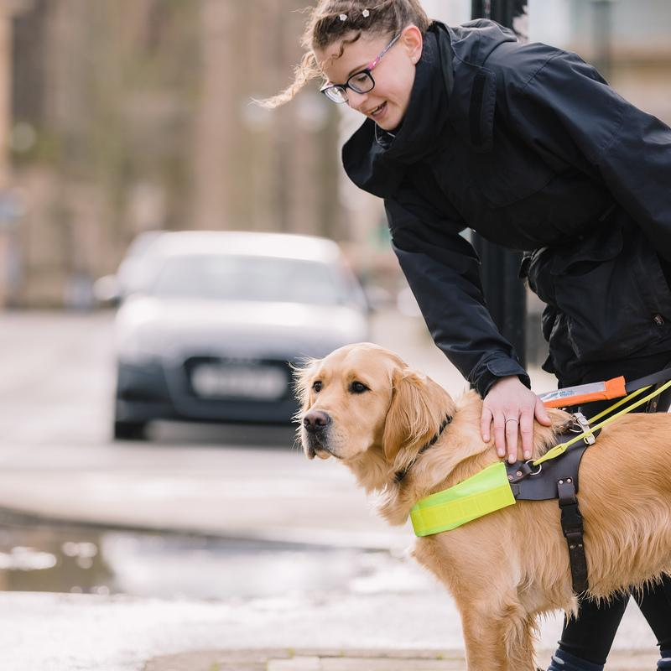
It’s an investment in technical staff, our guide dog service and in reducing waiting times
The Academy will:
Underpin our targeted growth in the guide dog service over the next five years.
Reduce waiting times for a guide dog.
Support our By My Side strategy goal /ambition of creating 1,000 new guide dog partnerships per year.
Recruit and develop more than 200 new Guide Dog Trainers and Guide Dog Mobility Specialists.
Future-proof our organisation.

Slide 15
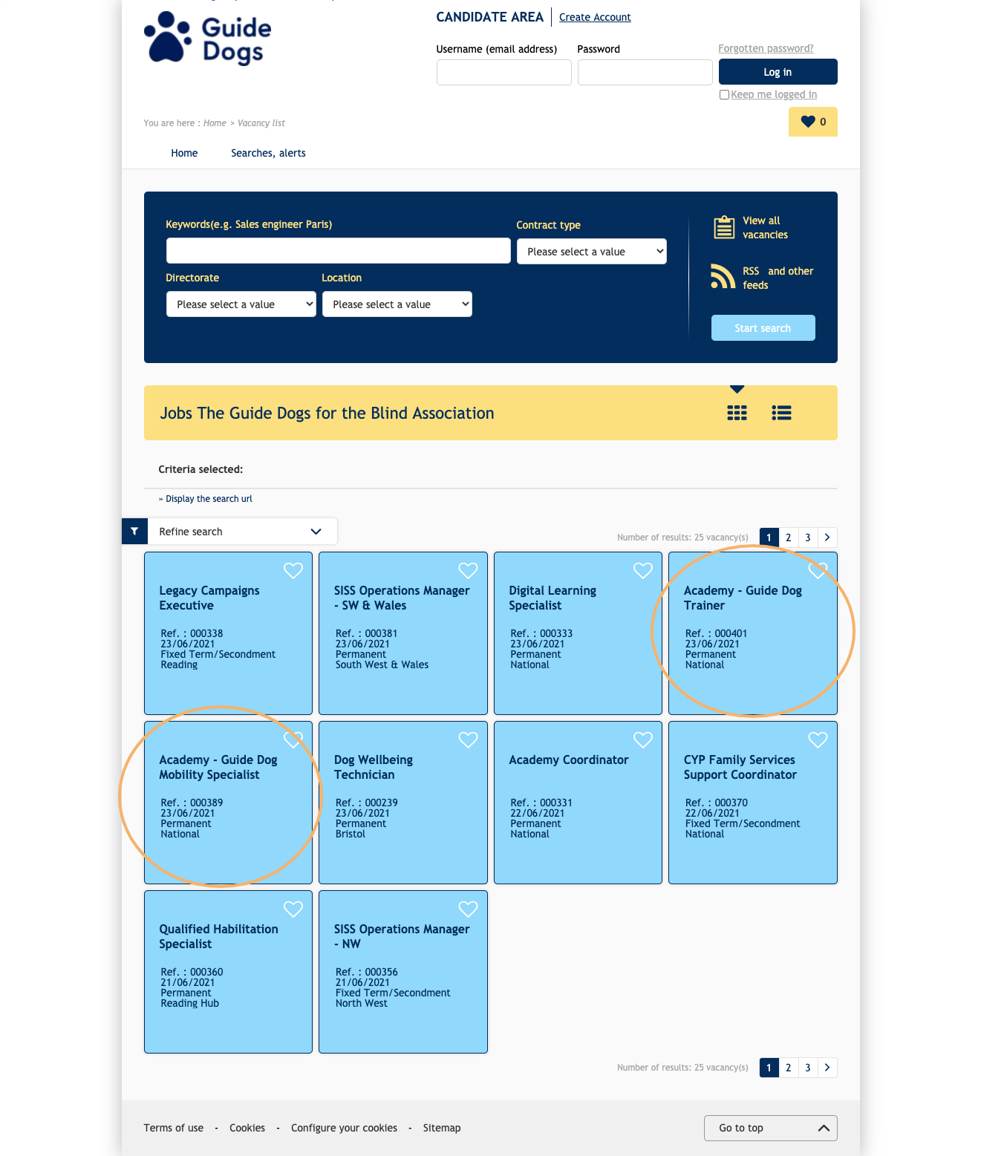
We’ve started recruiting and will be adding more roles in the near future
Recruitment started last week - w/c 21 June 2021.
Please visit our website to find out more or to share these opportunities with friends and family.

Slide 16
How we’re helping more people with digital content

Slide 17
We’re increasing our digital information and advice content to reach more people with sight loss
More and more people are going online first to find information and advice.
What is digital information and advice (and what it’s not)
Our work to date.
Upcoming content areas for development.

Slide 18
For adults with sight loss, we have four main content areas
We currently have 4 main sections for adults on the website
Eye conditions,
Making the most of your vision,
Life skills,
How technology can help me

Slide 19
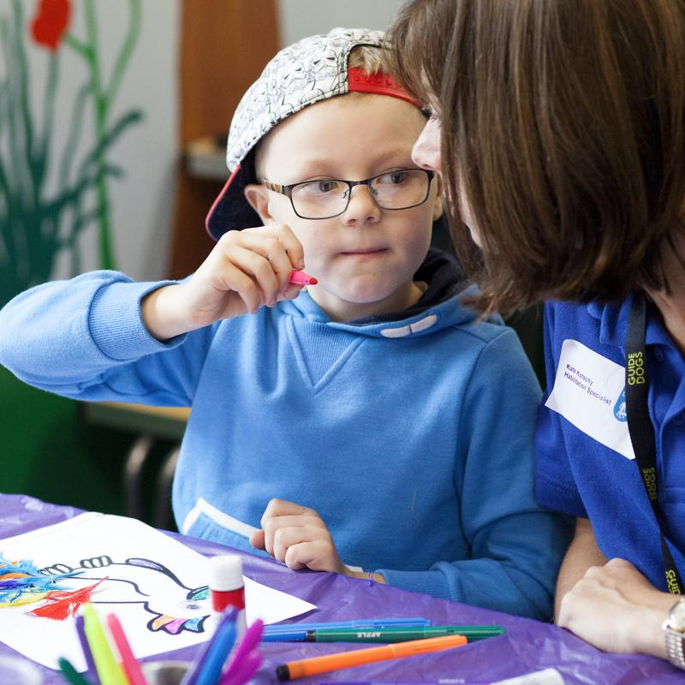
We also have a range of content for parents, carers and key professionals to use with Children and Young People
Light touch - activities that didn't need specific habilitation input.
Purpose - to help develop new skills and consolidate new learning.
Early years activity sheets
Linked to development journal.
babies with VI.
My Time To Play
Song book.
Yoga videos.

Slide 20
We’re also expanding our Children and Young People content to meet more of their support needs
Diverse content to meet the broad spectrum of children's different sight loss conditions and experiences

Slide 21
Making it easier to ‘ask’ for help online

Slide 22
We know that using 'voice' to access information is a growing trend, especially for people with sight loss
Our research tells us that a major pain point for people with sight loss is finding information, advice and guidance.
Voice is a growing channel for accessing info
People with sight loss already familiar with/use voice activated technology
Voice activated information will help us to extend our help and support to more people with sight loss

Slide 23
We’ve already made progress in developing technology to provide information using voice activation
Thanks to funding from the People’s Postcode Lottery, we’ve worked on:
Content mapping and Audit - the full Guide Dogs user lifecycle – from application through to retirement.
Knowledge base - to serve more use cases and user groups.
Machine learning (AI) - testing the voice skill so it grows in scale and smartness with each use.
Developed a production-ready prototype and Minimum Viable Product

Slide 24
With the use of artificial intelligence, we’ve developed a useful source of information that’s accessible by voice

Slide 25
Our chatbot is just the beginning of our exciting exploration into voice activated services
In the future, we hope to:
Increase chatbot/website integration.
Hand off to human support when needed.
Accept Donations.
Integration with our database for personalised approach.
Integration with social media.

Slide 26
Coming soon: Tech for All - accessible technology for every child in the UK

Slide 27
Many families with visually impaired children don’t know about our range of services and we need to change this
Every six minutes in the UK, one more person loses their sight and there are 28,000 children (under 18) who are blind or partially sighted in the UK.
Guide Dogs exists to help people with sight loss, and their families, from the day they’re born.
We are the number 1 provider of services and the largest sole employer of specialists dedicated to helping children and young people with a vision impairment.
But our range of services only reach approximately 4% of children and young people today – we must reach more.

Slide 28
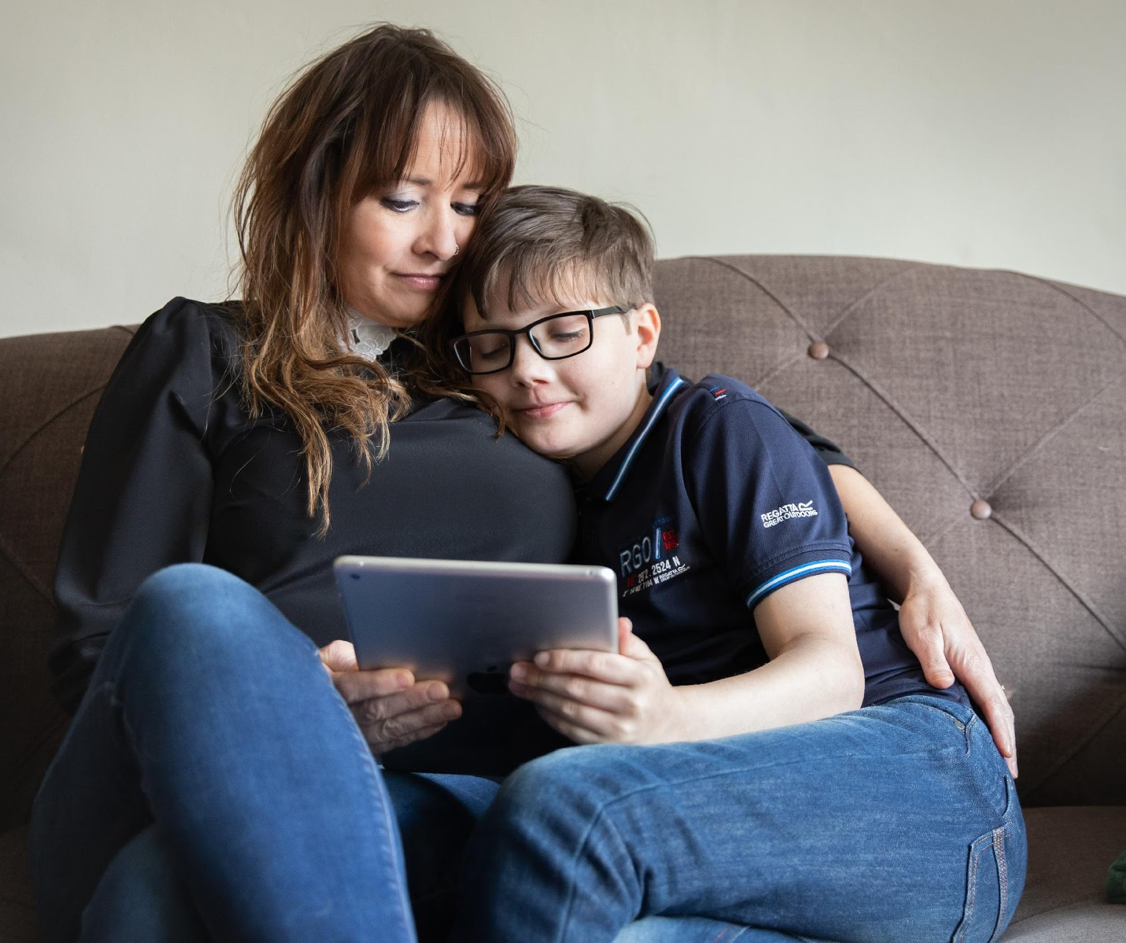
Our Tech for All pilot will allow us to reach more children to support them along their sight loss journeys
We know from our research that technology can completely transform the ability of children with sight loss to live independently and well.
We will pilot a new service to provide free accessible technology to all children with vision impairment aged 3-18 in the UK to use outside of school.
In partnership with BT and Apple, devices will be purchased on-demand and at a discount.

Slide 29
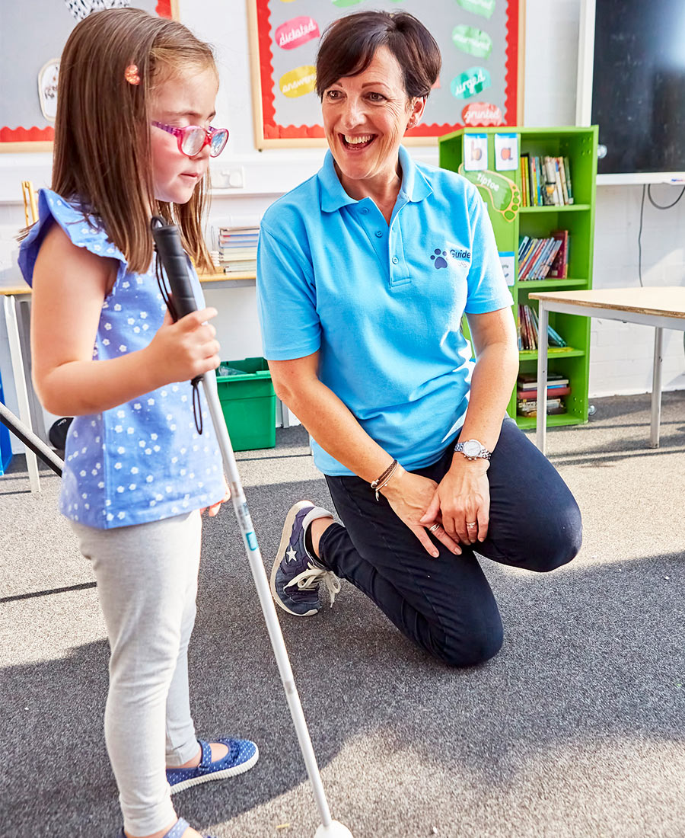
Tech for All will help children to learn invaluable digital skills, connect with others and more Guide Dogs services
All products are by Apple, the leaders in accessible technology.
A digital learning programme to ensure they get the most out of their technology.
The service will allow us the opportunity to also let families know about the other life-changing services we can provide to children beyond a guide dog.

Slide 30
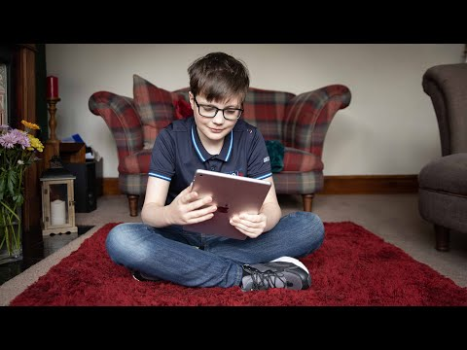
But don't take our word for it, here's Will whose life changed since receiving an iPad

Slide 31
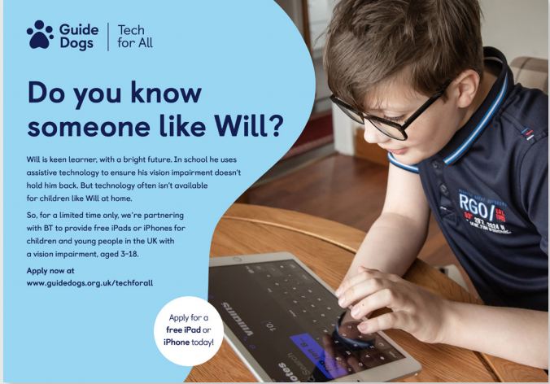
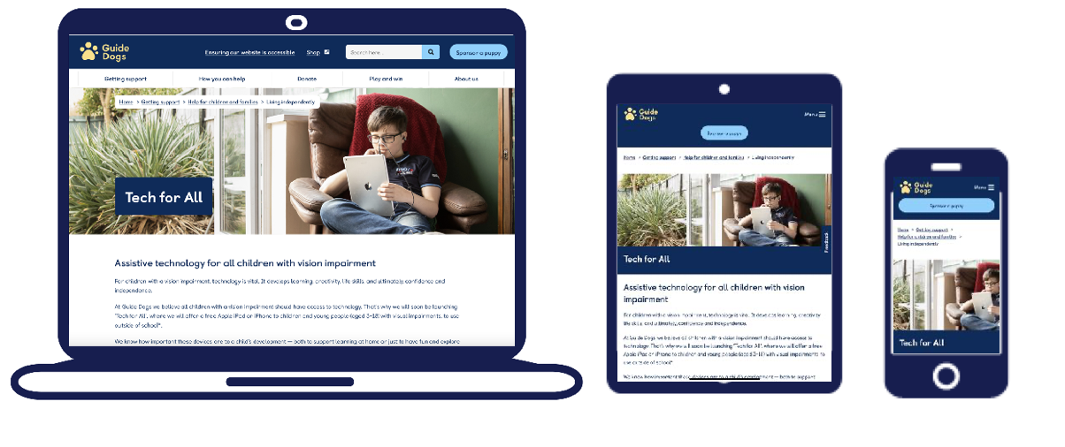
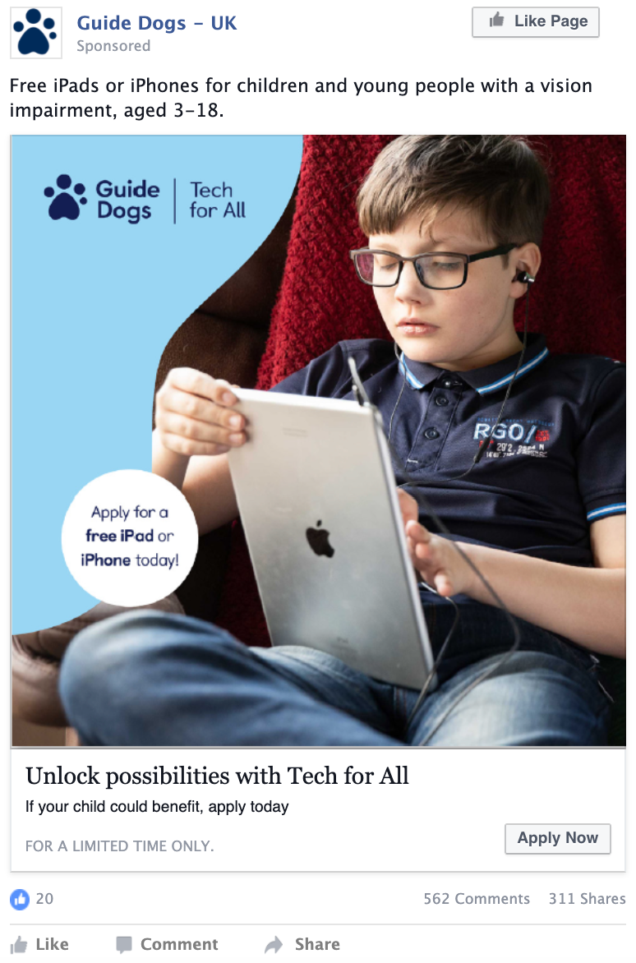
The pilot launches in July 2021 and will be supported by a marketing campaign
Raise awareness in professional magazines, hospitals and online.
Visit the Guide Dogs website for more information and to apply.
Applications will open in July and close in December 2021.

Slide 32
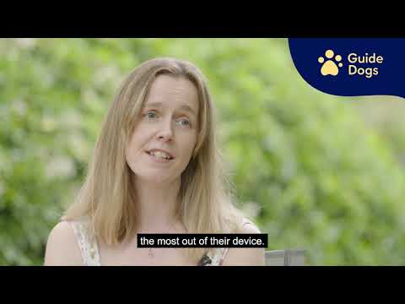
In the meantime, we’ve published a Q&A video which we hope will answer some of your questions at this time

Slide 33
Kallidus: an online learning platform for Puppy Raisers

Slide 34
Puppy Raising for Excellent Partnerships is our new standard way for raising puppies and will be supported by e-learning
PREP is based on four key principles which bring together new and existing learning and techniques into an easy-to-follow programme of e-learning (Kallidus) and puppy classes.

Slide 35
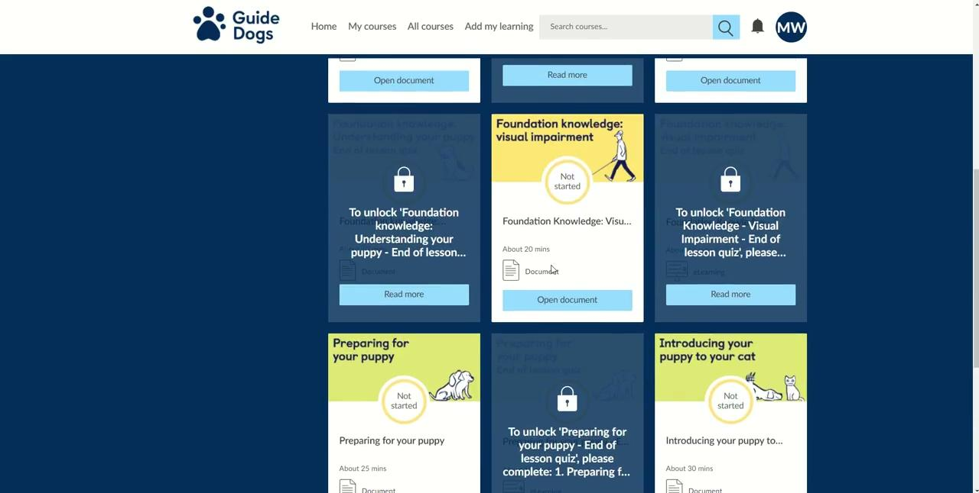
So, what does Kallidus look like? Here’s a short demonstration

Slide 36
There’s now a wealth of information and resources available on Kallidus for Puppy Raisers
The benefits of using Kallidus for raising puppies:
Receive the latest information.
A flexible and accessible approach to learning.
Focused resources that provide person-centred learning.
Tracked learning, enabling relevant and timely support.
Video support available (step-by-step) alongside guidance.

Slide 37
Exploring how we can better nurture our volunteering community

Slide 38
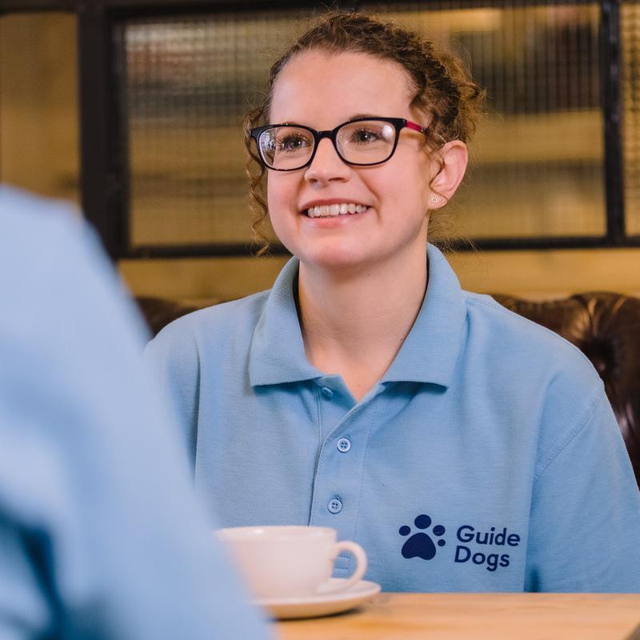
To help bring volunteers closer, we’re developing a more nurturing, supportive and community-based way of volunteering
Our community hub pilot is looking at how to:
Create a volunteer-centric and volunteer-led style of volunteering.
Create closer links between volunteers, staff support and volunteer-led services.

Slide 39
Our community hub pilot is exploring how to improve the volunteer experience and the use of technology between volunteers
Develop and improve our range of volunteering opportunities.
Provide different ways to get involved with us.
Improve our support and recognition of volunteers.
Test direct communications between volunteers by using Microsoft Teams.

Slide 40
Questions and Comments

Slide 41
Thank you for joining us today!
Details of the next Guide Dogs Futures webinar will be published on the Volunteer Information Point and in The Guide e-newsletter.
Any questions?
Email: GuideDogsFutures@guidedogs.org.uk
Document Ends.

