Slide 1
Raising puppies
Guide Dogs Futures webinar series
18 February 2021
Hosted by: Damion Afflick
Panellists: Jessica Stubbens, Gavin Miles, Kat Gunn, Becky Hunt

Slide 2
Welcome to Guide Dogs Futures: Raising puppies
We’ll cover:
The world of sight loss, right now
Types of services available for people with sight loss
The common theme for support services
How we’ll better support volunteers and their pups
Introducing ‘Ethos’
Coming soon: Puppy Raising for Excellent Partnerships
Taking care of puppies
Born to Guide
Q&A
Close and thank you

Slide 3
The world of sight loss, right now

Slide 4
Sight loss can affect anyone, at anytime
Every six minutes in the UK, one more person loses their sight
Every day, 250 more people join the 2 million already living with sight loss
And this number is set to double by 2050

Slide 5
Having a visual impairment is on a huge and varied spectrum
There are over 2 million people living with sight loss. Here are the main causes of their sight loss:
39% Uncorrected refractive error
23% Age-related macular degeneration
19% Cataract
7% Glaucoma
5% Diabetic eye disease

Slide 6
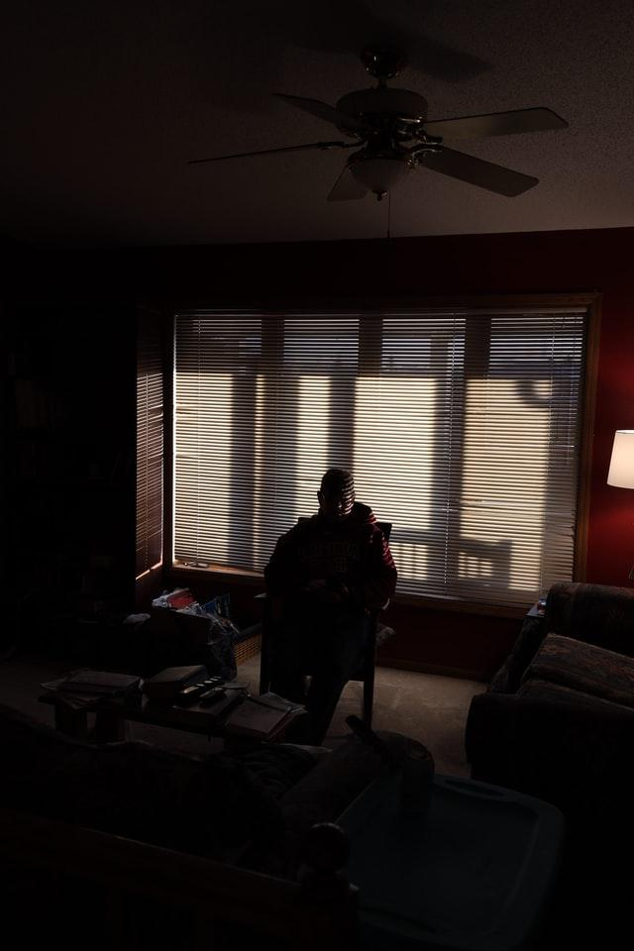
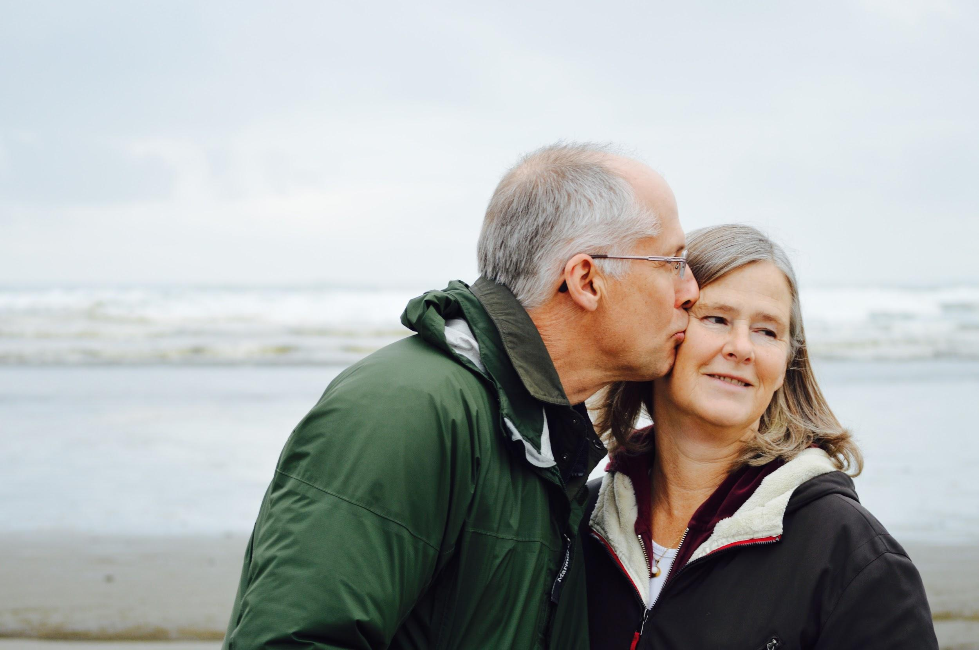
Everyone’s sight loss journey is different, including their support needs

Slide 7
Today, the impact of COVID-19 on people with sight loss has led to increased inactivity, isolation and loneliness
Our research shows that isolation and social distancing on people with a vision impairment results in lower levels of ‘activity’ during COVID-19:
84% are “much less” active in terms of mobility.
62% experienced reduced activity related to work, study and volunteering.
60% experienced reduced exercise, hobbies and other activities.

Slide 8
So, what type of services are available for people with sight loss?

Slide 9
In the last 50 years, sight loss support services have grown in response to the wide-ranging needs of people with a visual impairment
Isolation
Independence
Reading materials
Information & advice
Mobility skills
Digital inclusion
Support groups
Entertainment
Reasonable adjustments
Emotional support
Mental health & wellbeing
Assistive technology

Slide 10
RNIB: from accessible reading formats to multi-media services

Slide 11
Thomas Pocklington Trust now supports blind and partially sighted people to live in their communities and to pursue the same opportunities in education and employment
Moved from being a specialist housing provider to an organisation that supports and empowers blind and partially sighted people of all ages to live the life they want to lead.

Slide 12
Founded in 1987, the Macular Society offers a growing list of services to support its service users
Advice and Information service
Counselling
local support groups
Working age and young people
Patient information
Telephone befriending
Treatment buddies
Skills for Seeing
Access to treatment
Genetic support service

Slide 13
What’s the common theme?

Slide 14
In recognition of people’s various support needs, sight loss organisations have diversified their services and improved the ‘customer’ experience
Person-centred approach
Options for different services
Accessible information & guidance
Connections or companionship
Ongoing support

Slide 15
At Guide Dogs, we’re here to help as much as we can

Slide 16
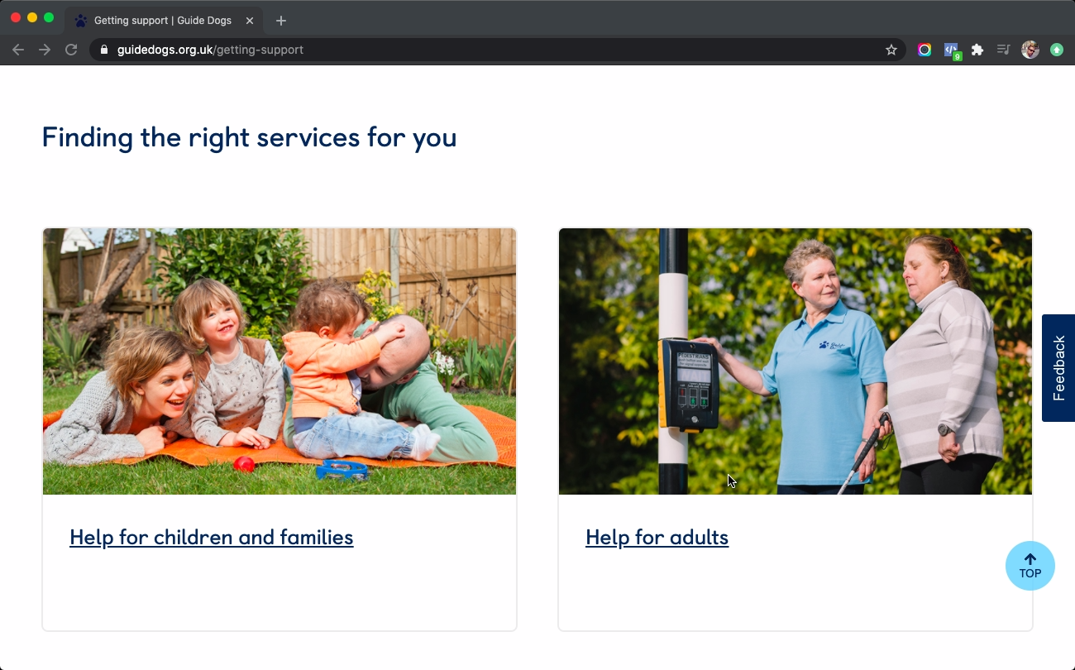
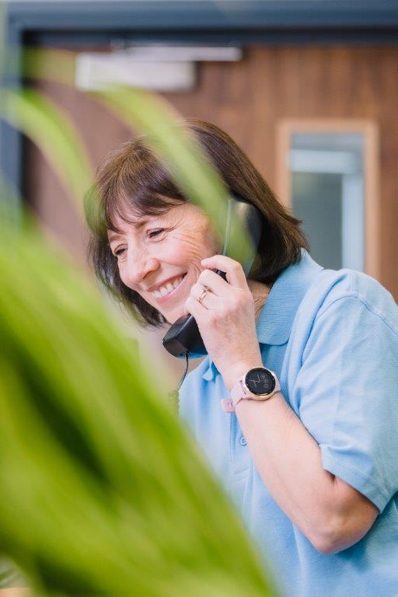
We’ve been helping people with sight loss for nearly 90 years

Slide 17
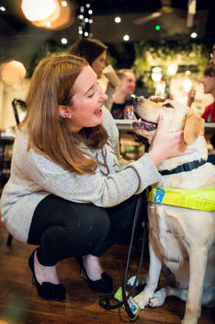
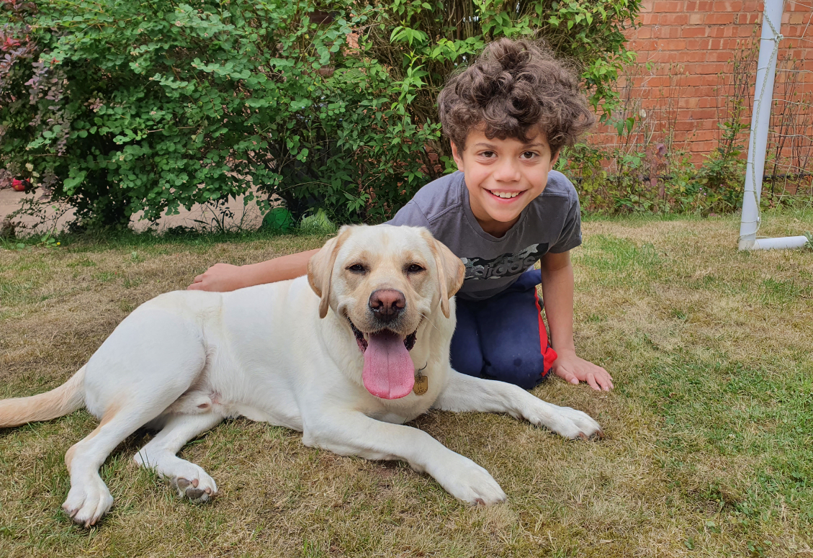
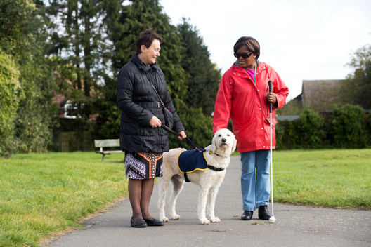
Our guide, buddy and companion dogs help adults and children with sight loss in different ways

Slide 18
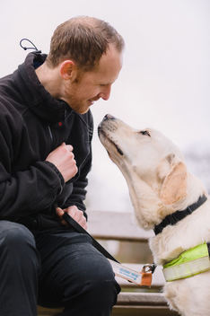
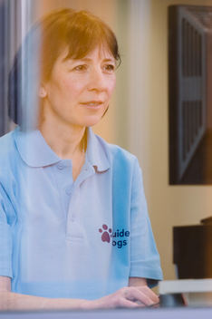
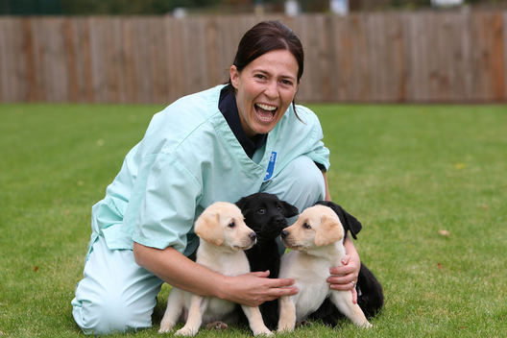
To better support our dogs life-changing journeys, we’re making improvements to how we — staff and volunteers — raise our puppies

Slide 19
Introducing ‘Ethos’

Slide 20
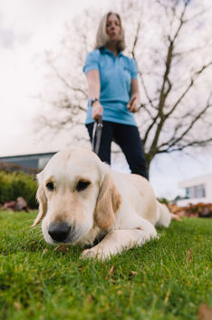
What is Ethos?
A new bespoke dog behaviour monitoring system.
Designed to meet Guide Dogs needs and maximise dog wellbeing.
Ensuring we capture accurate and timely behaviour data to support our dogs along their life-changing journeys.
To support all our canine services – guide dogs, breeding dogs, buddy and companion dogs and adopted dogs.

Slide 21
How will Ethos affect me as a volunteer?
Guide Dogs value the input of all our volunteers that raise and look after the dogs in our programme.
We are therefore asking Puppy Raisers, Fosterers and Breeding Dog Holders to complete behaviour questionnaires at set time points along a dog’s journey.
This information is vital to the work we do, and we really need your help!

Slide 22
Coming soon: ‘Puppy Raising for Excellent Partnerships’

Slide 23
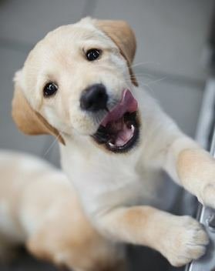
Puppy Raising for Excellent Partnerships (PREP)
our new standard way to raise our puppies.
PREP treats every pup as an individual.
Investment in our puppies, staff and volunteers.

Slide 24
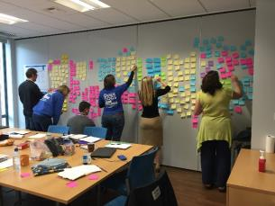
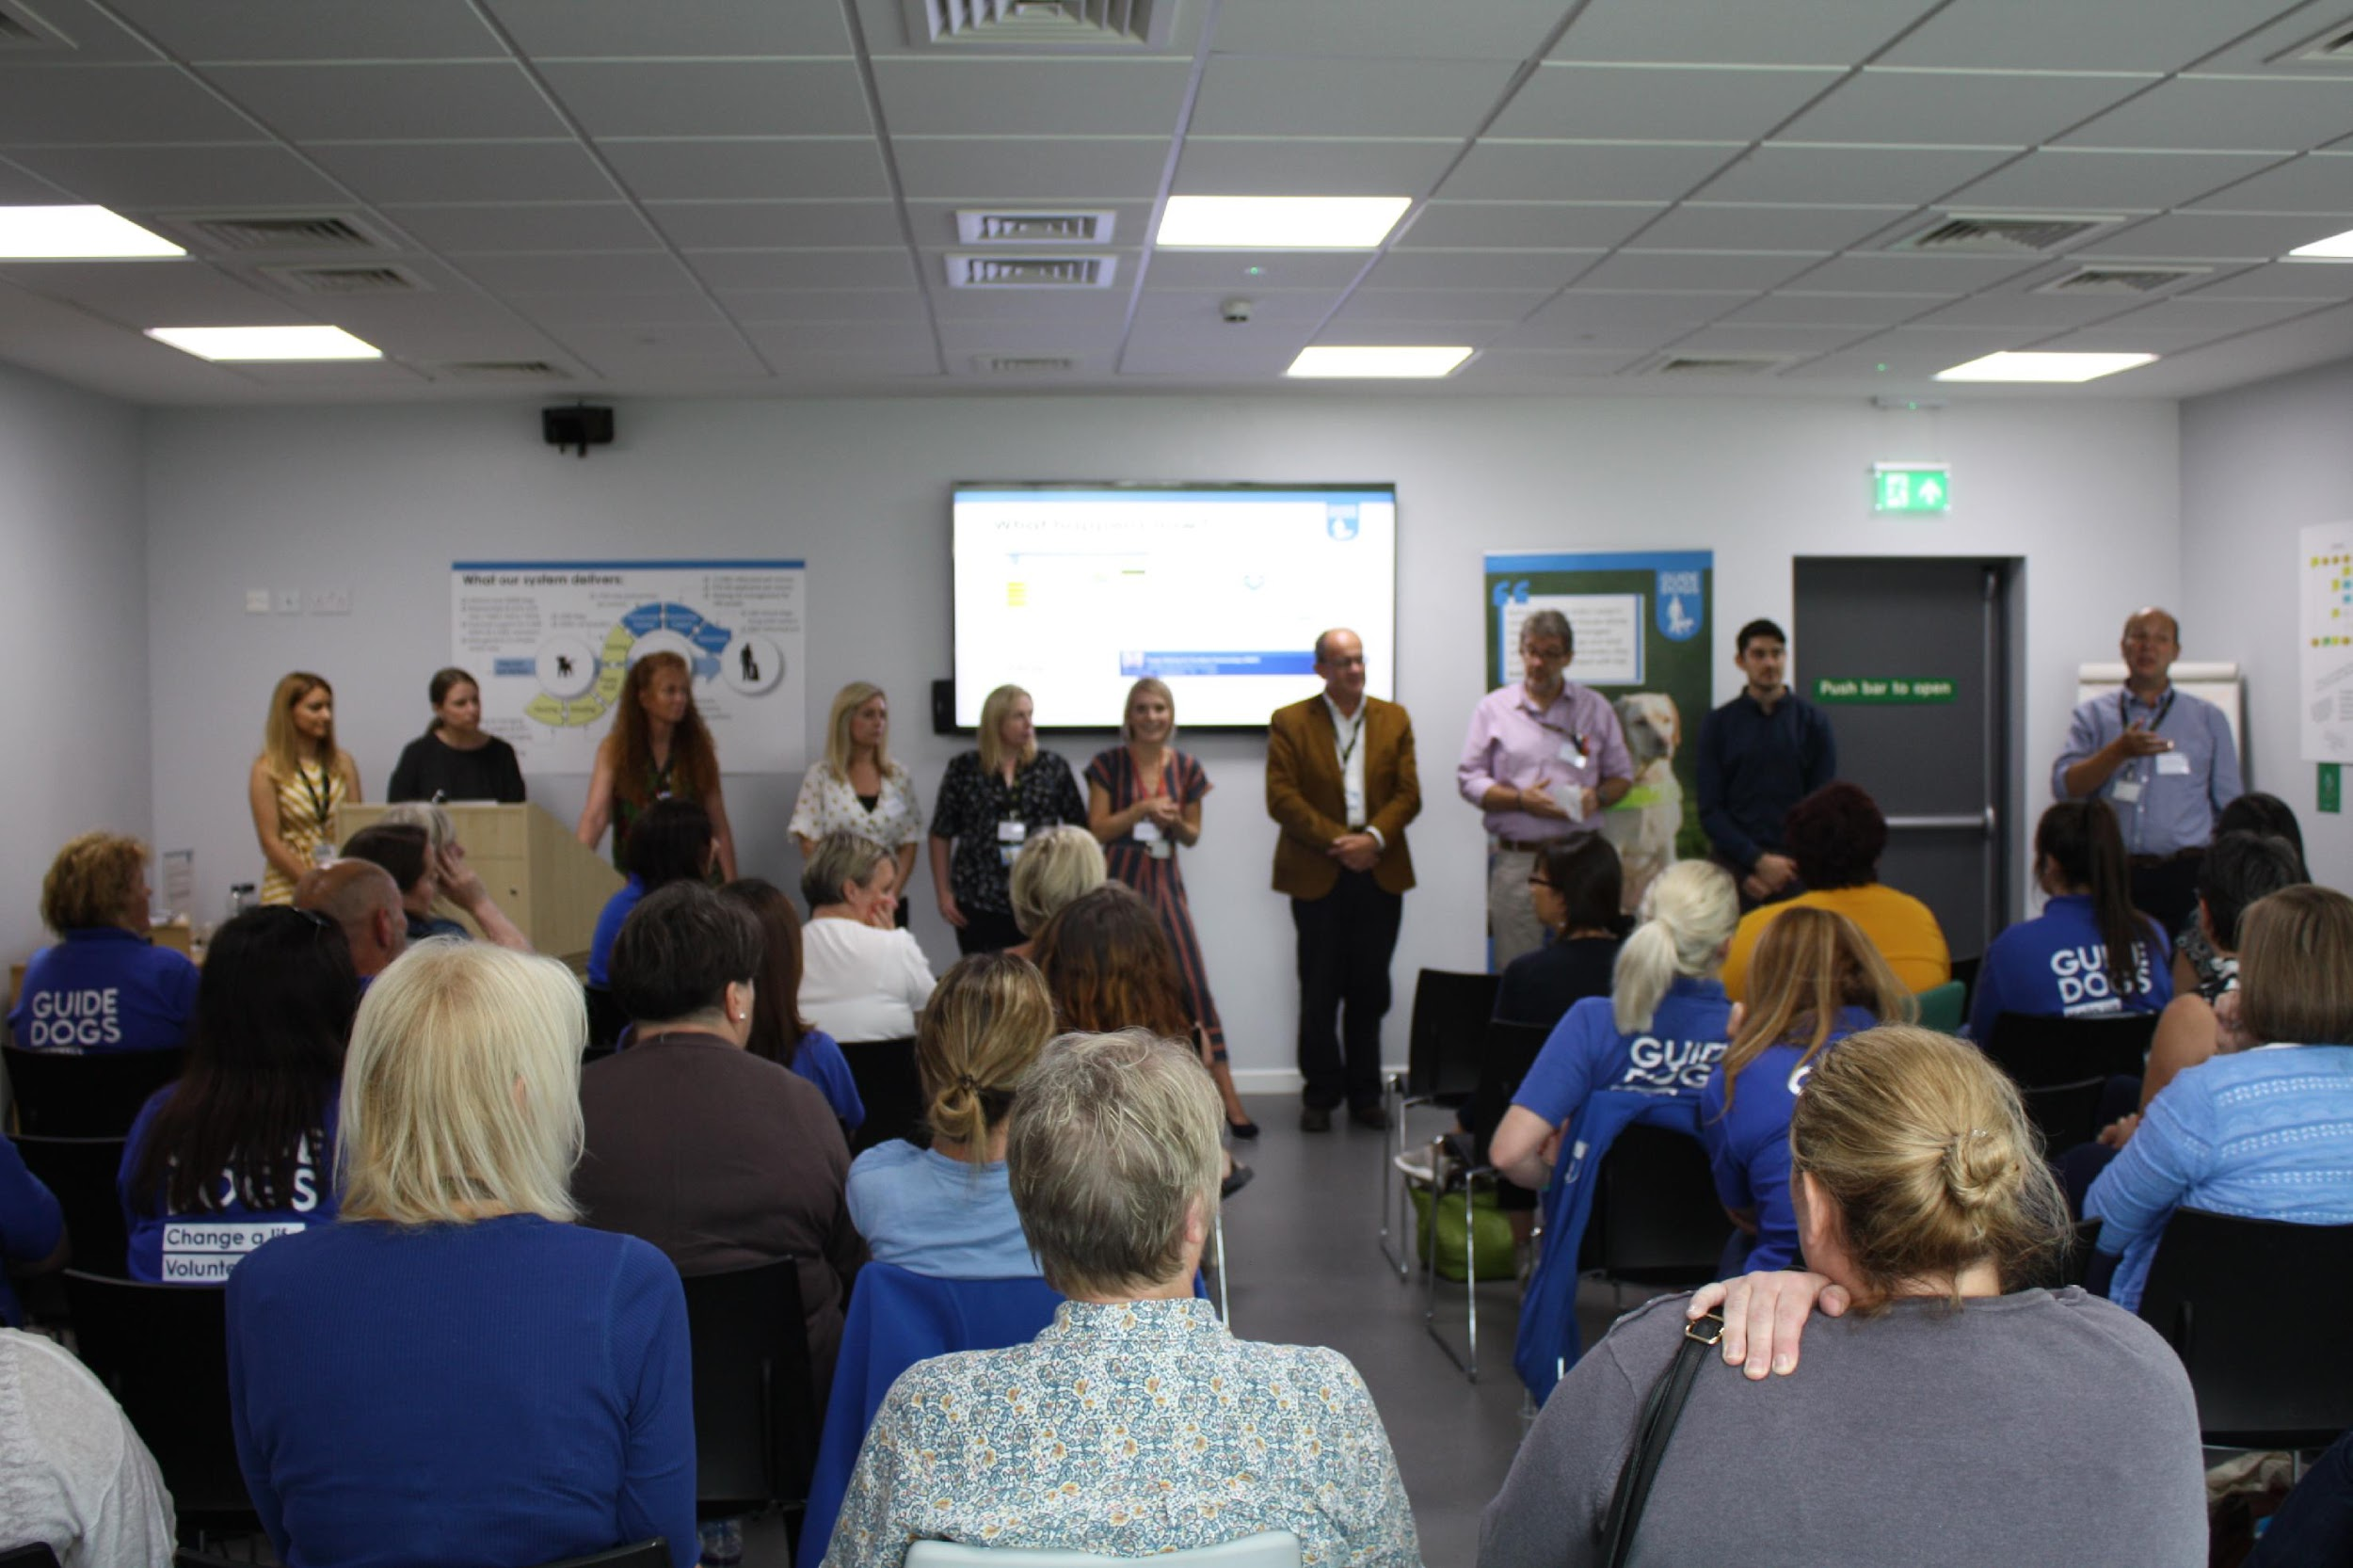
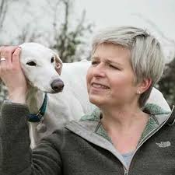
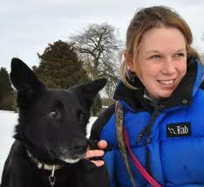
It’s informed by research and developed by people who know about raising puppies - subject matter experts, staff and volunteers
Research and focus groups.
External best practice and research.
Staff and volunteer input/engagement.
Subject matter experts

Slide 25
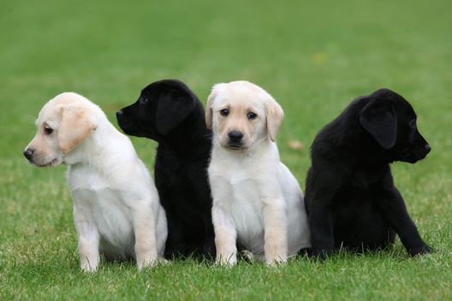
PREP is based on four key principles which bring together new and existing learning and techniques into an easy to follow programme
Knowing your puppy
Managing for success
Teaching foundations
Being a partnership

Slide 26
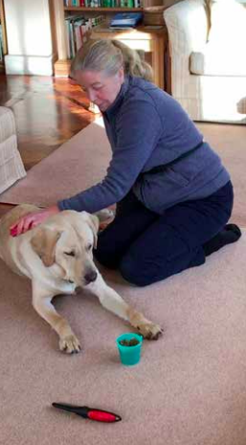
PREP demonstrates how we’re continuing to evolve as an organisation
Recognises that the training methods we use have updated.
Ensures a standardised approach to raising our puppies.
Places us at the forefront of puppy development.
Provides a framework for continuous improvement.
An investment in professional development for our staff and volunteers.

Slide 27
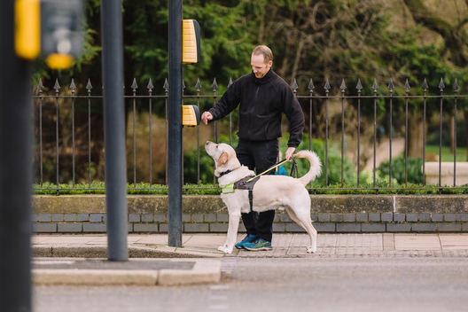
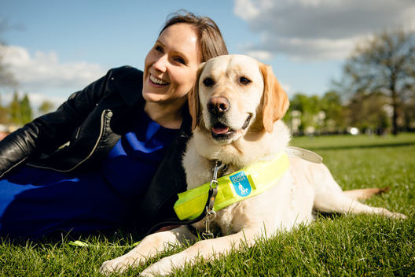
And how we’re better preparing our pups for any life-changing role that they’re naturally suited for
Meets the needs of our Guide Dog partners.
Improves the supply chain process.
Aligns with Standardised Training for Excellent Partnerships (STEP) and incorporates the needs of Buddy and Companion Dog services within the programme.

Slide 28
From July 2021, we’ll begin introducing PREP learning modules to volunteers
PREP is set to become our standardised way to raise puppies from July 2021.
Support from Puppy Development Advisors.
New learning tool and process to make it easier and more accessible for volunteers.

Slide 29
Taking care of puppies

Slide 30
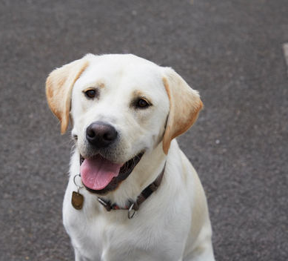
Ensuring good health and wellbeing is central to every pup’s development into an adult dog
Physical
Emotional
Mental

Slide 31
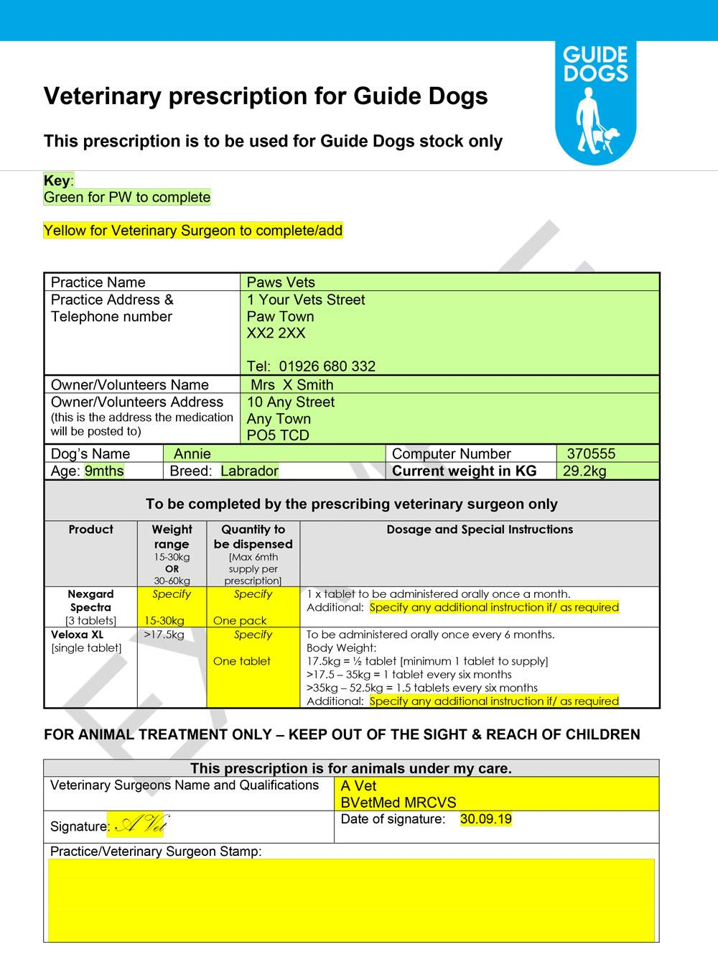
For volunteer Puppy Raisers, there are some newly available dog health and wellbeing resources/processes
New prescription process for dispensing worm and flea treatment.
Volunteers can call Guide Line for help with dog health and wellbeing queries.
Dog health and welfare information, guidance and resources (e.g. podcasts, Alexa) available from our website and Volunteer Information Point.

Slide 32
And when you’re out and about, remember these useful safety tips to keep you and your dog safe
Avoid putting your dog on social media, especially with clues about where you live.
Make sure your garden is secure, your gate is locked and adorned with bells to alert you to someone coming in.
Never leave your dog in the garden unattended.
Never leave your dog unattended in public, or left visible in a car.
Work hard on getting a reliable recall, practice it often, and have this in place before letting your dog off the lead, so you can keep him/her close and away from strangers.
Be wary of people asking information about your dog, particularly if you are alone

Slide 33
Born to Guide

Slide 34
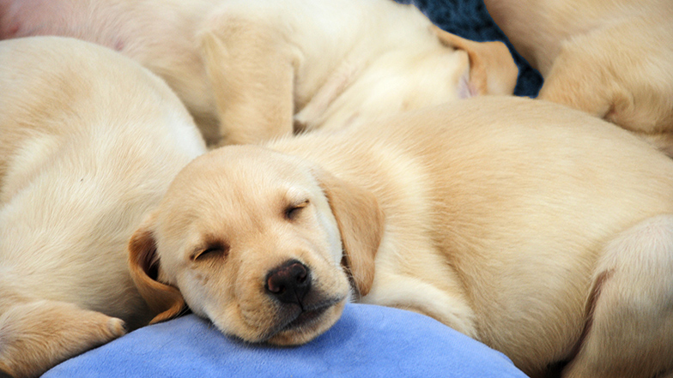
Born to Guide is a pioneering project to help us better understand our dogs’ genes
Born to Guide aims:
To understand the genetic links to complex diseases and behaviour
To create genomic breeding values for our breeding programme to produce more healthy and successful dogs
To share our findings for the wider scientific, academic and dog community

Slide 35
The project and its outcomes will benefit people with sight loss in lots of ways
Born to Guide to help us breed happy, healthy dogs.
Researchers would be able to identify complex relationships between genes, health and behaviour.
The database we create will benefit our breeding programme today and improve the health of generations of guide dogs to come.

Slide 36
Our aim is to collect DNA from 3,000 of our puppies using saliva swabs
The Born to Guide project involves:
Extracting the DNA via whole genome sequencing = really good quality DNA data for each dog
Developing and use artificial intelligence (AI) and powerful computing techniques to explore and analyse the dogs’ genetic data alongside the health and behaviour data
Seeking external funding for the project
Long term (6+ year) project

Slide 37
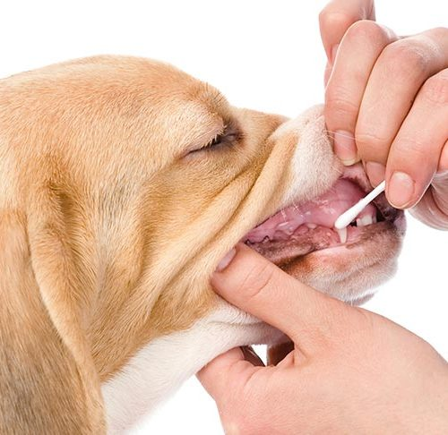
For this project to work, we’ll need our volunteer Puppy Raisers to swab and send
Puppy raisers will be asked to take a saliva swab when their puppy is five months or older.
Instructions and all the kit you will need is provided by Guide Dogs.
Any questions please contact borntoguide@guidedogs.org.uk.

Slide 38
Comments and questions

Slide 39
Use the Q&A function to ask questions

Slide 40
Thank you for joining us today!
Details of the next Guide Dogs Futures webinar will be published on the Volunteer Information Point and in The Guide e-newsletter.
Any questions? GuideDogsFutures@guidedogs.org.uk
Document Ends.

