Slide 1
Midlands regional round-up
News and information from your teams
7 May 2021
Hosted by: Colin Vince – Regional Head - Midlands
Panellists: Graham Kensett, Head of Canine Assisted Services | Sarah McNulty, Head of Skills Information & Support Services | Matt Bottomley, Head of Breeding | Rachel Smith, CAS Operations Manager | Sara McIver, Training & Behaviour Consultant

Slide 2
Welcome to Midlands regional round-up
We’ll cover:
Welcome and introductions
COVID-19 roadmap activities update, including what it means for different volunteering roles
Guide Dogs 90th anniversary
Latest news and developments in Volunteering
Community Fundraising
Puppy raising
Dog health, wellbeing and safety
Puppy Raising for Excellent Partnerships: the four principles
Q&A
Close and thank you

Slide 3
COVID-19 roadmap activities update

Slide 4
Over the last year, COVID-19 has impacted upon our operations, services and volunteering
Furloughed staff and remote working
Some volunteer roles and activities were either paused or adapted
Breeding programme – paused breeding / then restarted
Puppy schemes – were paused and we supported Puppy raisers virtually
Guide dog training – paused but restarted with Covid protocols after lockdown 1

Slide 5
During this time, we’ve adapted to new ways of working and used some of this learning to get back on track and deliver services
Keeping in touch calls with My Sighted Guide partners
Set up COVID-19 information line, now called Guide Line
Virtual volunteer support, puppy classes and fundraising
Virtual buddy dogs and My Time To Play sessions
Investing in technical staff
2021 Annual Plan

Slide 6
As restrictions continue to ease, we’ll gradually reopen sites and restart all our services and volunteering
Our intention to fully recommence all services and volunteering by around mid-June
A recap on our interim phase which started in mid-April
My Sighted Guide service
Guide dogs service (training and partnerships), including bringing down waiting list/times
Puppy raising and breeding programme
Premises update
Staff and volunteer recruitment

Slide 7
In the Midlands region, some COVID-secure protocols remain in place for volunteering activities
This depends on your role and site, but in general many roles continue:
My Sighted Guide
Drivers
Puppy Raisers
Fosterers
Dog Exercisers
Breeding Dog Holders
Fundraisers
We’ll share this information in full afterwards and when circumstances change.

Slide 8
For now, COVID-secure protocols remain in place for staff and volunteers visiting our sites in Birmingham, Nottingham, Regional Centre, NBC
We have workplace operating levels limiting our numbers to sites and allocated space. Sites will remain having social distancing protocols
Most essential breeding operations, Dog Health and Well-being and CAS staff are now on site working to Covid secure protocols – other visits by staff are by booking only. A high percentage of staff remaining working from home

Slide 9
Before we move onto the other updates, here’s some of the reasons why our volunteers support us

Slide 10
Our 90th anniversary

Slide 11
Last month, we kicked off our 90th anniversary with a film about a Puppy Raiser and their puppy ‘Flash’

Slide 12
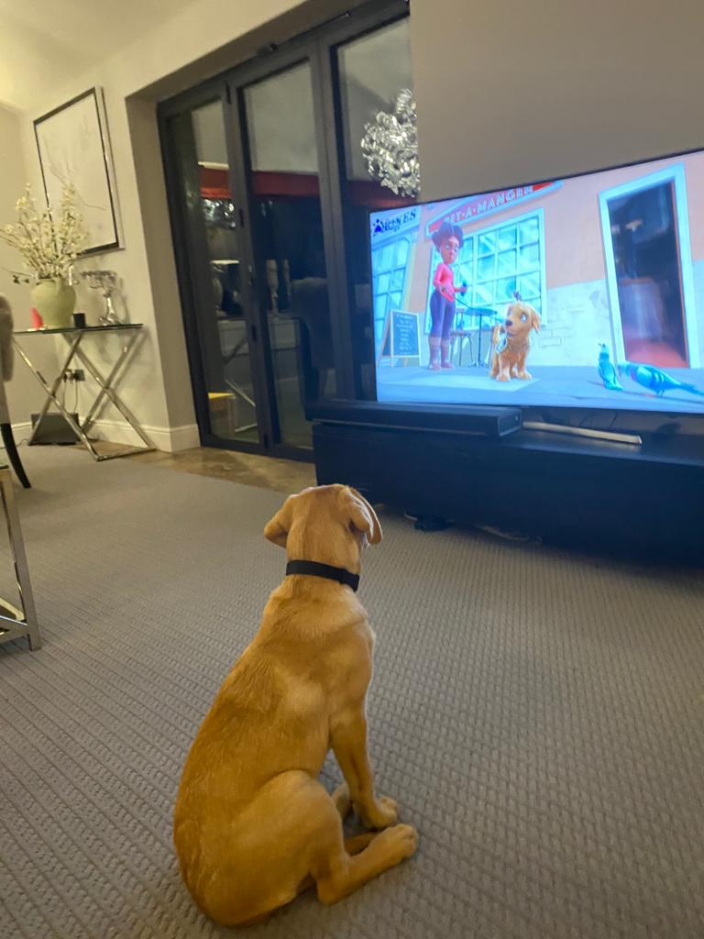
Since Flash hit our screens, dogs all over have been watching with excitement
#MeetFlash

Slide 13
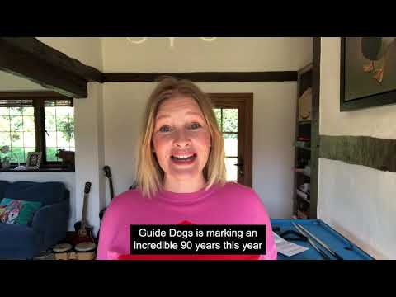
Actress and Guide Dogs supporter Joanna Page recorded voice to a special Flash recording and message for volunteers

Slide 14
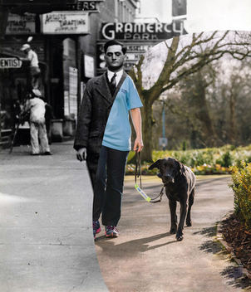
There’s more activities planned for the year, but we also want to hear your ideas too
Email your ideas and stories to GD90@guidedogs.org.uk

Slide 15
Latest developments in volunteering

Slide 16
We’re exploring what a more community-based style of volunteering would look like at Guide Dogs
Our pilots are looking at how:
A standardised, volunteer-centric and multifunctional volunteering model could work.
We think it could hep to:
Reduce ‘silos’ amongst volunteers.
Improve the volunteer experience.
Support volunteer fundraisers to grow and diversify their fundraising.

Slide 17
Volunteer insight shapes our future, so it’s now easier to share feedback and get involved in areas that interest you
Volunteer Impact Assessment.
‘Pulse’ survey results - headlines and next steps.
Volunteer Voices, including workstreams and vacancies.

Slide 18
Community Fundraising

Slide 19
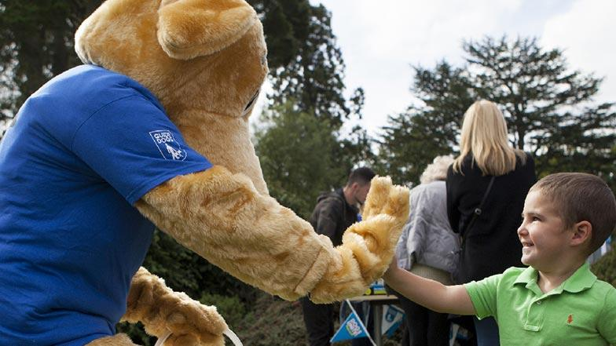
As we restart community fundraising activities, here’s what you need to know
86% of our fundraising volunteers are ready and keen to start fundraising again
Permitted activities include: Emptying of collection boxes, banking, collections, distance selling, Name a Puppy visits, cheque presentations and merchandise stalls, speaking engagements and pop up shops.
Guidance Document for all activities
Community Fundraising Supporter Care 0345 143 0234

Slide 20
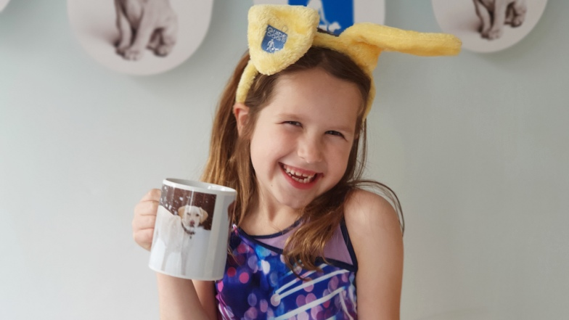
The recent Great Guide Dogs Tea Party was a great success with more fundraising activities coming up
Looking back
Great Guide Dogs Tea Party
Mansfield Chad’s 60th anniversary
Looking ahead
Guide Dogs Appeal (October)
Donate an Hour (December)
Queensgate Shopping Centre

Slide 21
Raising puppies

Slide 22
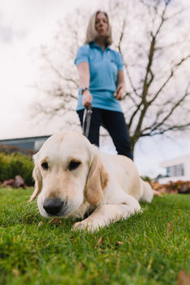
We’ve made a few small but important changes to how we raise and support our puppies’ development
Change in neutering policy
Ethos
new data collection points
Puppy Behaviour Questionnaire (at five months) to puppy raisers.
The Dog Behaviour Questionnaire (to fosterers and breeding dog holders)

Slide 23
Dog health, wellbeing and safety

Slide 24
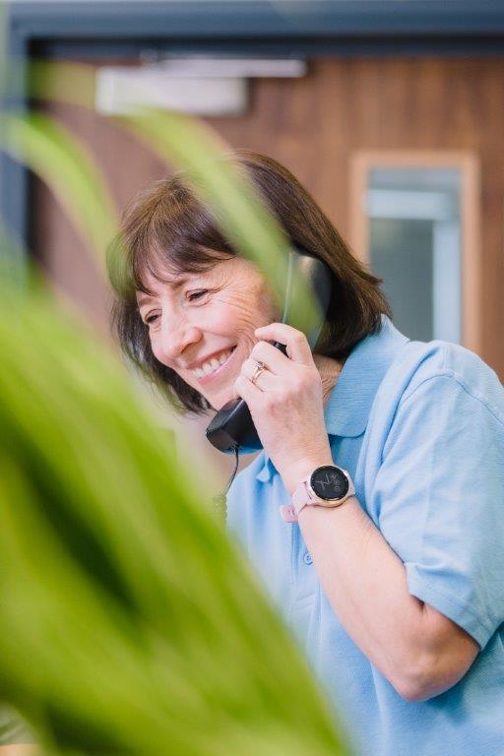
You can call Guide Line to get help on dog health and wellbeing issues from a dedicated member of staff
Guide Line covers four areas:
Adult services.
Children and Young People services.
Dog health.
General enquiries.
Call Guide Line on 0800 781 1444.

Slide 25
And when you’re out and about, remember these useful safety tips to keep you and your dog safe
Avoid putting your dog on social media, especially with clues about where you live.
Make sure your garden is secure, your gate is locked and adorned with bells to alert you to someone coming in.
Never leave your dog in the garden unattended.
Never leave your dog unattended in public, or left visible in a car.
Work hard on getting a reliable recall, practice it often, and have this in place before letting your dog off the lead, so you can keep him/her close and away from strangers.
Be wary of people asking information about your dog, particularly if you are alone

Slide 26
Puppy Raising for Excellent Partnerships: the four principles

Slide 27
To recap, PREP is our new standard way of raising puppies and will be gradually introduced to Puppy Raisers from July 2021
An investment in professional development for our staff and volunteers
Provides a standardised framework
Puppy and person-centred approach
Easier access to resources and advice
Using technology gives the ability to access the latest information
Will still have face to face support/visits

Slide 28
PREP is based on four key principles which bring together new and existing learning and techniques into an easy to follow programme
Knowing your puppy
Managing for success
Teaching foundations
Being a partnership

Slide 29
‘1. Knowing you puppy’ focuses on how to recognise, enhance and nurture your puppy’s development, behaviour and welfare

Slide 30
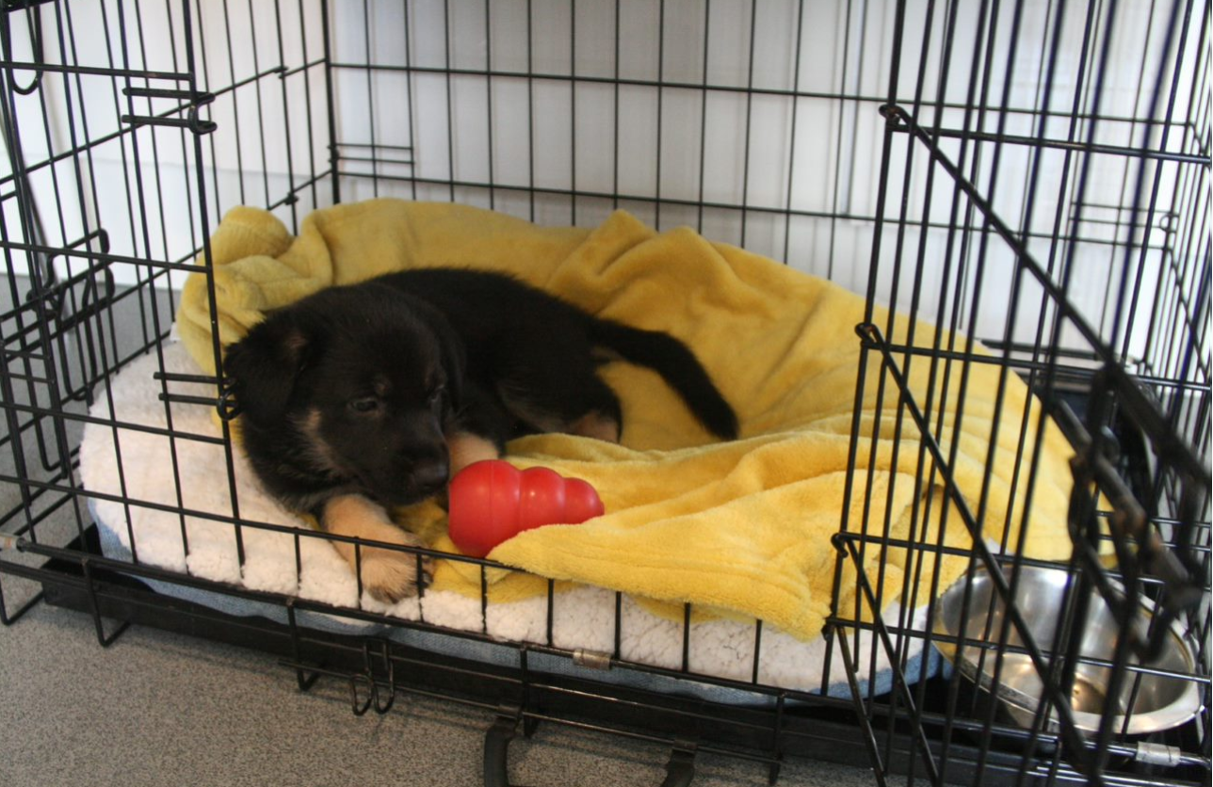
‘2. Managing for success’ focuses on learning how to accurately predict your puppy’s behaviour, problem-solve and adapt to different scenarios

Slide 31
‘3. Teaching foundations’ uses positive reinforcement for desirable behaviour and teaches good habits for future learning

Slide 32
‘4. Being a partnership’ develops a mutual understanding and how to respond to different situations and people

Slide 33
All PREP learning materials, will be available through an easy-to-use online learning system (Kallidus)
Benefits of using Kallidus
Receive the latest information
Focused resources that provide person-centred learning
Tracked learning, enabling relevant and timely support
Video support available (step by step) alongside guidance
Only 7 puppy raisers without an email address
Support available
A flexible and accessible approach to learning
Designated system support (puppy raisers will be provided with an email address where they can send queries)

Slide 34
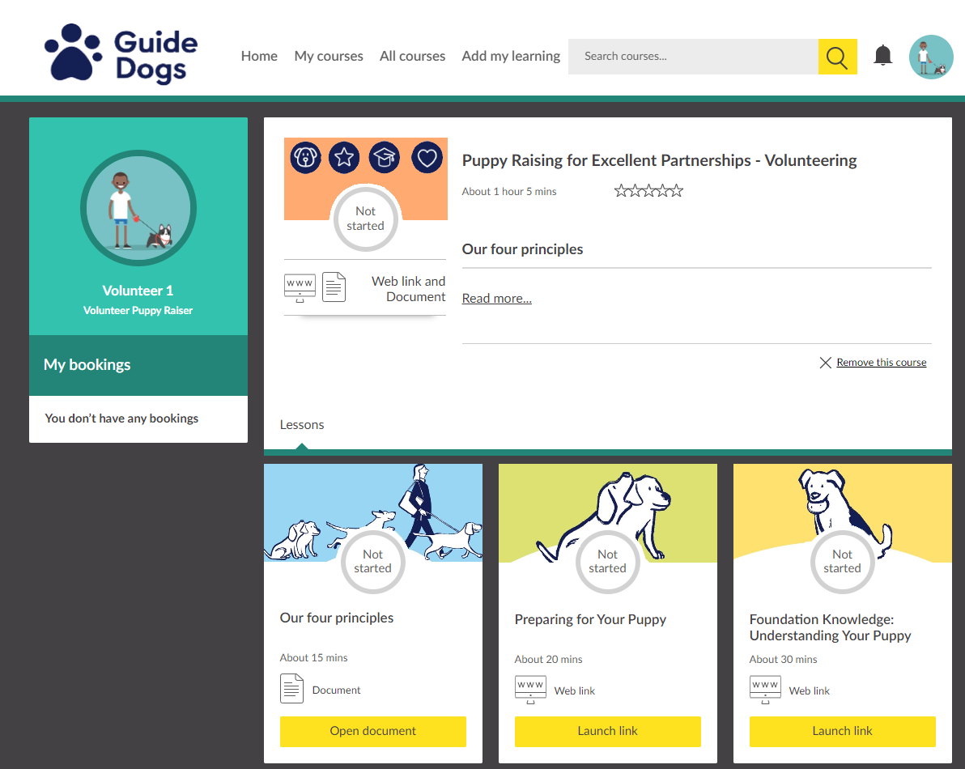
What does Kallidus look like for me?

Slide 35
Ultimately, PREP builds upon how we currently raise our puppies to better prepare them for guide dog training and partnerships
More resources and guidance available to puppy raiser
A puppy and person-centred approach
Meets the needs of our guide dog partners
Improves the supply chain process
Aligns with Standardised Training for Excellent Partnerships (STEP) and incorporates the needs of Buddy and Companion Dog services within the programme.

Slide 36
So, what can Puppy Raisers expect next?
For puppy raisers with a puppy- gradual introduction and ongoing support to PREP content.
From July 1st PREP resources on preparing for and in early days of having a puppy
From August online PREP foundation course
Late 2021 access to Raising your puppy guidance
Late 2021/Early 2022 Updated puppy classes

Slide 37
Comments and questions

Slide 38
Use the Q&A function to ask questions

Slide 39
Thank you for joining us today!
Details of your next regional round-up event will be published on the Volunteer Information Point and in The Guide e-newsletter.
Document Ends.

