Slide 1
Northern Ireland & Scotland
regional round-up
News and information from your teams
10th May 2021
Panellists: Ken Mayes, Maria Rogan,
Tammy Robinson, Emma Murton, Clare Cruttenden,
Gill Flynn & Emily Harvey

Slide 2
Welcome to NI & Scotland Regional Round-up
We’ll cover:
Welcome and introductions
COVID-19 roadmap & activities update
Guide Dogs 90th anniversary
Latest news and developments in Volunteering
Community Fundraising
Puppy raising
Dog health, wellbeing and safety
Puppy Raising for Excellent Partnerships: the four principles
Q&A
Close and thank you

Slide 3
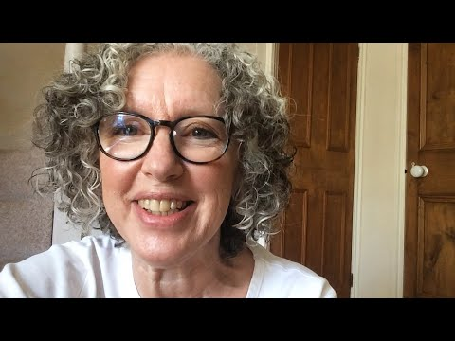
Before we move onto the other updates, here’s some of the reasons why our volunteers support us

Slide 4
COVID-19 roadmap activities update

Slide 5
We have adapted our ways of working to minimalise the impact of COVID-19 upon our operations, services and volunteering
Furloughed staff and remote working
Volunteer roles and activities were paused or adapted
Breeding programme
Guide dog training
Keeping in touch calls with My Sighted Guide partners & waitlist GD
Set up COVID-19 information line, now called Guide Line
Virtual volunteer support
Investing in technical staff

Slide 6
As restrictions continue to ease, we’ll gradually reopen sites and restart our services and volunteering
Our intention to recommence all services and volunteering starting from mid-June, in a staged way, based on government guidelines

Slide 7
Our 90th anniversary

Slide 8
Last month, we kicked off our 90th anniversary with a film about a Puppy Raiser and their puppy ‘Flash’

Slide 9
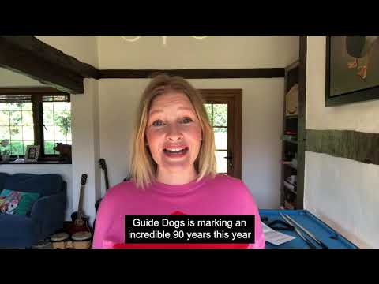
Actress and Guide Dogs supporter Joanna Page recorded voice to a special Flash recording and message for volunteers

Slide 10
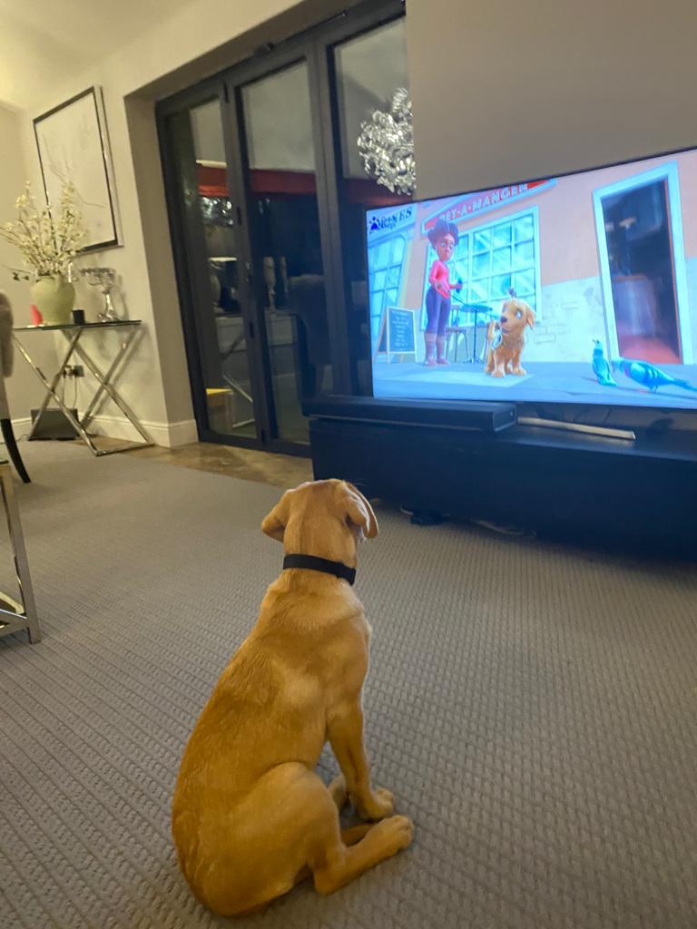
Since Flash hit our screens, dogs all over have been watching with excitement
#MeetFlash

Slide 11
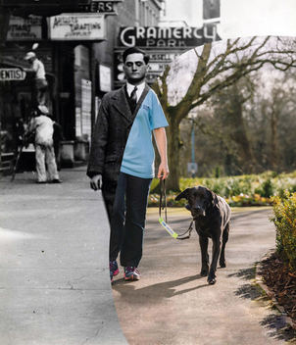
There’s more activities planned for the year, but we also want to hear your ideas too
Email your ideas and stories to GD90@guidedogs.org.uk

Slide 12
Latest developments in volunteering

Slide 13
We’re exploring what a more community-based style of volunteering would look like at Guide Dogs
Our pilots are:
Looking at how a standardised, volunteer-centric and multifunctional volunteering model could work.
We think it could hep to:
Reduce ‘silos’ amongst our volunteers.
Develop and improve the volunteer experience.
Support our volunteer fundraisers to grow and diversify our income streams.

Slide 14
Volunteer insight shapes our future, so it’s now easier to share feedback and get involved in areas that interest you
Volunteer Impact Assessment.
‘Pulse’ survey - headlines and next steps.
Volunteer Voices, including workstreams and vacancies

Slide 15
Community Fundraising

Slide 16
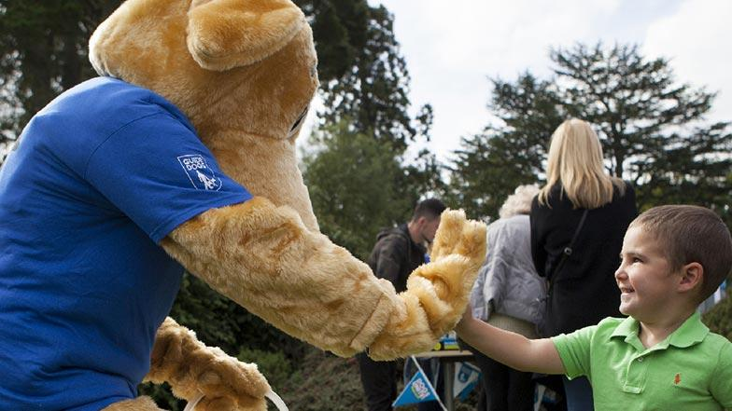
As we restart community fundraising activities, here’s what you need to know
86% of our fundraising volunteers are ready and keen to start fundraising again
Permitted activities include: Emptying of collection boxes, banking, collections, distance selling, Name a Puppy visits, cheque presentations and merchandise stalls, speaking engagements and pop up shops.
Guidance Document for all activities
Community Fundraising Supporter Care 0345 143 0234

Slide 17
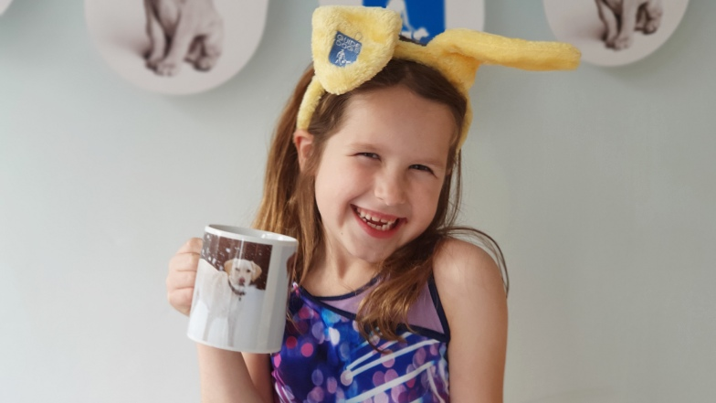
The recent Great Guide Dogs Tea Party was a great success with more fundraising activities coming up
Looking back
Great Guide Dogs Tea Party
Regional Success
Looking ahead
Guide Dogs Appeal throughout October
Donate an Hour December 2021
Regional Horizon

Slide 18
Dog health, wellbeing and safety

Slide 19
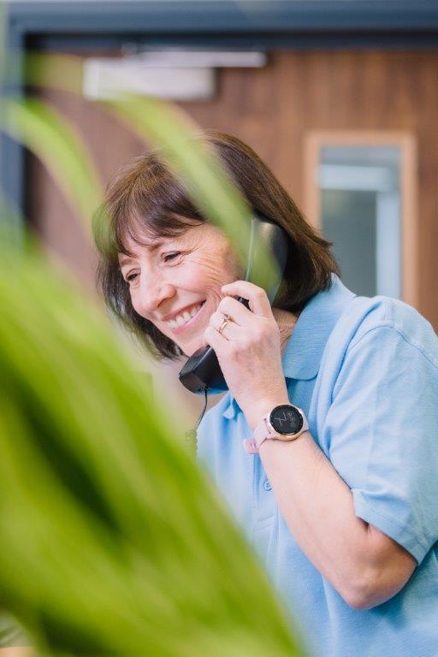
You can call Guide Line to get help on dog health and wellbeing issues from a dedicated member of staff
Guide Line covers four areas:
Adult services.
Children and Young People services.
Dog health.
General enquiries.
Call Guide Line on 0800 781 1444.

Slide 20
And when you’re out and about, remember these useful safety tips to keep you and your dog safe
Avoid putting your dog on social media, especially with clues about where you live.
Make sure your garden is secure, your gate is locked and adorned with bells to alert you to someone coming in.
Never leave your dog in the garden unattended.
Never leave your dog unattended in public, or left visible in a car.
Work hard on getting a reliable recall, practice it often, and have this in place before letting your dog off the lead, so you can keep him/her close and away from strangers.
Be wary of people asking information about your dog, particularly if you are alone

Slide 21
Puppy Raising for Excellent Partnerships: the four principles

Slide 22
To recap, PREP is our new standard way of raising puppies and will be gradually introduced to Puppy Raisers from July 2021
An investment in professional development for our staff and volunteers
Provides a standardised framework
Puppy and person-centred approach
Easier access to resources and advice
Using technology gives the ability to access the latest information
Will still have face to face support/visits

Slide 23
PREP is based on four key principles which bring together new and existing learning and techniques into an easy to follow programme
Knowing your puppy
Managing for success
Teaching foundations
Being a partnership

Slide 24
‘1. Knowing you puppy’ focuses on how to recognise, enhance and nurture your puppy’s development, behaviour and welfare

Slide 25
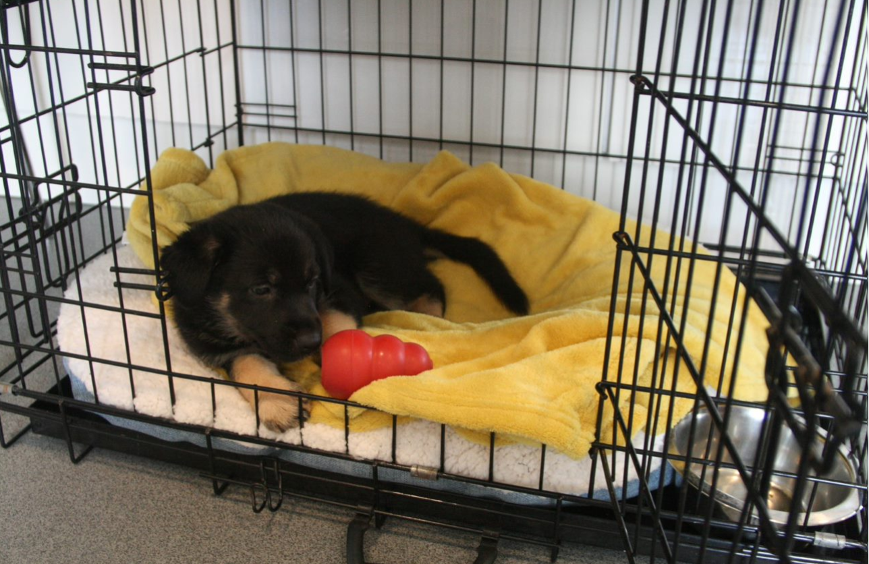
‘2. Managing for success’ focuses on learning how to accurately predict your puppy’s behaviour, problem-solve and adapt to different scenarios

Slide 26
‘3. Teaching foundations’ uses positive reinforcement for desirable behaviour and teaches good habits for future learning

Slide 27
‘4. Being a partnership’ develops a mutual understanding and how to respond to different situations and people

Slide 28
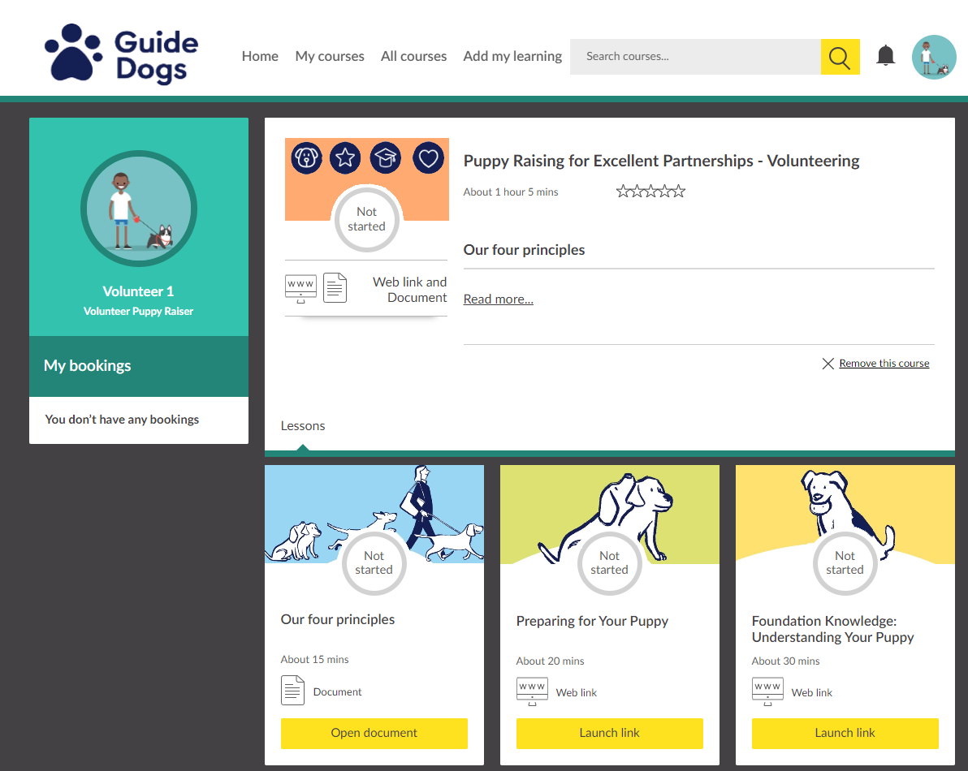
What does Kallidus look like for me?

Slide 29
Ultimately, PREP builds upon how we currently raise our puppies to better prepare them for guide dog training and partnerships
More resources and guidance available to puppy raiser
A puppy and person-centred approach
Meets the needs of our guide dog partners
Improves the supply chain process
Aligns with Standardised Training for Excellent Partnerships (STEP) and incorporates the needs of Buddy and Companion Dog services within the programme.

Slide 30
So, what can Puppy Raisers expect next?
For puppy raisers with a puppy- gradual introduction and ongoing support to PREP content.
From July 1st PREP resources on preparing for and in early days of having a puppy
From August online PREP foundation course
Late 2021 access to Raising your puppy guidance
Late 2021/Early 2022 Updated puppy classes

Slide 31
Comments and questions

Slide 32
Thank you for joining us today!
Details of your next regional round-up event will be published on the Volunteer Information Point and in The Guide e-newsletter.
Document Ends.

