Slide 1
Northern Ireland & Scotland
regional round-up
News and information from your teams
11th August 2021
Hosted by: Ken Mayes
Panellists: Ken Mayes, Emily Harvey, Wendy Kinnin,
Linda Middlemist, Martin Walls, Emma Brown,
Robbie Campbell, Emma Murton

Slide 2
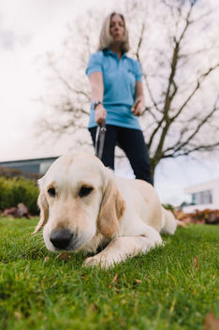
Guide Dogs Service Update
123 pups at walk
56 dogs in training
12 dogs on class at moment
34 partnerships qualified so far
70 planned total partnerships this year
112 people waiting for a dog
55 people coming through application process
9 Buddy dog partnerships this year (40 nationally)

Slide 3
Other Services Update
My Sighted Guide
CYP
My Time to Play
Tech for All
Buddy Dogs

Slide 4
Volunteering Update
Volunteer Expenses
Investors In volunteers
Welcome Days
Volunteer Voices
Community hubs pilot update

Slide 5
Guide Dogs 90 Appeal
Celebrating 90 years of life-changing services this October
The Annual Guide Dogs Appeal is back again this October and is linking with our 90th anniversary celebrations.

Slide 6
What are we doing? We will be working on generating new third party fundraising supporters Testing a Facebook challenge model (Walk 90) Engaging fundraising groups and other supporters to join in with the appeal

Slide 7
90 Themed Fundraisers We are asking people to take on a 90 themed fundraiser such as play 90 minutes of charity football, wash 90 cars, give something up for 90 days, live stream for 90 minutes, hold a Guide Dogs 90 quiz (pack available), dress down at work for 90p or hold a £90 enterprise challenge at school. Anything goes, and we have something for all ages. We will support anyone with whatever their idea, but our three main asks will be:

Slide 8
Walk 90 Raise funds at your own pace by walking 90km throughout the month of October. Don’t forget to set up a Facebook Fundraiser and join our Walk 90 Facebook group. Bake 90
Host a bake sale, offer doorstep delivery, or go all out with your own bake-off challenge. Enter our star baker challenge by uploading a photo of your guide dog bakes using the #GuideDogs90 hashtag. Celebrate 90 90’s rave, 1930’s themed bash, invite 9 or 90 people, host a dinner party, murder mystery, cocktail hour or afternoon tea. Whatever your style, celebrate Guide Dogs 90 your way.

Slide 9
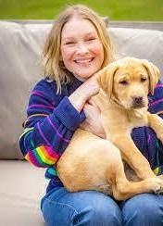
Promotion
We will be working with a range of celebrities on a #GuideDogs90 photos campaign. Look out for it, and feel free to join in with your own photos. Full MarComms toolkit for media and social media will be available. Template content that can be used by staff and volunteers will be available for social media. We will have zoom backgrounds and Facebook profile frames to help promote, and you might like to make use of these when they become available. We will be promoting the campaign in the coming months to generate interest and support. You can help too by spreading the word with your volunteers and service users.

Slide 10
Incentives
Sign up to get a free fundraising pack, full of useful resources to help organise your activities and support you to fundraise. Join the Walk 90 and get a beanie hat and dog bandana to wear with pride during your walk. Individual fundraisers, who choose a different challenge, and bank their fundraising will receive one of our limited edition 90-year pin badges. (T&Cs apply.)
Any group, organisation or school will be eligible to be entered into a prize draw to win an in-person visit from our 90th year puppy – Flash!

Slide 11
How will you do 90 your way? Our Regional Community Fundraising team are currently working on plans for our own 90 themed fundraiser. We will be going into competition with the other regional Community Fundraising teams and we’ll be sure to share our plans with you soon. We’d love for you to join us, with your own Guide Dogs 90 Appeal fundraiser this October, either individually or for even more fun, with your team. Please speak to a member of the Community Fundraising team if you would like more information or some inspiration to get you started.

Slide 12
Academy
New way of recruiting and training our technical canine workforce
Enables more recruits at one time than ever before
Standardises trainee experience with a centralised learning and management focus
We have recruited our Trainee Learning Specialist and Regional Manager and have started our recruitment of trainees.
Potential start dates of Oct/Nov this year

Slide 13
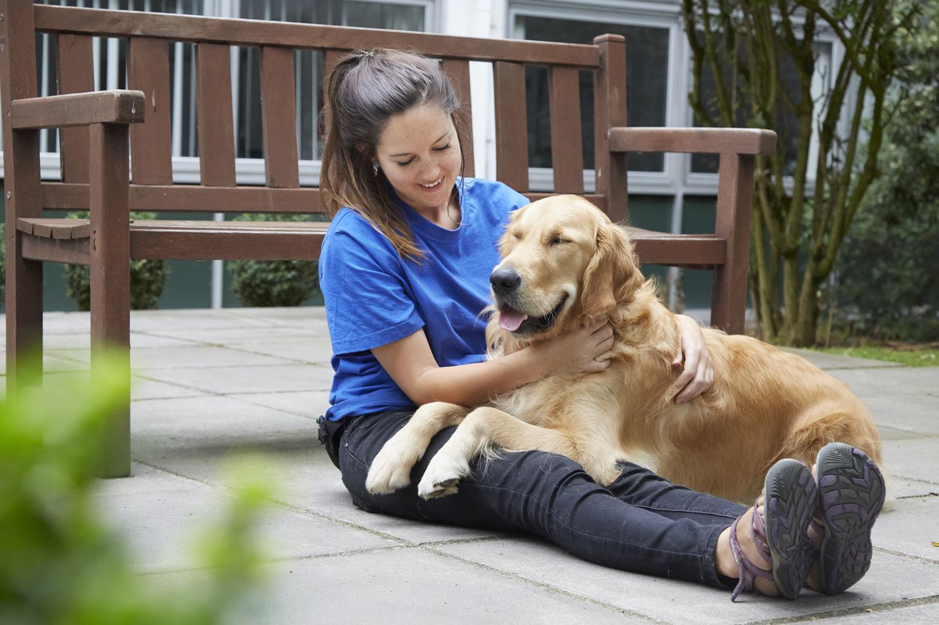
New guidance for dog handlers
The Five Domains Model (Mellor,1994), focuses on each dog having positive experiences in:
Nutrition
Environment
Physical health
Behavioural interactions
Emotional experiences

Slide 14
Here’s some tips based on our five domains
Feeding
Bedding
Choice
Understanding your dog

Slide 15
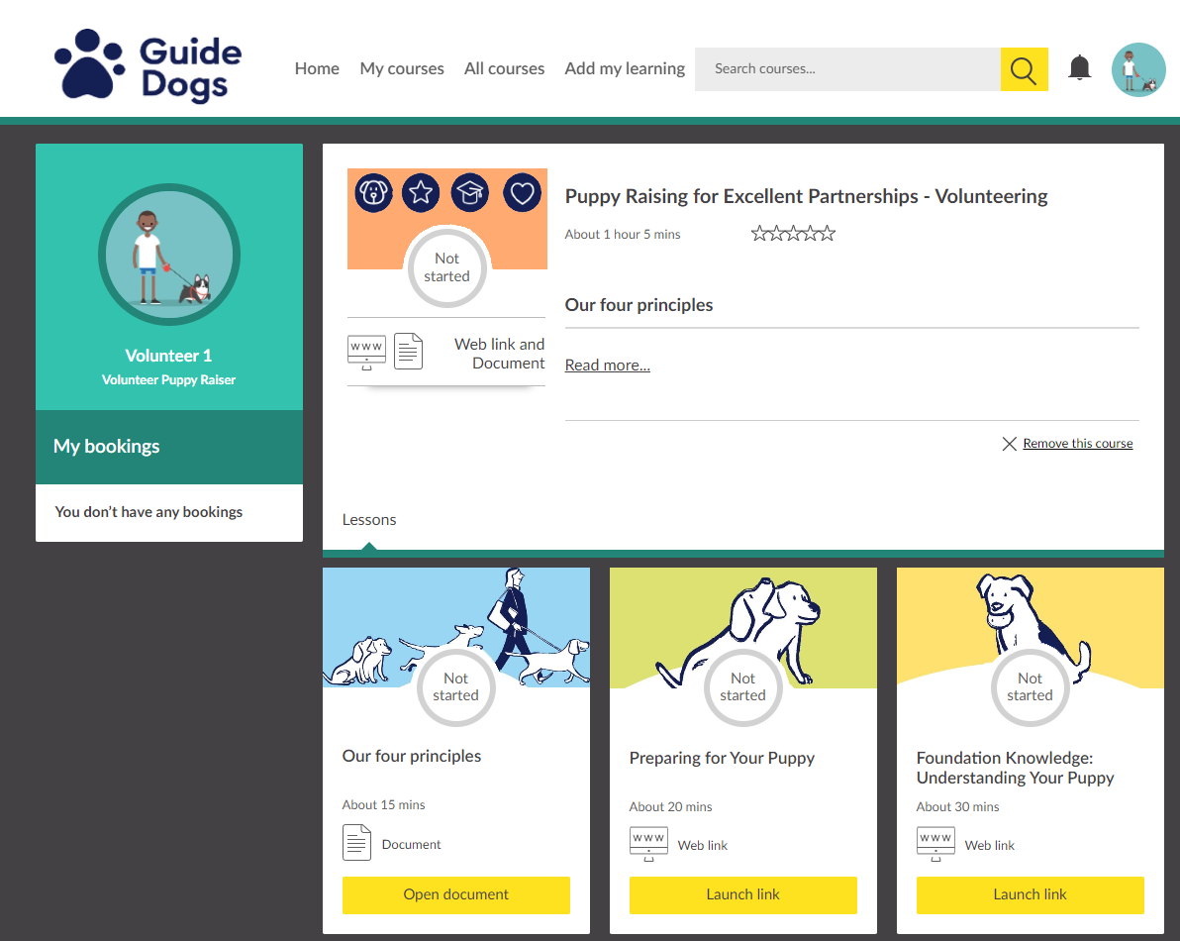
Reminder for our Puppy Raisers

Slide 16
Comments and questions

Slide 17
Thank you for joining us today!
Details of your next regional round-up event will be published on the Volunteer Information Point and in The Guide e-newsletter.
Any questions? Email volunteerscotland@guidedogs.org.uk
Document Ends.

