Slide 1
North East regional round-up
News and information from your team
Panellists: Louise Belsom, Janet Champion, Kris Hirscher, Lucy Prudhoe, Julie Wood
11th August 2021

Slide 2
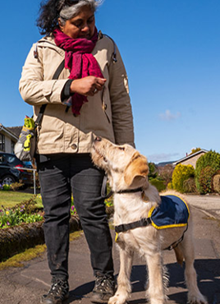
Agenda
Regional headlines
Guide Dogs' 90th anniversary
Media Champions
Skills, Information & Support (SISS) update
Volunteering update
Canine Assisted Services (CAS) update
Fundraising update
Comments and questions

Slide 3
Regional headlines
Staff
Welcome... Helen Foulston, Kristian Hirscher, Linden Cartwright, Alice Cheeseman, Elise Finney, Gemma Lodge-Milburn, Chloe Eckersley, Rebecca Stranney, Lucy Williams, Julie Wood, Emma Hill
Congratulations! Tegan Darby, Caroline Fell and Stuart Taylor
Academy Training & Learning Specialists, Guide Dog Mobility Specialist Learners
Service Delivery
Delivering in person (maintaining a 1m distance, or barrier items within 1m)
Tech for All and Digital Learning programme
Leeds redevelopment
Capital appeal has now launched and we're speaking to large donors about their support (the appeal can be viewed on our website)

Slide 4
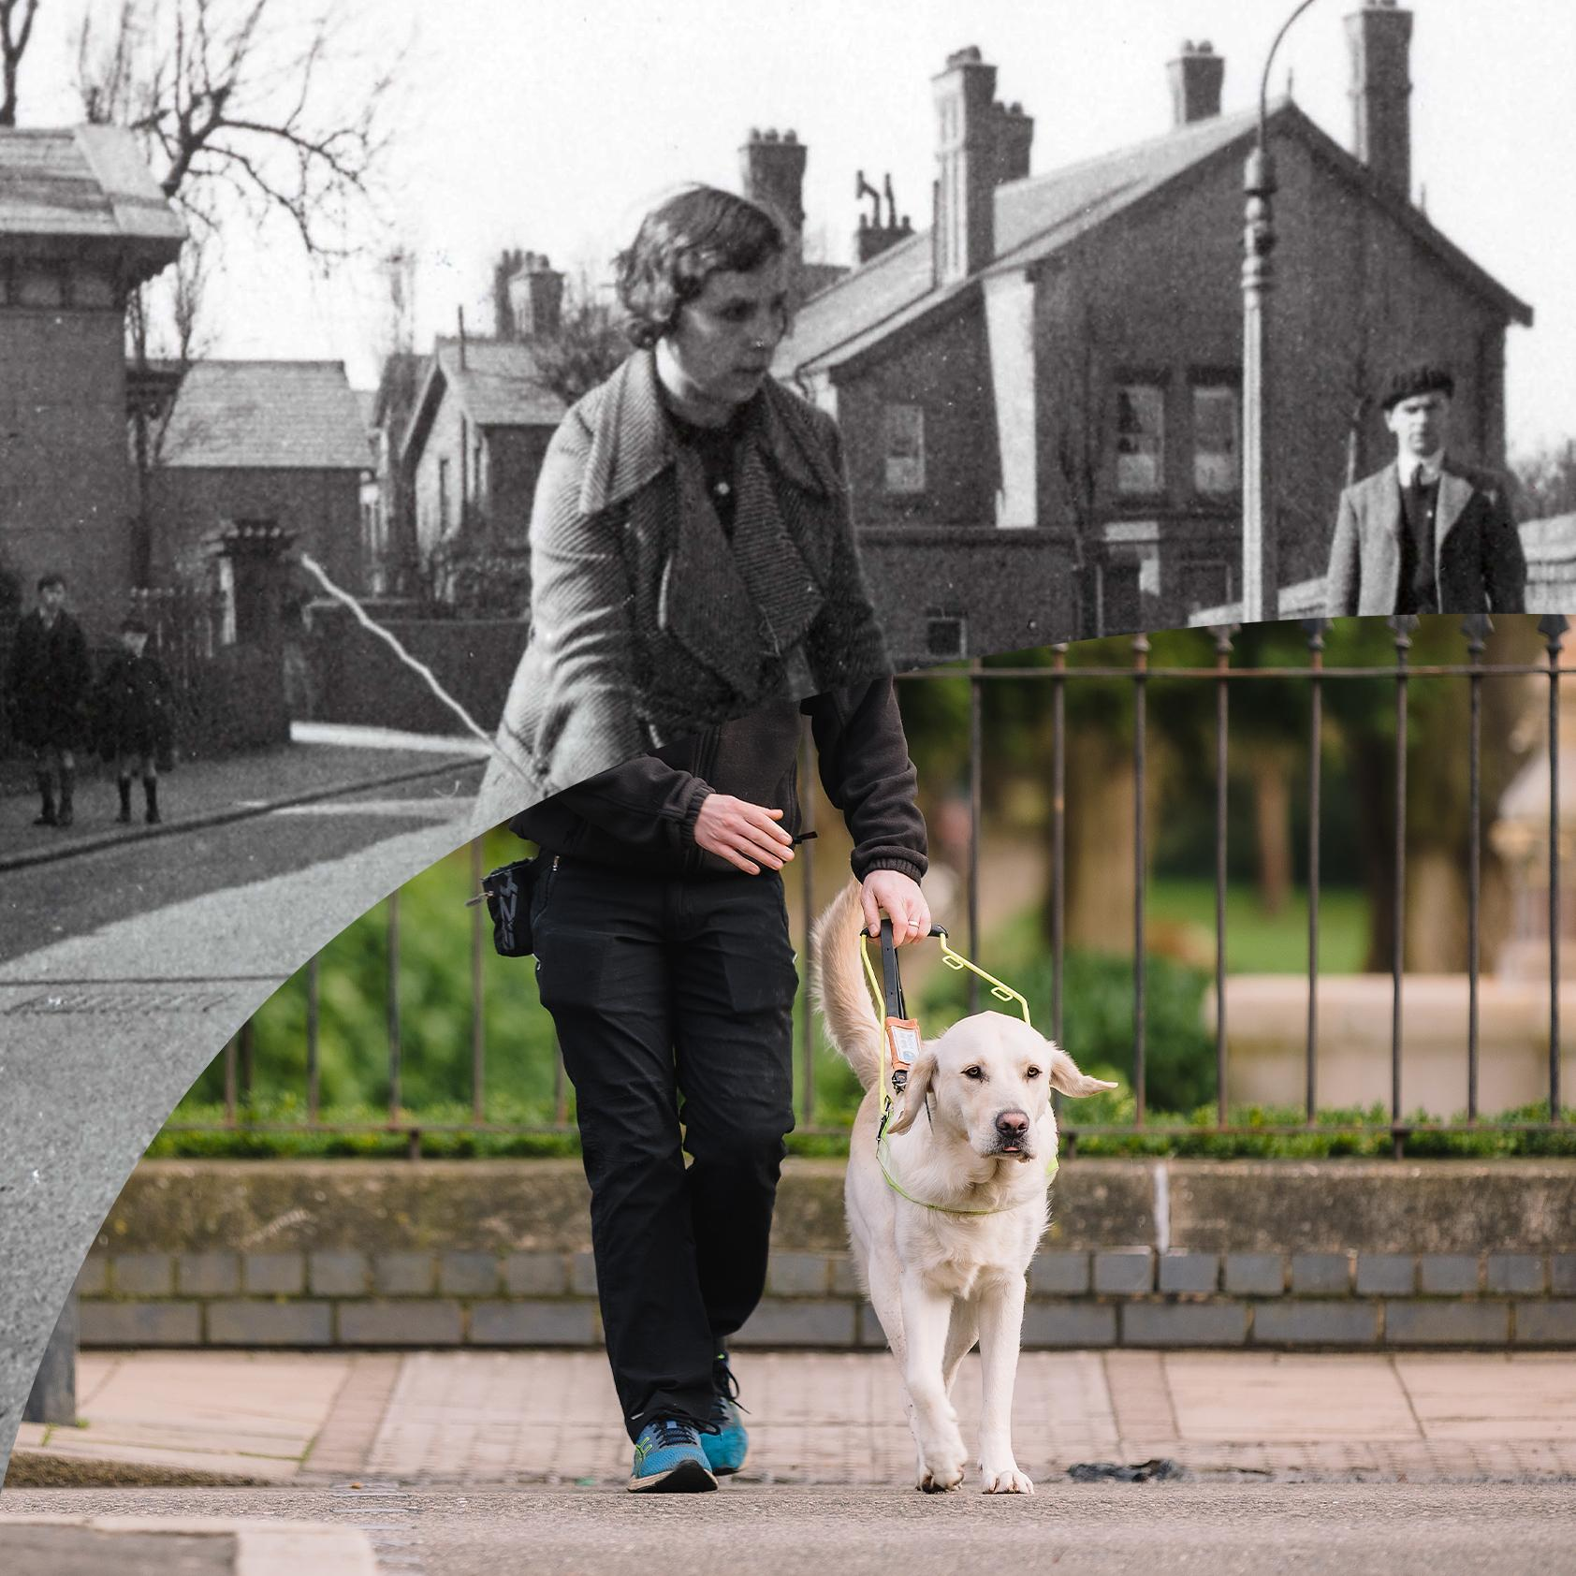
90th Anniversary and Media Champions
Guide Dogs' 90th anniversary
Guide Dogs Appeal
Chelsea Flower Show
Anniversary toolkit
New Media Champions role
To support Regional Marketing & Communications Managers
1-2 per region initially
Support with our 90th birthday appeal

Slide 5
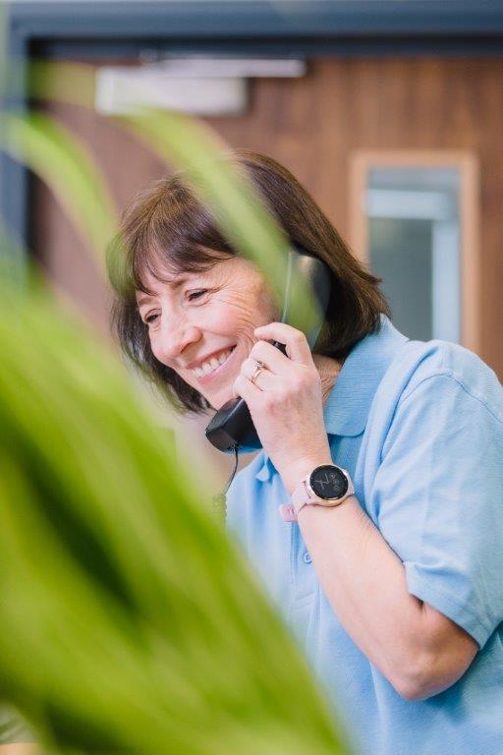
Skills, Information & Support Services (SISS)
Orientation & Mobility
By the end of June, our team had supported 160 interventions, helping people by providing mobility assessments, training plans and second conversations
3 trainee Orientation & Mobility Specialists qualified last month – two in Leeds, one in Newcastle
New trainee joining us in September!

Slide 6
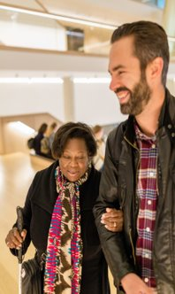
Skills, Information & Support Services (SISS)
My Sighted Guide
51 reinstated partnerships
Refresher training to over 60 volunteers, with more in progress for new volunteers
Friends & Family sessions for 10 people over the last couple of months
Working on a project to improve the volunteer journey, launching in the autumn
Children & Young People
My Time to Play pilots went brilliantly, with in-person programme launching in January
Habilitation Specialist team deliver 11 contracts across the region
Two Trainee Habilitation Specialists join us in September

Slide 7
Volunteering
Community Hubs pilots
Investing in Volunteers
New volunteer expenses form
Regional Welcome Event
Volunteer Voices

Slide 8
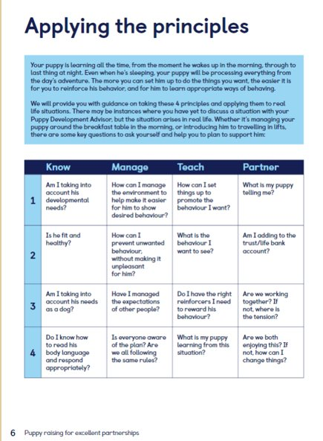
Canine Assisted Services (CAS)
Puppy Raising for Excellent Partnerships (PREP) launched on 1st July 2021.
To recap, the four PREP principles are:
Knowing your puppy
Managing for success
Teaching foundations
Being a partnership
For more information, visit the Volunteer Information Point to watch the 'Guide Dogs Futures: leading the way' webinar recording.

Slide 9
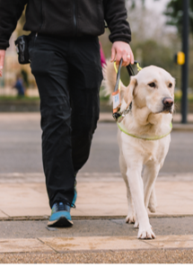
Canine Assisted Services (CAS)
Currently we have 135 people Ready to Train and have qualified 31 partnerships so far this year, with many more lined up!
Working hard to match people who are our longer waiters, including two matches last week (1 Leeds, 1 Newcastle).
80% people matched in less than two years, with an average of 18 months.
Guide Dogs Academy recruitment started in July, and the North East will build our dog training staff numbers significantly.

Slide 10
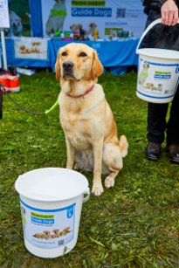
Community Fundraising Activities
We have had 32 activities so far in the North East Region since we have been able to get back out fundraising in the community.
We have a further 52 activities booked in for the rest of the year – and we're increasing these regularly as people are comfortable having us back out fundraising.
If you would like to support your local group, please contact: Community Fundraising Supporter Care 0345 143 0234.
Name a Puppy website up and running with full supporter journey.

Slide 11
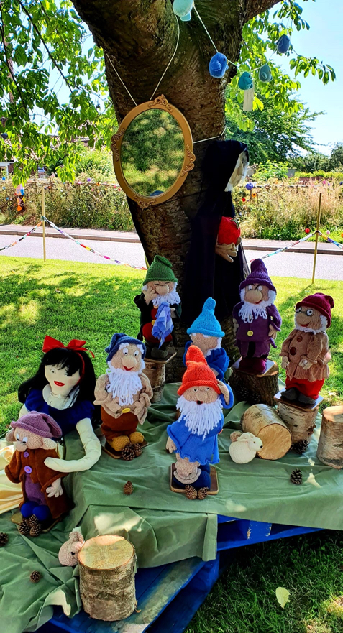
Fundraising - Looking ahead
Guide Dogs appeal throughout October – all about 90th Birthday
Donate an Hour December 2021
Regional Successes
We have brought in an amazing £145,624 so far this year, including £45,000 from Floor and Countertop Boxes
A knitting group in Doncaster raised £4000 from yarn-bombing their village.

Slide 12
Thank you for joining us today!
Details of your next regional event will be published on the Volunteer Information Point and in The Guide e-newsletter.
Email us: regionalroundup@guidedogs.org.uk
Document Ends
Comments and questions – you can use the Q&A function

