Slide 1
North East Regional Update
News and information from your teams
12th May 2021
Panellists: Louise Belsom, Becki Issott, Claire Devine, Paul Bush, Sue Robinson
Notes:
All intro and welcome volunteers

Slide 2
Welcome to the North East Regional Update
We’ll cover:
Welcome and introductions
COVID-19 roadmap & activities update
Guide Dogs 90th anniversary
Latest news and developments in Volunteering
Community Fundraising
Dog health, wellbeing and safety
Puppy Raising for Excellent Partnerships: the four principles
Q&A
Close and thank you

Slide 3
COVID-19 Roadmap:
What's happened and what's coming up...

Slide 4
COVID-19 response
Furlough leave and working remotely
Some volunteer roles and activities were paused or adapted
Breeding programme paused then restarted
Guide dog training paused while we established protocols
Keeping in touch calls
Set up COVID-19 information line, then Guide Line
Virtual volunteer support and online puppy classes
Remote support, including Hab@Home and online second conversations
Lots of professional development and online training!
2021 Annual Plan

Slide 5
What happens next?
Already underway:
Investing in technical staff
My Sighted Guide refresher training and preparing to restart
Guide dogs service training and partnership matches
Puppy raising and breeding programme
Staff and volunteer recruitment
Gradual resumption of face-to-face working
My Time to Play
Up next:
Intend to fully restart all services and volunteering by the end of June – some in new ways
Residential class from the summer
Leeds site

Slide 6
COVID secure working for everyone
Our sites in Hull, Leeds, Newcastle and Sheffield are all COVID-secure, with capacity limits and social distancing protocols.
Most canine staff are working from offices when they need to, with other staff visits booked in advance to ensure we don't have too many people on site.
The offices remain closed to public and volunteers unless booked in advance.

Slide 7
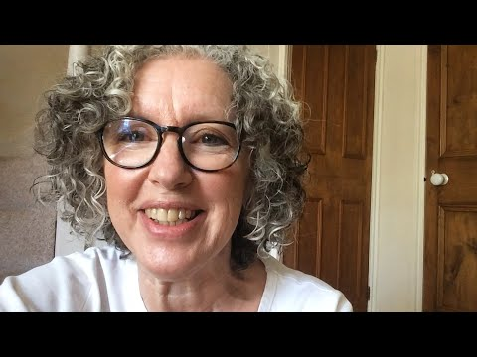
Before we move onto the other updates, here’s a reminder of why we’re all here

Slide 8
Our 90th anniversary

Slide 9
Last month, we kicked off our 90th anniversary with a film about a Puppy Raiser and their puppy ‘Flash’

Slide 10
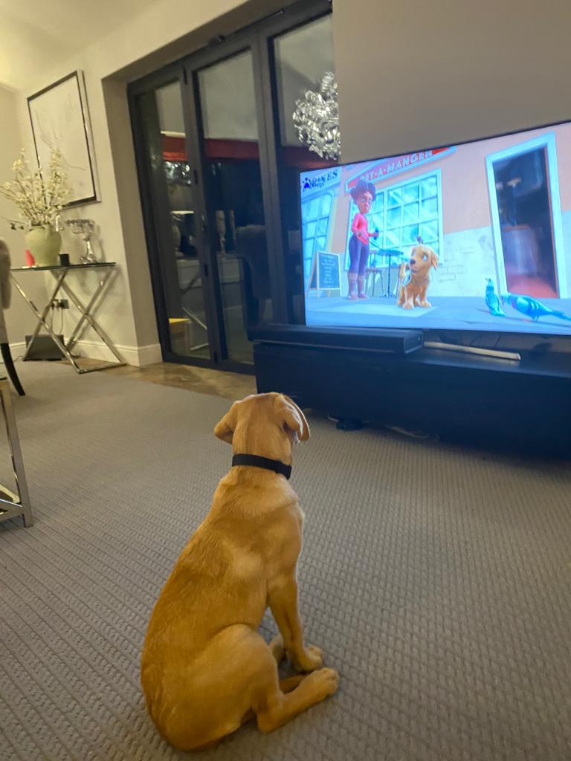
Since Flash hit our screens, dogs all over have been watching with excitement
#MeetFlash

Slide 11
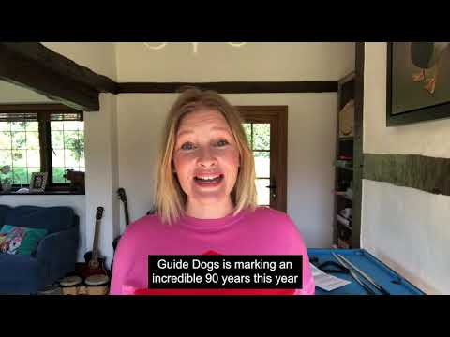
Actress and Guide Dogs supporter Joanna Page recorded voice to a special Flash recording and message for volunteers

Slide 12
More activities planned, but we want to hear your ideas too!
Email your ideas and stories to GD90@guidedogs.org.uk

Slide 13
Latest developments in volunteering

Slide 14
We’re exploring what a more community-based style of volunteering would look like at Guide Dogs
Our pilots are:
Looking at how are volunteer communities can be volunteer led in a way that's the same across teams
Considering how you can support multiple volunteer roles - community
We think it will help to:
Reduce ‘silos’ amongst our volunteers.
Develop and improve the volunteer experience.
Support our volunteer fundraisers to grow and diversify our income streams.

Slide 15
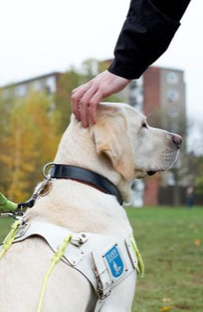
Volunteer insight shapes our future, so it’s now easier to share feedback and get involved in areas that interest you
Volunteer Impact Assessment – closed
‘Pulse’ survey - highlights shared in mailing?
Volunteer Voices, including workstreams and vacancies
And.......our Local Awards. Thank you!

Slide 16
Community Fundraising

Slide 17
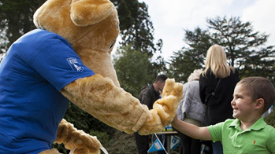
As we restart community fundraising activities, here’s what you need to know
86% of our fundraising volunteers are ready and keen to start fundraising again
Permitted activities include emptying collection boxes, banking, collections, distance selling, Name a Puppy visits, cheque presentations and merchandise stalls, speaking engagements and pop-up shops.
Community Fundraising Supporter Care: 0345 143 0234
Guidance Document for all activities

Slide 18
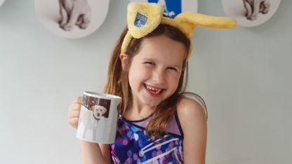
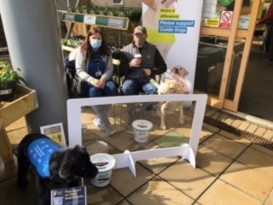
The recent Great Guide Dogs Tea Party was a great success – and there are more fundraising activities coming up
Looking back
Great Guide Dogs Tea Party
Chester Le Street – Garden Centre collection
Looking ahead
Guide Dogs Appeal - October
Donate an Hour - December
Volunteers being back fundraising

Slide 19
Dog health, wellbeing and safety

Slide 20
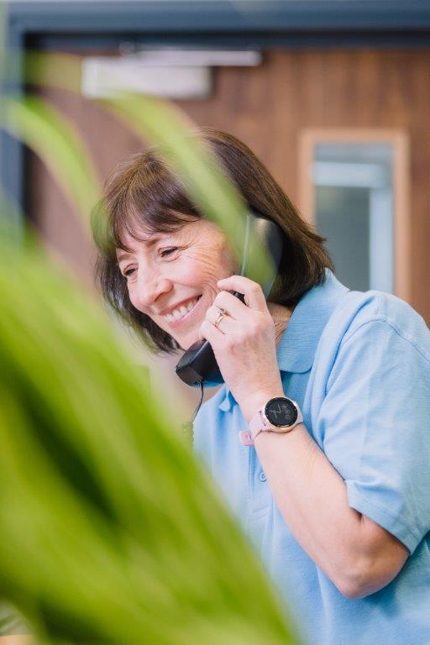
You can call Guide Line to get help on dog health and wellbeing issues from a dedicated member of staff
Guide Line covers four areas:
Adults
Children and Young People
Dog health
General enquiries
Call Guide Line on 0800 7811 444

Slide 21
Useful safety tips to keep you and your dog safe
Avoid putting your dog on social media, especially with clues about where you live.
Make sure your garden is secure, your gate is locked and adorned with bells to alert you to someone coming in.
Never leave your dog in the garden unattended.
Never leave your dog unattended in public, or left visible in a car.
Work hard on getting a reliable recall, practice it often, and have this in place before letting your dog off the lead, so you can keep him/her close and away from strangers.
Be wary of people asking information about your dog, particularly if you are alone

Slide 22
Puppy Raising for Excellent Partnerships: the four principles

Slide 23
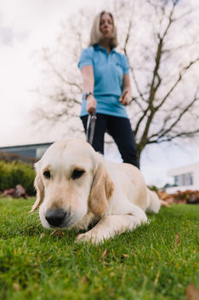
We’ve made some important changes to how we raise and support our puppies’ development
Change in neutering policy
Ethos and new data collection points
Puppy Behaviour Questionnaire (at five months) to puppy raisers.
Dog Behaviour Questionnaire (to fosterers and breeding dog holders)

Slide 24
PREP is our new standard way of raising puppies and will be gradually introduced to Puppy Raisers from July 2021
An investment in professional development for our staff and volunteers
Provides a standardised framework
Puppy and person-centred approach
Easier access to resources and advice
Using technology gives the ability to access the latest information
Will still have face-to-face support or visits, often in groups

Slide 25
PREP is based on four key principles which bring together new and existing learning and techniques into an easy to follow programme
Knowing your puppy
Managing for success
Teaching foundations
Being a partnership

Slide 26
‘1. Knowing your puppy’
focuses on how to recognise, enhance and nurture your puppy’s development, behaviour and welfare

Slide 27
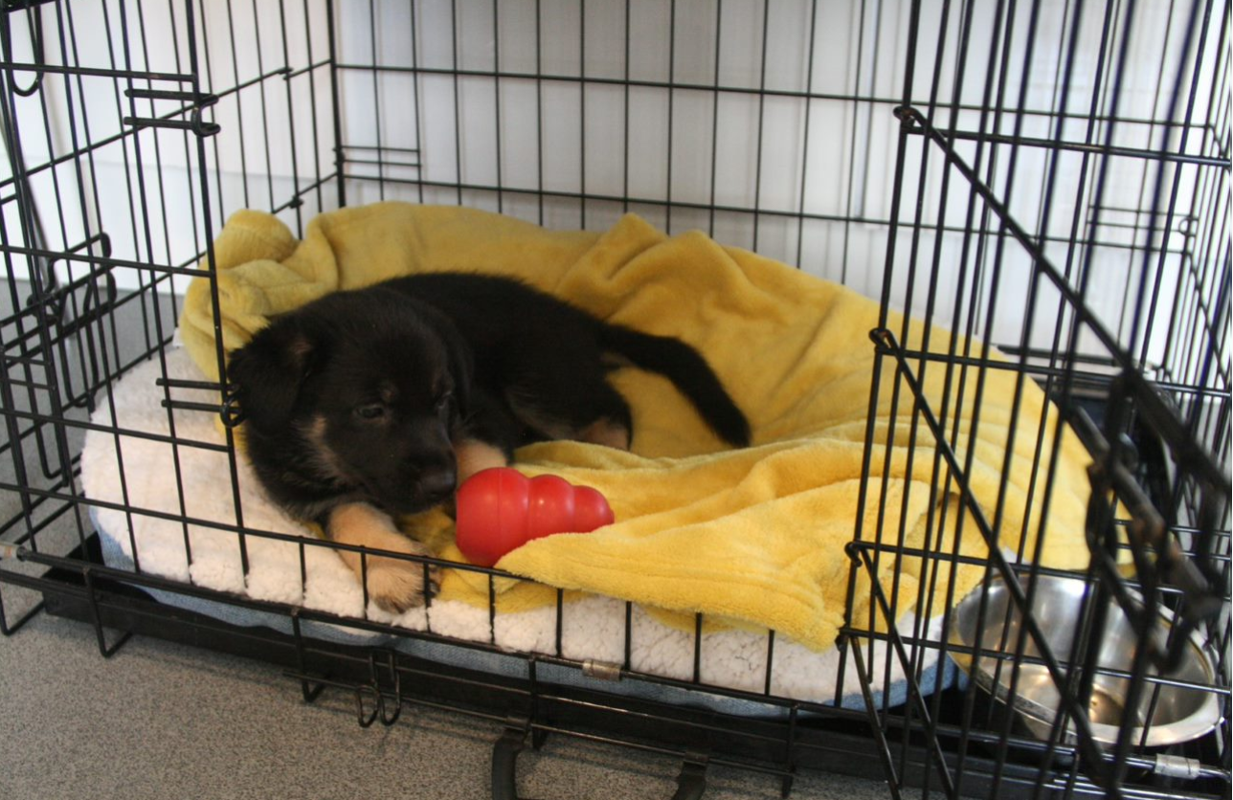
‘2. Managing for success’
focuses on learning how to accurately predict your puppy’s behaviour, problem-solve and adapt to different scenarios

Slide 28
‘3. Teaching foundations’
uses positive reinforcement for desirable behaviour and teaches good habits for future learning

Slide 29
‘4. Being a partnership’
develops a mutual understanding and how to respond to different situations and people

Slide 30
PREP builds on how we currently raise our puppies to better prepare them for guide dog training and partnerships
Aligns with Standardised Training for Excellent Partnerships (STEP)
All PREP learning materials will be available through an easy-to-use online learning system, Kallidus
Kallidus will always have the latest information, person-centred learning resources, and step-by-step video support and guidance.

Slide 32
Thank you for joining us today!
Details of your next regional event will be published on the Volunteer Information Point and in The Guide e-newsletter.
Document Ends
Comments and questions – you can use the Q&A function

