Slide 1
North West regional round-up
News and information from your teams
29 July 2021
Hosted by: Richard Bounds, Deputy Director of Operations
Panellists: Charli Gibson, Janet Harper, Jenny Lloyd, Vanessa Scott, Lucy Michaliszyn

Slide 2
Updates from the North West Region on our Operations, Volunteering and Fundraising Activities
Operations
29 GD Partnerships
Children and Young People
Services for Adults
My Sighted Guide
Puppy Development
Guidance for Dog Handlers
Volunteering
Media Champions
Volunteer Expenses
Changes to the Team
Investors in Volunteers
Welcome Day
Fundraising
Returning to Communities
Looking Ahead
Guide Dogs’ 90th Anniversary

Slide 3
Regional Marcomms (Marketing and Communications) update
Media Champions
A new volunteer role to celebrate your success

Slide 4
Media champions are volunteers who can help identify news stories and share them with media. Training provided.
Got a story to share? You can let your Regional Marcomms manager or your local media champion know (when in post) and together we’ll spread the word!
Recruiting 1 or 2 per region to start with, to be on board in time for our special 90th Birthday Guide Dogs appeal in October. The 90th Birthday Appeal is gaining momentum with lots of media activity and community promotion planned across our very large region

Slide 5
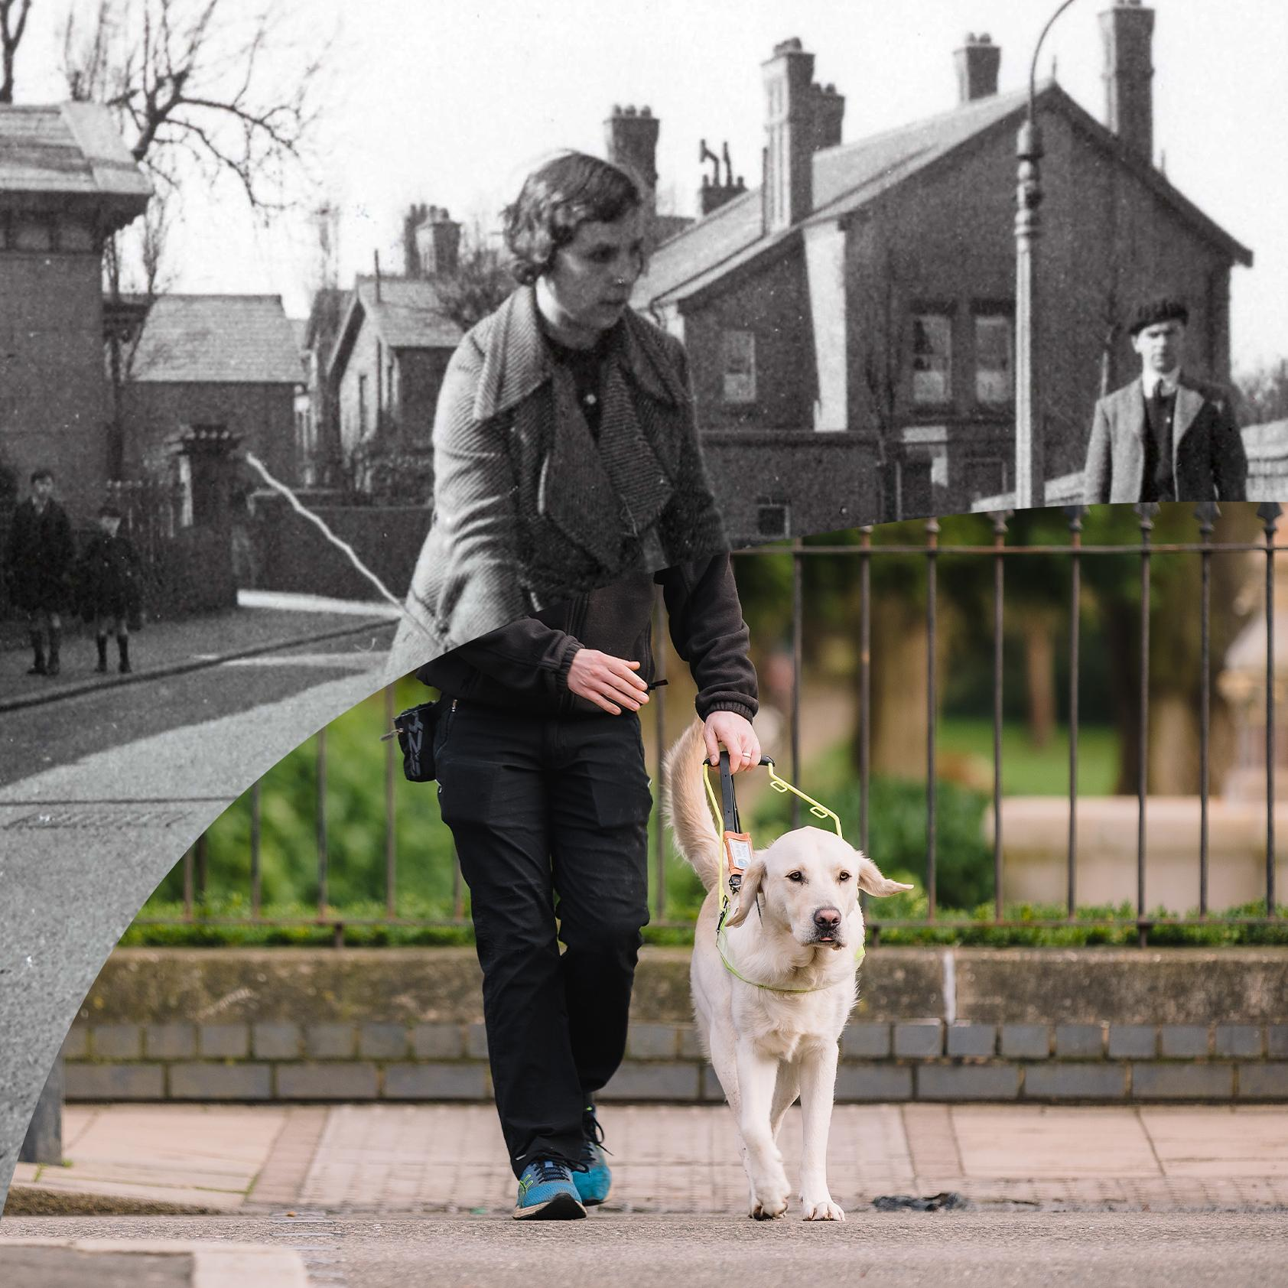
It’s Guide Dogs’ 90th Anniversary - Let’s Celebrate!
Key activities and how to get involved:
Guide Dogs Appeal
New Media Champions role
Anniversary toolkit

Slide 6
Community Fundraising
North West

Slide 7
Fundraising Activities
We have had over 30 activities so far in the North West Region since we have been able to get back out fundraising in the community
We have a further 86 activities booked in for the rest of the year and increasing as people are comfortable having us back out fundraising
If you would like to support your local group please contact:
Community Fundraising Supporter Care 0345 143 0234
Name a Puppy website – up and running with full supporter journey
www.guidedogs.org.uk/nameapuppy

Slide 8
Looking Ahead
Guide Dogs Appeal throughout October – all about 90th Birthday
Donate an Hour December 2021
REGIONAL SUCCESSES / HORIZONS
We have brought in £218,035 so far this year, £40k from Floor and Counter Top Boxes – huge thank you and well done
We have some great big events coming up for rest of the year

Slide 9
Skills, Information & Support Services (SISS)
Children & Young People
Orientation & Mobility Service
My Sighted Guide

Slide 10
Key achievements
Children and Young People
Virtual delivery Hab@home
Return to school
Orientation and Mobility Services
4 x Trainees Qualified
Service delivery – over 200 interventions
Extra training – the Covid effect

Slide 11
My Sighted Guide
Continue to deliver Keeping in Touch Calls to volunteers and clients with support from volunteers
Reinstatement of partnerships (free running partnerships and My Sighted Guide)
Friends and family virtual training
Interviewing volunteers
New Partnerships

Slide 12
Sue’s Story
My Sighted Guide –
Making a difference

Slide 13
Puppy Development Updates
North West

Slide 14
PREP recap
Kallidus live to all active PR on 1st July
Stage 1
Stage 2

Slide 15
Looking ahead
Stage 3 – PREP behaviours
Stage 4 – Puppy classes

Slide 16
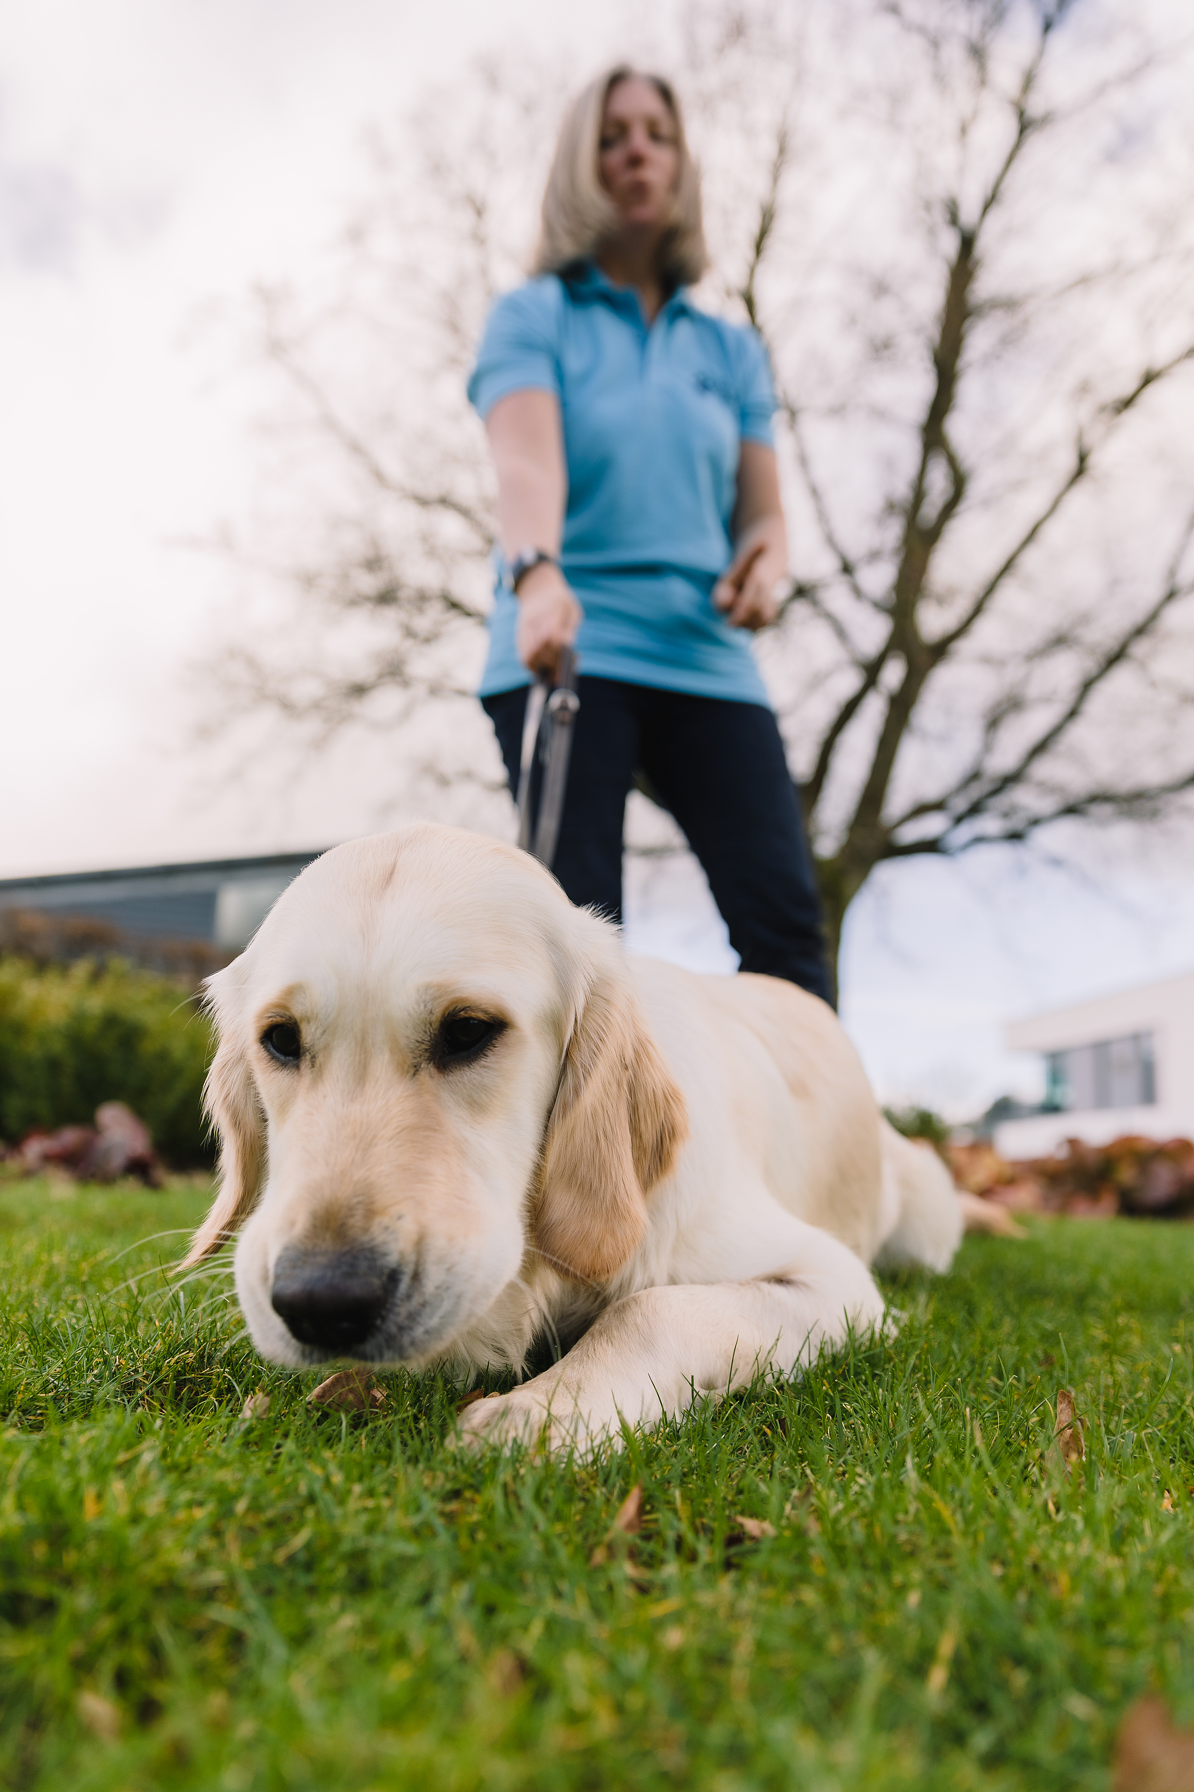
New Guidance for Dog Handlers
Treating our dogs as individuals
Providing choice, knowing their preferences and understanding their needs
Aligning dog handler guidance materials with PREP and STEP
Moving above and beyond a minimum standard of welfare
The Five Domains Model
Positive experiences in: Nutrition, Environment, Physical Health, Behavioural interactions, Emotional experiences

Slide 17
Five domains of animal welfare
Copyright 2016 Wild Welfare

Slide 18
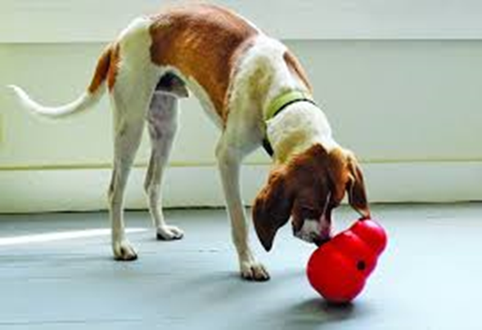
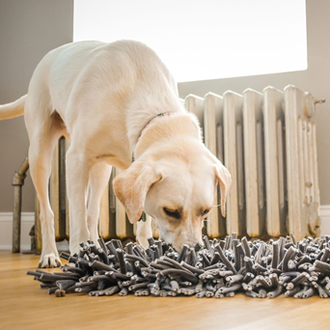
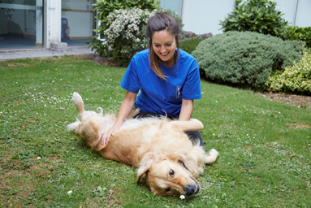
Here are some tips based on our five domains
Consider sometimes feeding your dog’s meals in different ways – for example, using an interactive toy.
We should give dogs the opportunity to choose what they do when they are at home. By encouraging choice, we allow our dogs the freedom to settle by themselves and ‘walk-away’ from sessions of training or play when they have had enough.

Slide 19
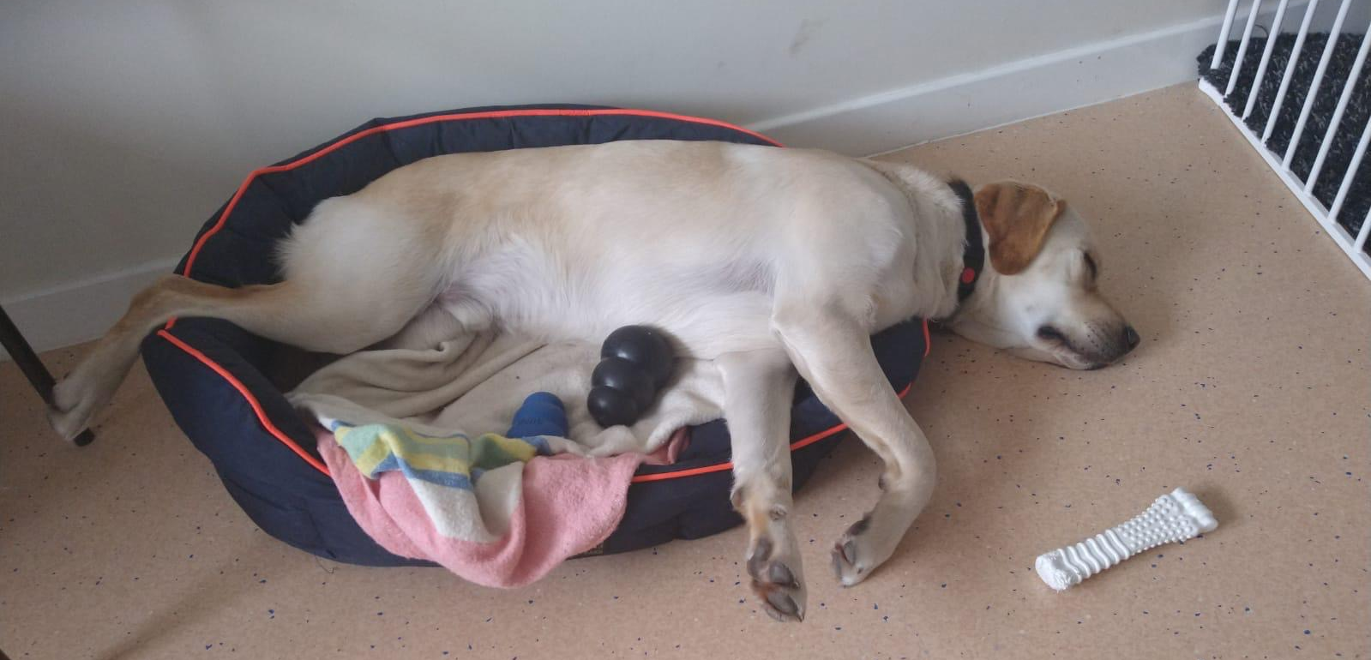
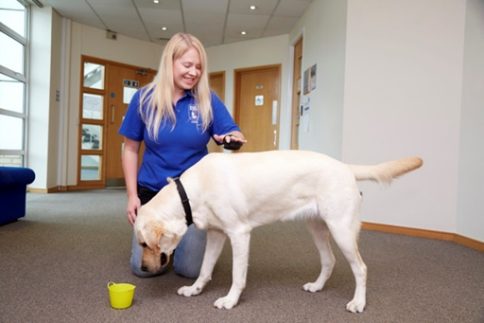
Here are some tips based on our five domains
A bed should be selected based on your individual dog’s preference. For example, does your dog like to curl up or do they prefer to stretch out? Some like to do both!
As a handler it is really important to be aware of how your dog is coping with what you ask of them. If at any time they show signs of finding things stressful you must seek support and guidance.

Slide 20
Thank you for joining us today!
Details of your next regional round-up event will be published on the Volunteer Information Point and in The Guide e-newsletter.
Document Ends.

