Slide 1
South East regional round-up
News and information from your team
10 August 2021
Hosted by: Simon Cope and Esther Browne
Panellists: Desi Nathanielsz, Tina Boreham, Rachael Barton and Damion Afflick

Slide 2
Updates from the South East region on our Operations, Volunteering and Fundraising Activities
Operations
Children and Young People
Services for Adults
My Sighted Guide
Puppy Development
Guidance for Dog Handlers
Volunteering
Community Hub pilot
Volunteer Expenses
Investors in Volunteers
Welcome event
Volunteer Voices
Fundraising
Returning to Communities
Looking Ahead
Guide Dogs’ 90th Anniversary

Slide 3
Volunteering

Slide 4
Volunteering Updates
Community hubs pilot
Investing in Volunteers assessment in August
New volunteer expenses form
Regional Welcome event
Volunteer Voices

Slide 5
VolunteerVoicesLondon@Guidedogs.org.uk
VolunteerVoicesWelwyn@Guidedogs.org.uk
VolunteerVoices@Maidstone@Guidedogs.org.uk

Slide 6
Community
Fundraising across
the South East

Slide 7
Fundraising Activities
Nationally we have 394 activities booked across the UK July–December.
If you would like to support your local group please contact Community Fundraising Supporter Care on 0345 143 0234 or email SouthEastGroups@guidedogs.org.uk
Name a Puppy website – up and running with full supporter journey
www.guidedogs.org.uk/nameapuppy

Slide 8
Looking Ahead
•Guide Dogs Appeal throughout October – all about 90th Birthday
•Donate an Hour December 2021
Regional Update
•We have brought in just under £300,000 in the South East so far this year, £29,500 from Floor and Counter Top Boxes. £128,000 from Name a Puppy and £17,800 from Fundraise for Us.
•Thank you to all our volunteers for your continued support.

Slide 9
Skills, Information
and Support
Services

Slide 10
Key achievements
Children and Young People
My Time to Play
Tech for All (update on applications)
3 trainees progressing
Orientation and Mobility Services
3 x trainees qualified. 3 Progressing
Service delivery – 271 interventions
Extra training – COVID-19 effect

Slide 11
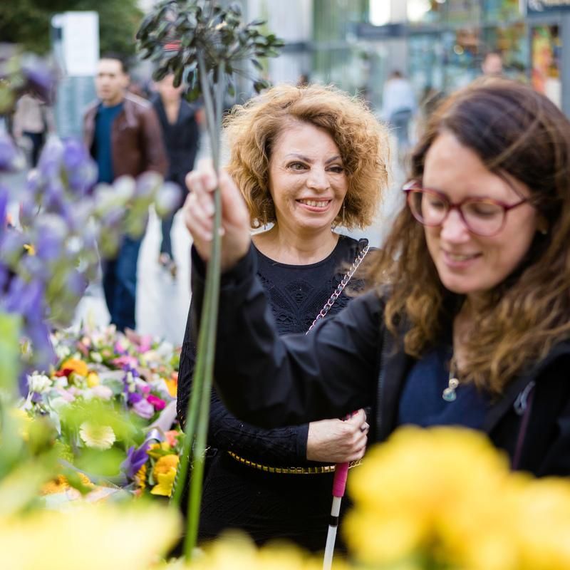
Key achievements
My Sighted Guide
Continue to deliver Keeping in Touch Calls to volunteers and clients with support from volunteers
Reinstatement of partnerships (My Sighted Guide and free running partnerships)
Friends and family virtual training
Interviewing volunteers
New Partnerships

Slide 12
Canine Assisted
Services across the
South East

Slide 13
Puppy development
PREP
Puppy Raising for Excellent Partnerships (PREP) launched 1 July 2021.
Kallidus, e-learning platform to support active PR with PREP went live at the same time. Rolled out with puppy allocation
Active Puppy Raisers can get help via PREPsupport@guidedogs.org.uk
Puppy stats
110 pups currently on scheme.
16 pups to be allocated.
7 Puppy Raisers beginning their PREP journey with pups.

Slide 14
Puppy development: looking ahead
PREP
PREP Foundation sessions available virtually from October.
Puppy Raising Mentors – PREP
Puppy classes incorporating PREP principles: 1. Know 2. Manage 3. Teach 4. Partner

Slide 15
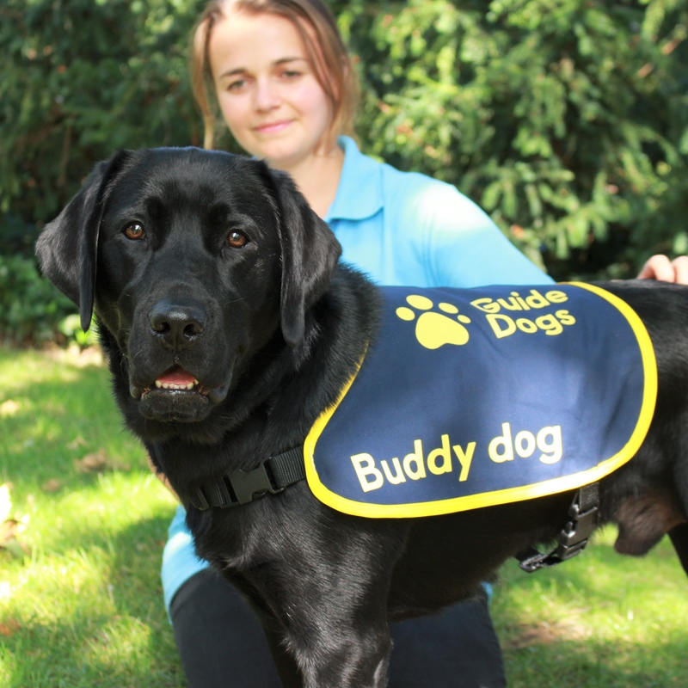
Guide dog and assistance dog partnerships
148 ready to train
32 partnerships to date
Challenges with restrictions for dogs and clients
Buddy dogs 16 and 5 Companion dogs

Slide 16
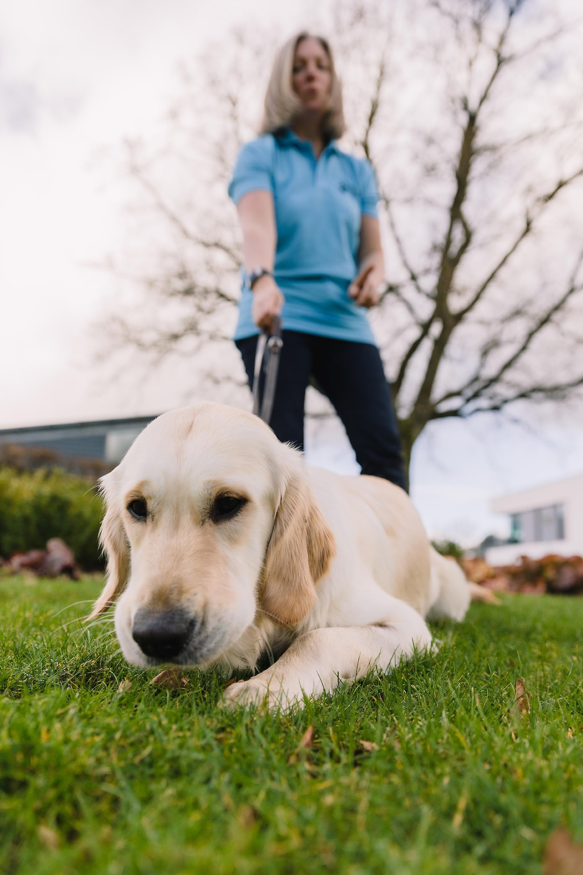
New guidance for dog handlers
Treating our dogs as individuals
Providing choice, knowing their preferences and understanding their needs
Aligning dog handler guidance materials with PREP and STEP
Moving above and beyond a minimum standard of welfare
The Five Domains Model
Positive experiences in: Nutrition, Environment, Physical Health, Behavioural interactions, Emotional experiences

Slide 17
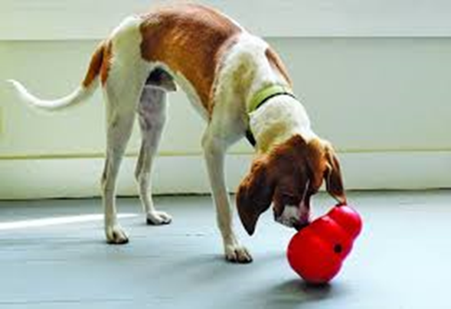
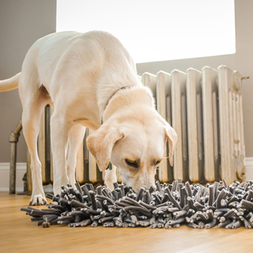
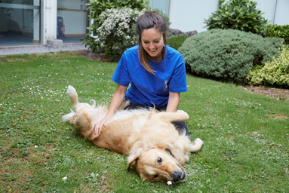
Here are some tips based on our five domains
Consider sometimes feeding your dog’s meals in different ways – for example, using an interactive toy.
We should give dogs the opportunity to choose what they do when they are at home. By encouraging choice, we allow our dogs the freedom to settle by themselves and ‘walk-away’ from sessions of training or play when they have had enough.

Slide 18
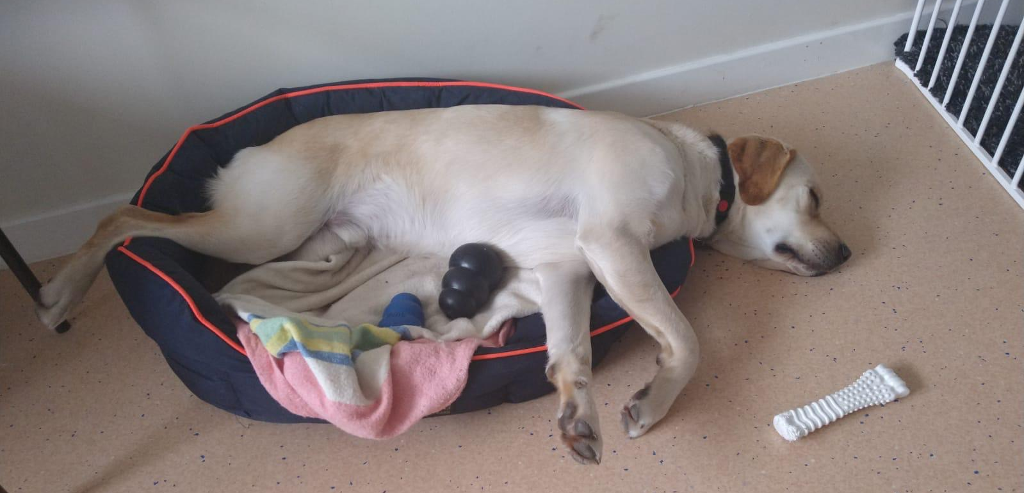
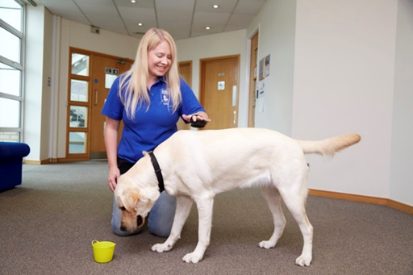
Here are some tips based on our five domains
A bed should be selected based on your individual dog’s preference. For example, does your dog like to curl up or do they prefer to stretch out? Some like to do both!
As a handler it is really important to be aware of how your dog is coping with what you ask of them. If at any time they show signs of finding things stressful you must seek support and guidance.

Slide 19
Guide Dogs 90th
Anniversary

Slide 20
Guide Dogs’ 90th Anniversary
Warming up activities:
‘Flash’ animated film
Press coverage: history of Guide Dogs
How you can get involved:
Guide Dogs Appeal
Coming soon: 90th anniversary toolkit
Media Champion

Slide 21
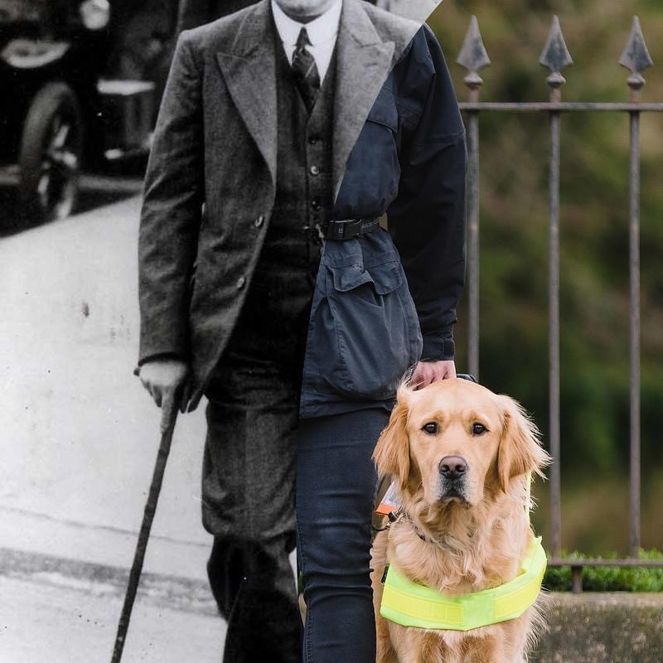
Media Champion
New Media Champions role
New role to support Regional Marketing and Communications Managers
Recruiting 1 — 2 per region initially
Support with 90th Birthday Guide Dogs Appeal in October

Slide 22
Thank you for joining us today!
Details of your next regional round-up event will be published on the Volunteer Information Point and in The Guide e-newsletter.
Document Ends.

