Slide 1
South East Regional Round-Up

Slide 2
Welcome to South East Regional Round-up
We’ll cover:
Welcome and introductions
COVID-19 roadmap & activities update
Guide Dogs 90th anniversary
Latest news and developments in Volunteering
Community Fundraising
Puppy raising
Q&A
Close and thank you

Slide 3
COVID-19 roadmap activities update

Slide 4
We have adapted our ways of working to minimalise the impact of COVID-19 upon our operations, services and volunteering
Furloughed staff and remote working
Volunteer roles and activities were paused or adapted
Breeding programme
Guide dog training
Keeping in touch calls with My Sighted Guide partners & waitlist GD
Set up COVID-19 information line, now called Guide Line
Virtual volunteer support
Investing in technical staff

Slide 5
As restrictions continue to ease, we are gradually reopening sites and restarting our services and volunteering
We are recommencing all services and volunteering starting from mid-June, in a staged way, based on government guidelines
Restarting existing MSG partnerships
OMSPs are back out supporting people
All dogs back in training
Restarting partnership training and have qualified 7/72 new partnerships already. 17 currently on class
11 Buddy Dog partnerships created. 9 Companion Dog Applications

Slide 6
Our Skills, information and Support Services for Adults and Children
Rolling out new, innovative services such as My
Time to Play and Access Tech for All.
To date our Regional OMS and My Sighted Guide staff have logged 3395 Keeping In Touch calls supporting or clients, families and volunteers.
New, unique web based accessible content to support independent living.
Virtual volunteer training has been attended by 103 My Sighted Guide volunteers, both new and as a refresher.
Developed a suite of virtual tools to train and support clients allowing us to reach more people.

Slide 7
Our 90th anniversary – Simon Cope

Slide 8
Last month, we kicked off our 90th anniversary with a film about a Puppy Raiser and their puppy ‘Flash’

Slide 9
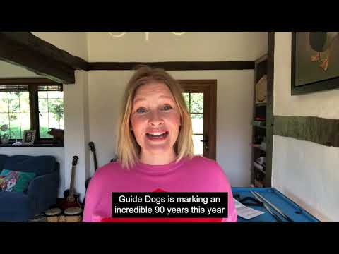
Actress and Guide Dogs supporter Joanna Page recorded voice to a special Flash recording and message for volunteers

Slide 10
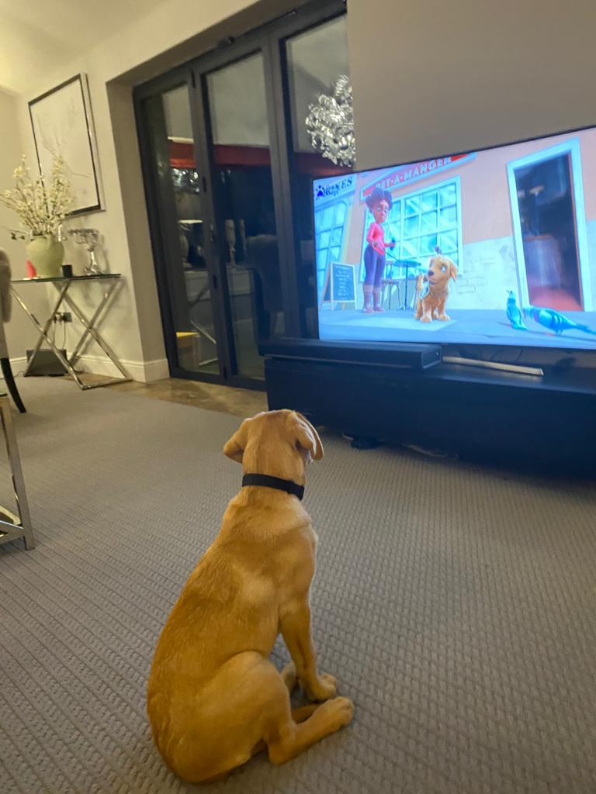
Since Flash hit our screens, dogs all over have been watching with excitement
#MeetFlash

Slide 11
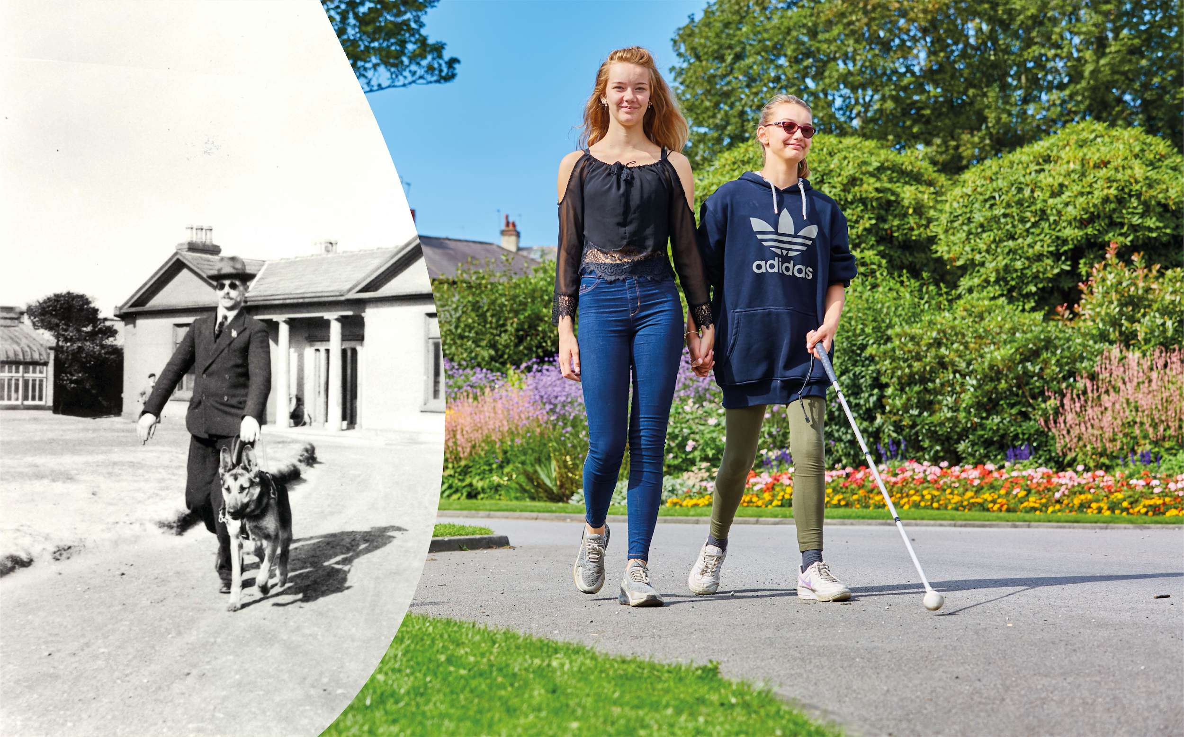
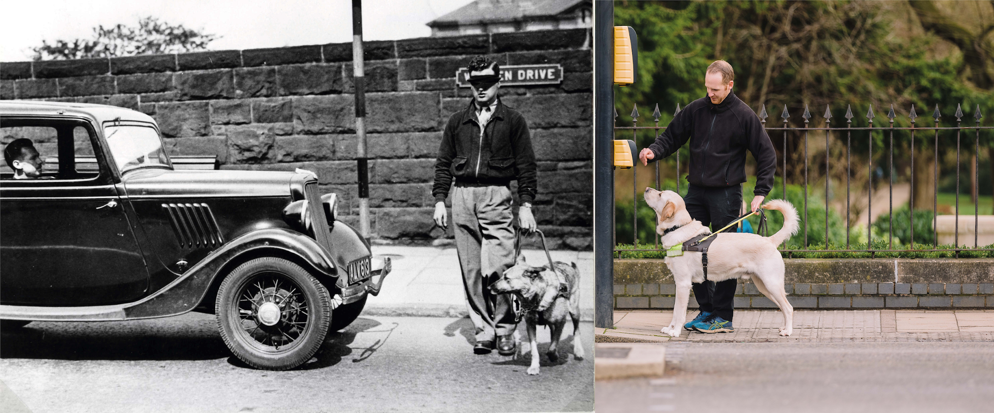
There’s more activities planned for the year, but we also want to hear your ideas too
The UK’s first guide dog partnerships qualified 90 years ago this October. Since then, we have helped transform the lives of thousands of people, through a range of services. For 90 years Guide Dogs has been at the side of people with sight loss. We will be there for the next 90.
Email your ideas and stories to GD90@guidedogs.org.uk

Slide 12
Latest developments in volunteering – Ben Cassells

Slide 13
We’re exploring what a more community-based style of volunteering would look like at Guide Dogs
Our pilots are:
Looking at how a standardised, volunteer-centric and multifunctional volunteering model could work.
We think it could help to:
Reduce ‘silos’ amongst our volunteers.
Develop and improve the volunteer experience.
Support our volunteer fundraisers to grow and diversify our income streams.

Slide 14
Volunteer insight shapes our future, it’s now easier to share feedback and get involved in areas that interest you:
Volunteer Impact Assessment - closed.
‘Pulse’ survey – highlights
Volunteer Voices - including workstreams and vacancies

Slide 15
Community Fundraising – Carrie Seaton

Slide 16
As we restart community fundraising activities, here’s what you need to know
86% of our fundraising volunteers are ready and keen to start fundraising again
Permitted activities include: Emptying of collection boxes, banking, collections, distance selling, Name a Puppy visits, cheque presentations and merchandise stalls, speaking engagements and pop up shops.
Guidance Document for all activities
Community Fundraising Supporter Care 0345 143 0234 or email: SouthEastGroups@Guidedogs.org.uk

Slide 17
The recent Great Guide Dogs Tea Party was a great success with more fundraising activities coming up
Looking back
Great Guide Dogs Tea Party
Nell advert inspired £5k Name a Pup in Bexley
Looking ahead
Guide Dogs Appeal throughout October
Donate an Hour December 2021
New volunteers

Slide 18
New ways of contacting us –
Nina Villa

Slide 19
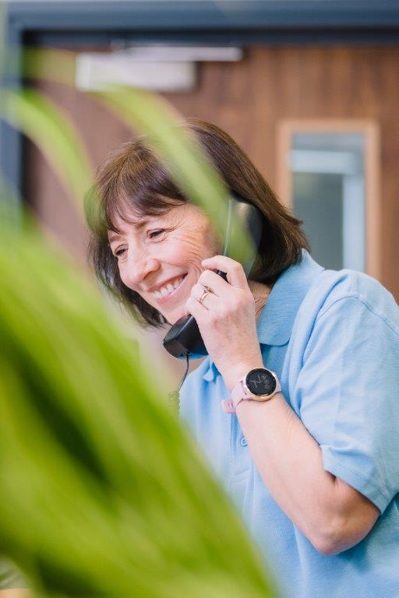
Guide Line - get help on dog health and many other issues from a dedicated member of staff
Call Guide Line on 0800 7811 444
Guide Line covers 4 areas
1. Adult services
2. Children and Young People
3. Dog health and welfare
4. General Enquiries

Slide 20
And when you’re out and about, remember these useful safety tips to keep you and your dog safe
Avoid putting your dog on social media, especially with clues about where you live.
Make sure your garden is secure, your gate is locked and adorned with bells to alert you to someone coming in.
Never leave your dog in the garden unattended.
Never leave your dog unattended in public, or left visible in a car.
Work hard on getting a reliable recall, practice it often, and have this in place before letting your dog off the lead, so you can keep him/her close and away from strangers.
Be wary of people asking information about your dog, particularly if you are alone

Slide 21
Raising puppies – Esther Stuart and Karen Brady

Slide 22
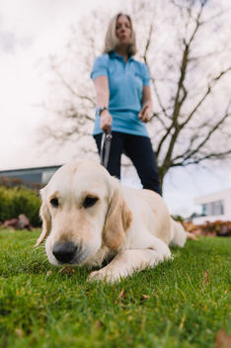
Puppy development - Getting the foundations right
Ethos – Puppy Behaviour Questionnaires & Dog Behaviour Questionnaires

Slide 23
Puppy Raising for Excellent Partnerships (PREP): the four principles

Slide 24
To recap, PREP is our new standard way of raising puppies and will be gradually introduced to Puppy Raisers
An investment in professional development for our staff and volunteers
Provides a standardised framework
Puppy and person-centred approach
Easier access to resources and advice
Using technology gives the ability to access the latest information
Will still have face to face support/visits

Slide 25
PREP is based on four key principles which bring together new and existing learning and techniques into an easy to follow programme
Knowing your puppy
Managing for success
Teaching foundations
Being a partnership

Slide 26
‘1. Knowing you puppy’ focuses on how to recognise, enhance and nurture your puppy’s development, behaviour and welfare

Slide 27
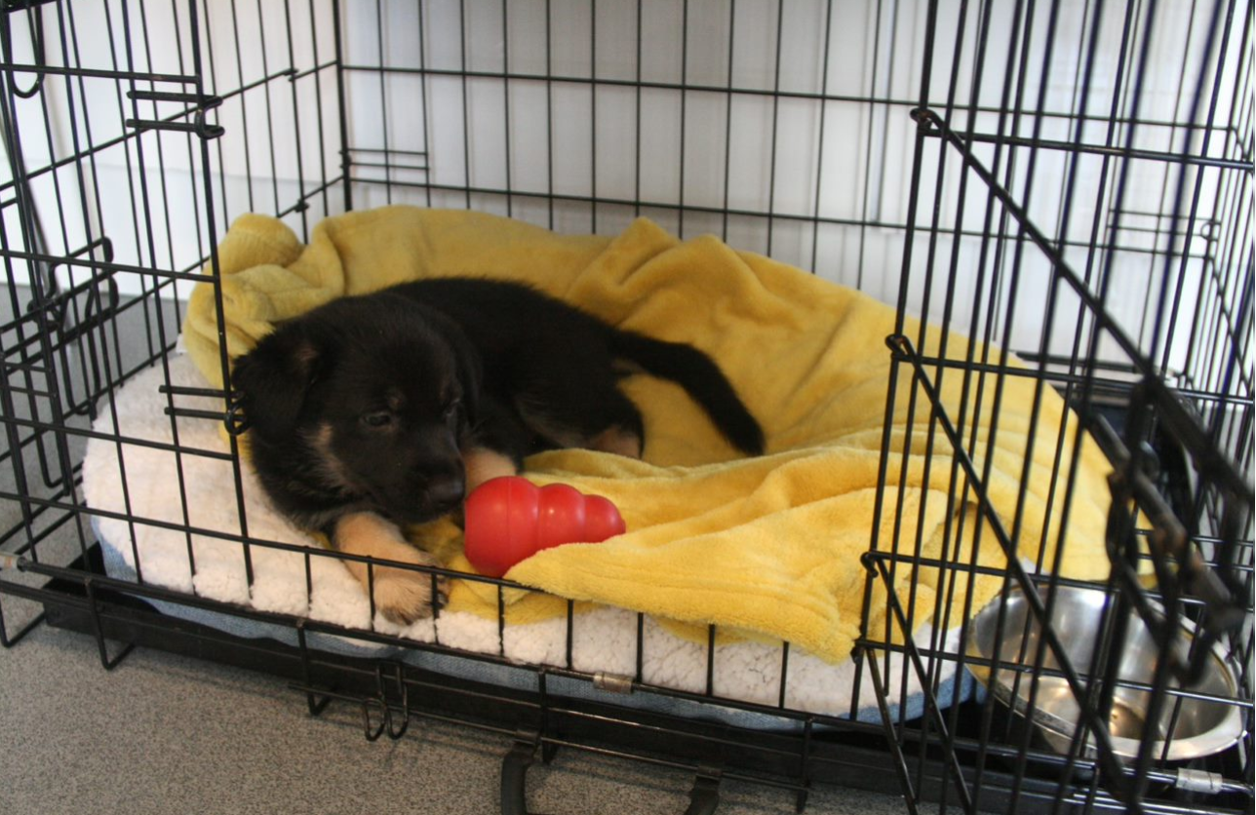
‘2. Managing for success’ focuses on learning how to accurately predict your puppy’s behaviour, problem-solve and adapt to different scenarios

Slide 28
‘3. Teaching foundations’ uses positive reinforcement for desirable behaviour and teaches good habits for future learning

Slide 29
‘4. Being a partnership’ develops a mutual understanding and how to respond to different situations and people

Slide 30
Ultimately, PREP builds upon how we currently raise our puppies to better prepare them for guide dog training and partnerships
More resources and guidance available to puppy raiser
A puppy and person-centred approach
Meets the needs of our guide dog partners
Improves the supply chain process
Aligns with Standardised Training for Excellent Partnerships (STEP) and incorporates the needs of Buddy and Companion Dog services within the programme.

Slide 31
Comments and questions

Slide 32
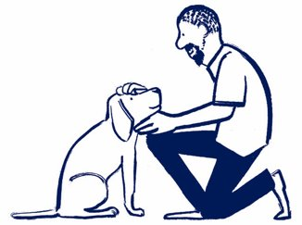
Thank you for joining us today!
Details of your next regional round-up event will be published on the Volunteer Information Point and in The Guide e-newsletter.
Document Ends.

