Slide 1
Eye Condition Simulator
Double click on the options to see through the eyes of people with different vision impairments..

Slide 2
20/20
Glaucoma
20/20 vision is a term used to indicate normal vision when the sharpness or clarity of a person’s vision is measured at a distance of 20 feet. It doesn’t mean perfect vision, as there are other important vision skills to take into account.
Cataracts
Diabetic Retinopathy
Macular Degeneration
Total Blindness
20/20 vision

Slide 3
Glaucoma
Glaucoma
Glaucoma, is caused when pressure increases in the eye and damages the optic nerve. This damage can cause tunnel vision and may make it difficult to get around safely.
Cataracts
Diabetic Retinopathy
Macular Degeneration
Total Blindness
20/20 vision

Slide 4
Cataracts
Glaucoma
Cataracts, the lens in your eye would become cloudy which dims your vision. Some people are born with cataracts.
Cataracts
Diabetic Retinopathy
Macular Degeneration
Total Blindness
20/20 vision

Slide 5
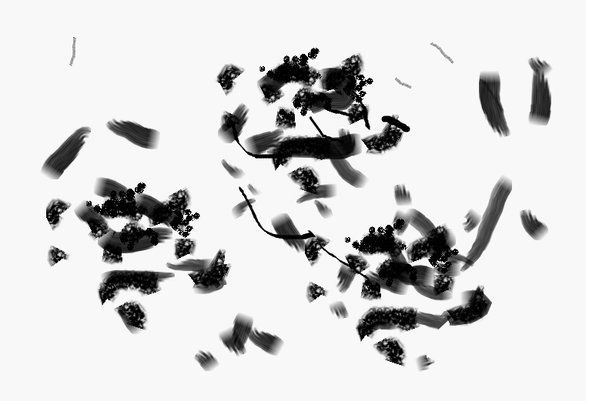
Diabetic Retinopathy
Glaucoma
Diabetic Retinopathy, linked to diabetes - which can occur if the amount of sugar in your blood is too high. It causes blood vessels to become blocked, which creates patches across your eye.
Cataracts
Diabetic Retinopathy
Macular Degeneration
Total Blindness
20/20 vision

Slide 6
Macular Degeneration
Glaucoma
Macular Degeneration, the damage causes sight distortion or loss to your central vision, making it hard to see faces or read.
Cataracts
Diabetic Retinopathy
Macular Degeneration
Total Blindness
20/20 vision

Slide 7
Total Blindness
Glaucoma
Total Blindness – is the inability to see anything from either eye, to not be able to tell the difference between whether it is light or dark.
Cataracts
Diabetic Retinopathy
Macular Degeneration
Total Blindness
20/20 vision

